Slide 1
The 12 Adventures of Odysseus
How to get home in just 20 years!

Slide 2
All of the places

Slide 3
AFTER TROY
The epic begins when Athena is angry at Odysseus for the violation of her shrine during the Trojan War when Troy is being destroyed by the Greeks
. There were three violations: sexual, intellectual and sacred violations of the dignity of Athena (at Athena’s temple)
Athena turns against Odysseus and persuades Poseidon to join her in punishing him.

Slide 4
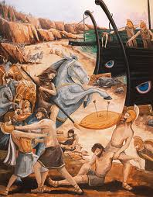
The Island of the Cicones
1
After leaving Troy, they stop to raid this island for supplies. They take the women as their prize.The Cicones attack on horseback, and Odysseus loses 72 of his men.

Slide 5
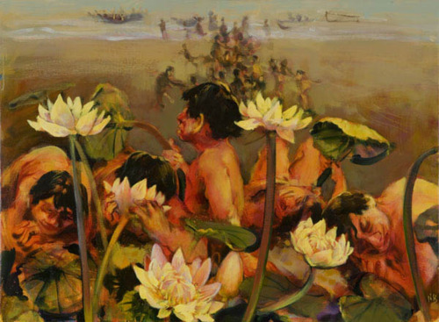
The Island of the Lotus Eaters
Odysseus sends his men out to search for food, and has to recover them when they eat the Lotus Flower

Slide 6
The Lotus is a plant creates an apathy of the eater. Once it is eaten, the person knows nothing nor cares for anything other than eating the lotus plant.

Slide 7
The Island of the Cyclopes:
Here, Odysseus and his men find a Cyclops' cave, lured by his cheese and wine.
The cyclops, Polyphemus, traps them inside the cave. Odysseus and his men blind the Cyclops with a heated spear and then sneak out under his heard of sheep.

Slide 8
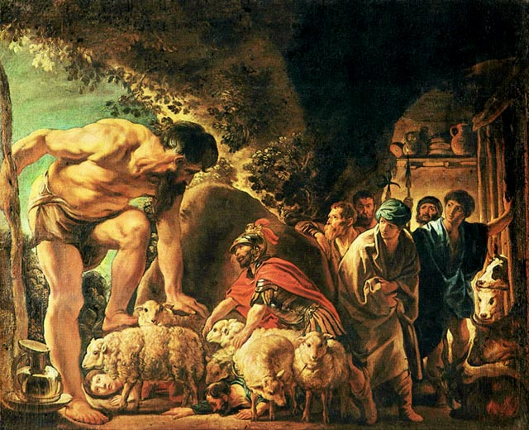
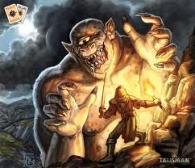
Then Odysseus and his men escape from the cave by hiding under Polyphemus's sheep.

Slide 9
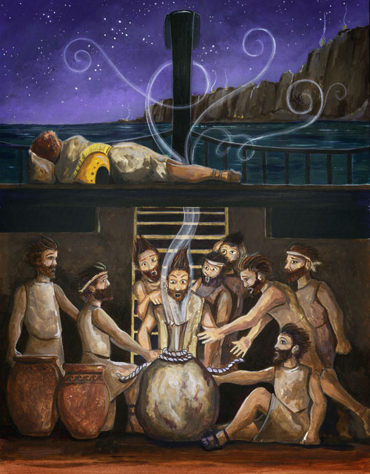
Aeolus, the god of the winds, gives Odysseus all of the bad winds, so he can safely sail home. Odysseus' men go against his orders and open the bag, and all of the winds escape.

Slide 10
Island of the Laestrygonians
The Laestrygonians, a race of cannibals, eat the Greeks.
. The giants ate many of Odysseus' men and destroyed eleven of his twelve ships by launching rocks from high cliffs. Odysseus' ship was not destroyed as it was hidden in a cove near shore. Everyone on Odysseus' ship survived

Slide 11
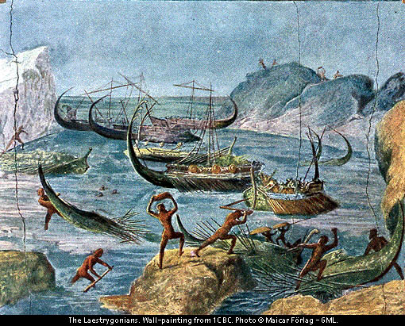
His soldiers, with a dozen ships, arrive at "the rocky stronghold of Lamos: Telepylus, the city of the Laestrygonians.
.

Slide 12
Circe’s Island
Odysseus lands on Aeaea, home to Circe. Odysseus sends some of his men to scout out the area, but when they do not return, he becomes worried.
.

Slide 13
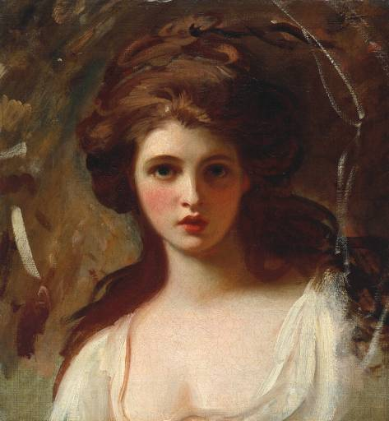
Hermes tells him that Circe is up ahead and that his only chance of survival is to eat the plant Moly.
.

Slide 14
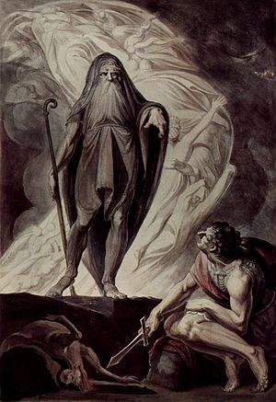
Circe pleads for them to stay on her island, and Odysseus does this because he was promised information on how to return home. Finally, Circe tells him to go see Tiresias, a prophet located in the underworld.
.
Oxymoron of a Blind Prophet

Slide 15
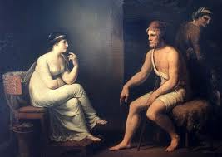
The Underworld
Odysseus consults the prophet Tiresias to ask how he can get home, and finds his mother there, who has committed suicide in her depression.
.

Slide 16
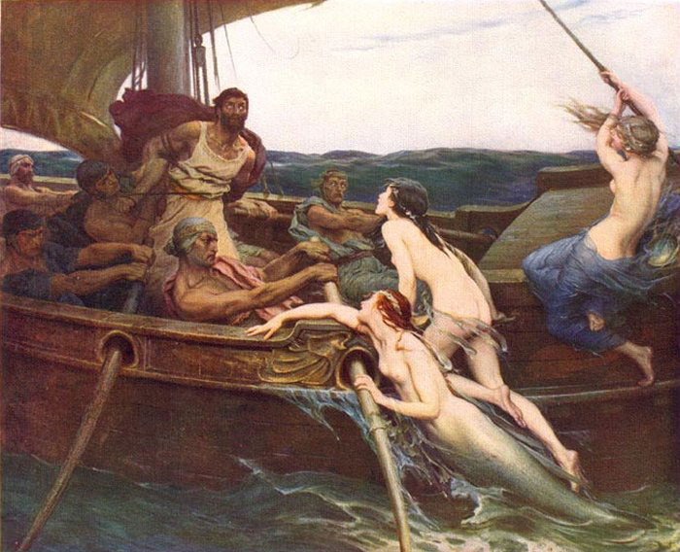
The Sirens
After Tiresias, and a brief stop at Aeaea, Odysseus's men go to the Sirenshe Sirens sing a song that no man can resist to passing ships. He has the men plug their ears, as he is tied to the mast and hears the song.
.

Slide 17
Scylla and Charybdis
Odysseus chooses to sail for Scylla, a six-headed sea serpent, rather than Charybdis, a giant whirlpool.
.

Slide 18
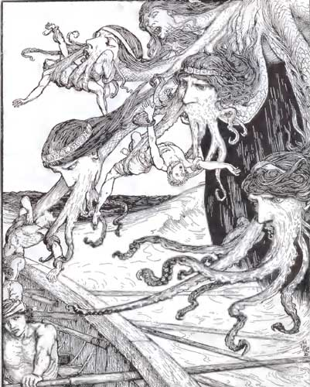
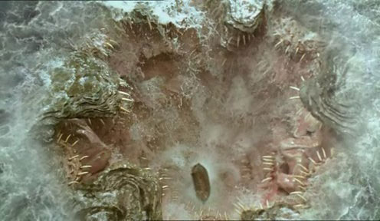
.
Scylla and Charybdis

Slide 19
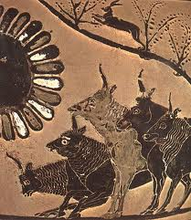
Island of the Sun God
After leaving from the island of Sirens and escaping Scylla and Charybdis, the traveled to the island of they Sun God. If you remember before, Circe and Tiresias said not to mess with the Sun God's cattle. After they beached our ship, Odysseus made them swear not to touch his cattle.
.

Slide 20
Ogygia (Calypso's Island)
Odysseus finds this island after drifting in the sea. It is a island of women, with a nymph named Calypso, with whom Odysseus has a seven-year affair with. After the seven years, Hermes convinces Calypso to let Odysseus build a new ship so he could sail home.
.

Slide 21
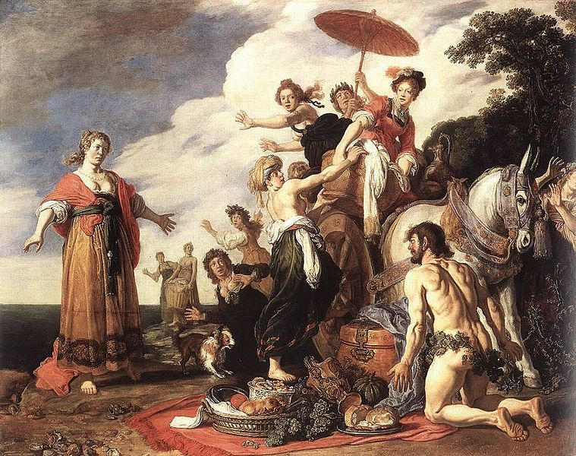
The Island of the Phaecians
The Phaecians accept Odysseus, and he explains his ten-year journey to them during a feast. They happily give him a ride home on one of their magical ships.
.

Slide 22
Ithaca (home at last)
Odysseus finally arrives home, and sees his son, Telemachus, for the first time in 15 years. He and Telemachus kill all of the suitors, and Odysseus takes his place as king, once again, alongside his wife Penelope.
.

