Slide 1

Virgil’s Aeneid
Books 1-2.
In which Aeneas and his men arrive at Carthage and tell Dido of his adventures in the Trojan War and on the high seas.

Slide 2
Comparisons between the Odyssey and the Aeneid
Both of the protagonists lament the fact that they survived the Trojan War.
Both had great harships at sea on the way to their destination.
Both Odysseus and Aeneas were detained by beautiful women (Odysseus = Calypso, Aeneas = Dido)
Neither one of these beautful women was the who they ended up with.

Slide 3
Laments
Odysseus:
”Thus four times blessed my friends in arms who died on the plains of Troy . . . Would to God I’d died there too . . .”
(Odyssey 5:338-343)
Aeneas:
“Diomedes, why could I not go down, when you had wounded me, and lose my life on Ilium’s battlefield?”
(Aeneid, Fagles translation, 1:136-139)

Slide 4
Both heroes blown ashore at alien countries
Odysseus: Lands at the shores of the Phaiakans and tells his story to King Alcinoos and company
Aeneas: Lands at the shores of Carthage and tells his story to Queen Dido and company

Slide 5
Neither hero can remain where he landed
Odysseus must return to Ithaca, restore order in his home, and reclaim Penelope from the claims of the suitors.
Aeneas has no home to return to, but by command of the gods, he must sail to Latium, conquer the neighboring territories, and found the city of Rome

Slide 6
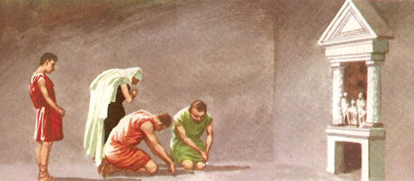
Getting Into the Text
1:7: Aeneas brings his household gods with him.
What does this day about the origins of Rome?
What does this say about the role of religion in culture?

Slide 7
Biblical Parallels
Rachel: Genesis 32 (a parody of this behavior)
Moses taking the children of Israel into the Promised Land
Micah’s idol: Judges 17
Jezebel
Daniel
Paul

Slide 8
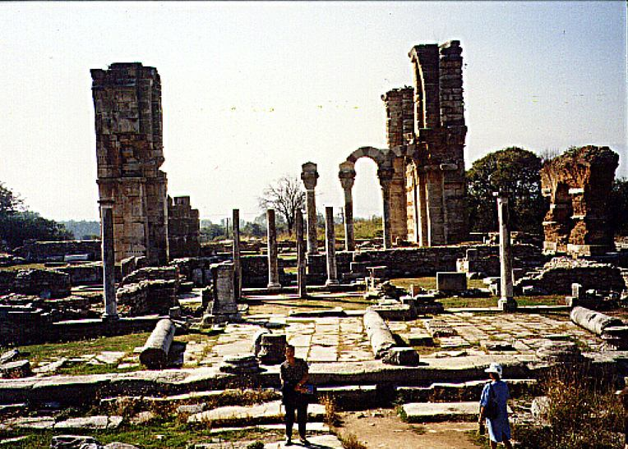
Colonization
Philippi: A Roman colony. The point of Rome going to Philippi to colonize was not so that the Romans could live like the native Philippians, but so that the Romans could bring Roman culture and civilization to Philippi.

Slide 9
Paul’s application
In Philippians 3:20, Paul uses the phrase, “our citizenship is in heaven.”
He’s using the metaphor of colonization to describe the task of the Christian in the world.
Christians are not here to live like the world, but to bring the beauties of heaven to earth through the Great Commandment and the Great Commission.

Slide 10
Prophecy
1:347-398: An extended “prophecy” about the line of Aeneas culmination in Caesar and the future dominIon of Rome.
The Aeneid contains numerous examples of these “prophesies.”
How do they differ from Biblical prophesy?
What do you think that Virgil is trying to do with these “prophesies”?

Slide 11
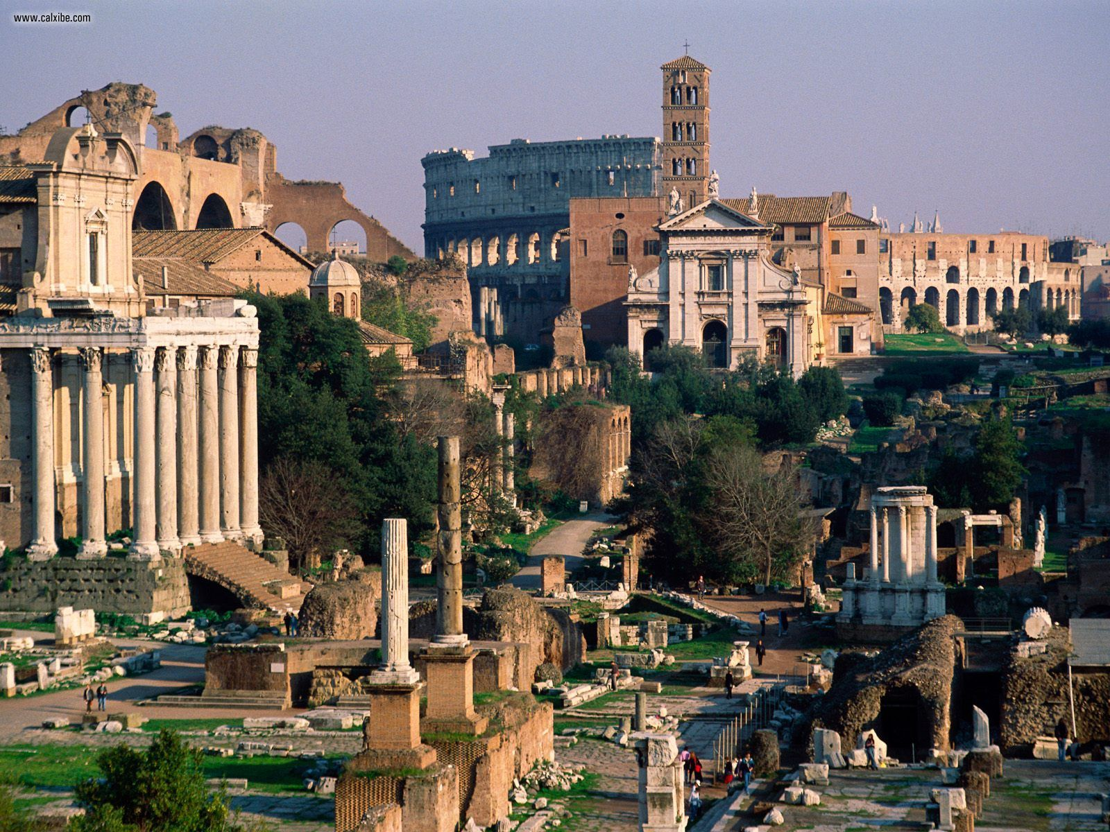
Imperium Sine Fine
1:375: The gift of “empire without end.”
Justification for Roman imperialism and extension of empire.
Imperialism in the recent past.

Slide 12
Aeneas and Dido
In lines 1: 776-779, what does Dido offer Aeneas?
What would be wrong with accepting Dido’s offer?
What does this tell us about Aeneas’ view of duty?
Does it seem like he entertains thoughts of accepting her offer?

Slide 13
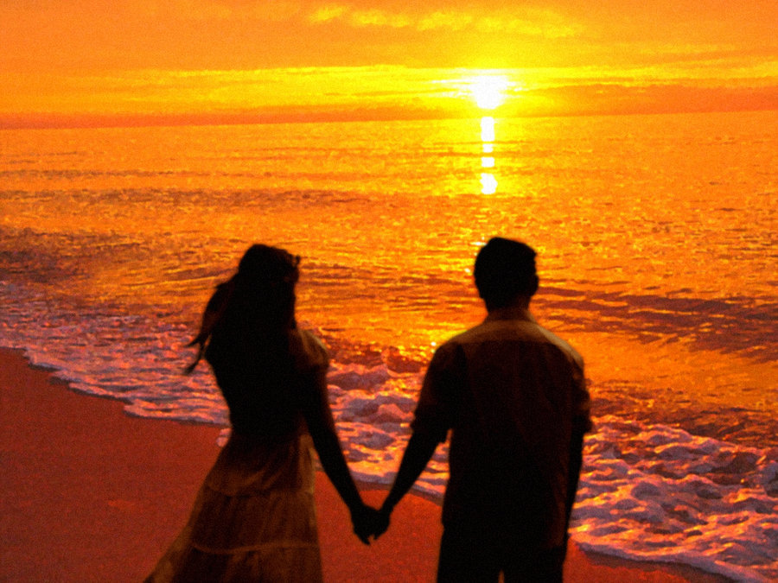
True Love?
What happens to Dido emotionally as she spends time with Aeneas?
How is this view of “falling in love” similar to our cultural ideal of romance?

Slide 14
Stoicism
Underlying philosophy of Virgil that he is attempting to transform the Romans with stoicism –doing one’s duty.
Aeneas is transformed from someone who appears to be a fairly normal human being to the embodiment of the Stoic hero.

Slide 15
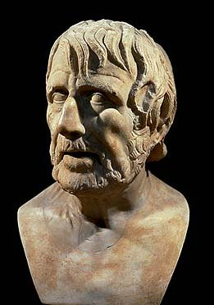
Tenets of Stoicism
God is impersonal
Reality is material
Rejects creator/creature distinction; everything contains divinity.
Every element of nature is reasonable and right:
  Denies sin and its effects
  Denies evil

Slide 16
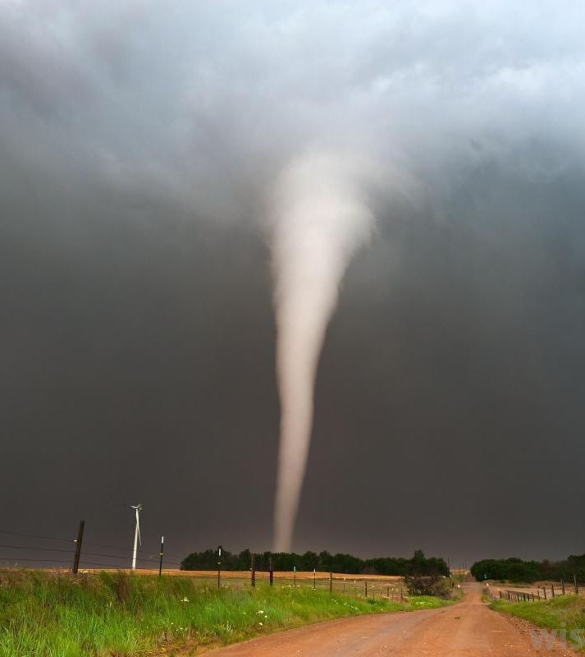
Fate
Everything is predetermined:
Que sirrah sirrah; what will be, will be.
Natural disasters:
  Hurricans
  Tornadoes
  earthquakes

Slide 17
The Force
Everything is predetermined by “the force” (“may the force be with you”)
There are no accidents
Even the force and its actions are predtermined

Slide 18
Differences with Providence
God is personal
God is sovereign
God is free
God works all things for His glory and for our good.
God governs all things personally.

Slide 19
Reason
In Stoicism, reason is man’s highest and best function
Man is totally autonomous
  Not under any kind of law or sovereign
  Everything is predetermined except man’s response to circumstances
  The state of the inner life is the key to Stoic “pietas”

Slide 20
Ethics
Circumstances – health, sickness, wealth, poverty, disease, calamity, are indifferent
The virtuous man is indifferent about these things
The important thing is that his response to them is rational
Virtuous acts must be done without hope of reward

Slide 21
“Follow Nature”
It’s unreasonable to oppose nature
This is why Aeneas’ affair with Dido is not frowned on as it might be by Virgil
Passions are to be rejected in favor of reason
  They lead astray from rational responses
  Indifferent to suffering or joy
  Claimed right to commit suicide

Slide 22

Lack of hope
Carried out responsibilities with melancholic sense of duty

Slide 23
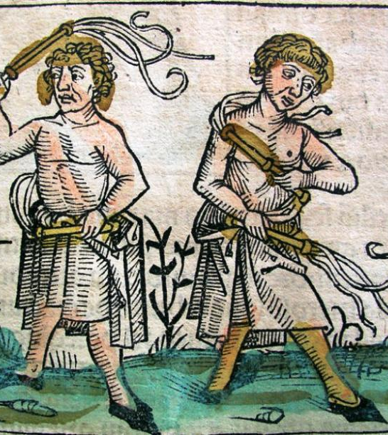
Ascecitism
Slept on the ground
Drank water instead of wine
Flagellated themselves
Refused to shave because it was unnatural

Slide 24
Summary of Book I
We learned some things in Book 1 but Book 2 is really where the action starts.
Here’s what Virgil told us in Book 1:
  Juno is still holding a grudge against the Trojans for the judgment of Paris which left her with “an eternal inward wound” (1:40, 54)
  She knows that the Trojans are destined to overthrow her favorite city, Carthage.
  She fears Aeneas will be the one to do this.

Slide 25
More observations from Book 1
Virgil’s description of Aeneas. Landing at Carthage is modeled after Homer’s description of Odysseus’ landing at Ithaca.
Might Carthage be Aeneas’ Ithaca? Might Dido be his Penelope? These are the questions that Virgil is trying to get his readers to ask.

Slide 26
Aeneas’ homecoming?
Virgil has already told us (1:3, 12) that our hero is destined for Italy to bring the gods of Troy “within the high walls of Rome.”
But if Carthage is not Aeneas’ homecoming, why does Virgil depict it in this way?
The same ambiguity exists in Aeneas’ observation of Carthage. He admires the civilization that has developed under Dido’s leadership (1:576-587).

Slide 27
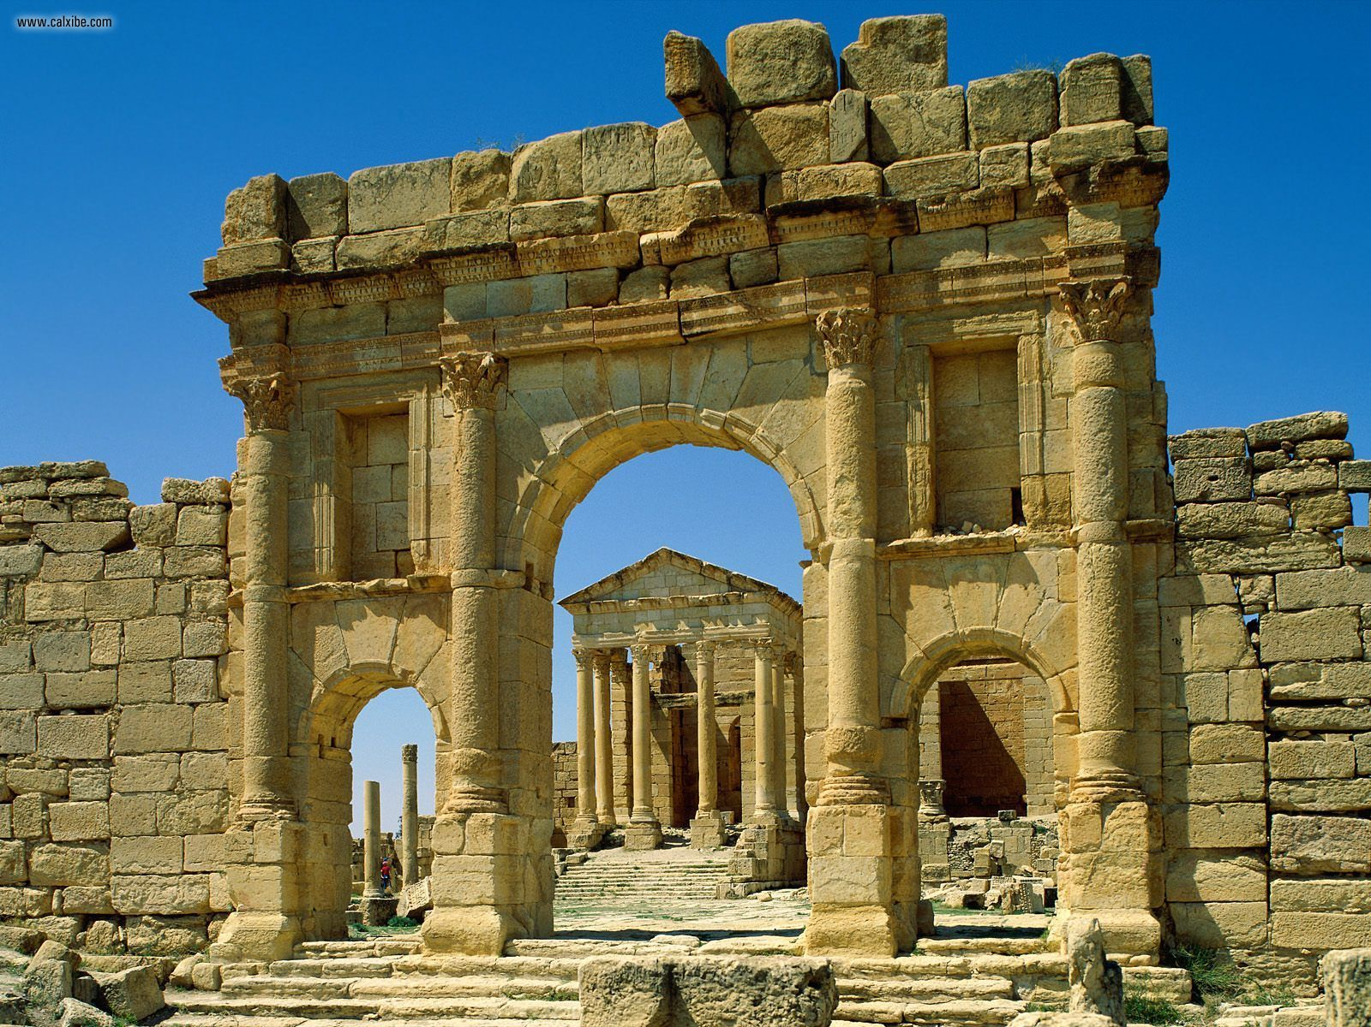
Aeneas’ homecoming?
When Aeneas sees Carthage and the civilization that Dido has built, he sees a picture of what he is destined to achieve, but has not (1:595-596).

Slide 28
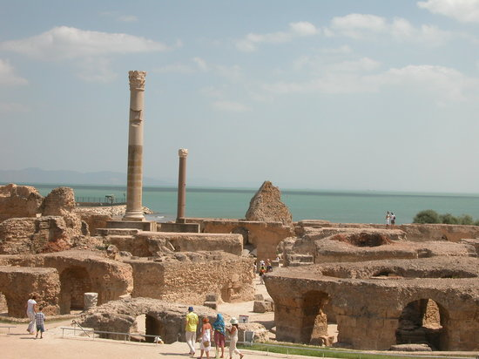
Temple of Juno
Aeneas is even more impressed with the Temple that the Carthaginians are constructing

Slide 29
Temple of Juno
Temple walls are decorated with battle scenes of Trojan War
He even sees himself in the midst of battle.
He concludes that since Carthage knows the suffering of Troy, that Dido will be sympathetic to the Trojans’ need for refuge

Slide 30
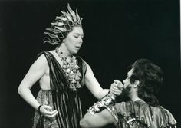
Dido Enters
Dido is every inch a queen
She has a quiver on her shoulder
She is a head taller than anyone else
She is queen of a vigorous civilization (1:685-692)

Slide 31
Too Good To Be True?
When the Trojans approach her for asylum, she is reassuring and hospitable. She even says that she will send out a search party for Aeneas.
But . . . It all seems too good to be true . . . Which it is! Virgil shows us that anything that Aeneas does here will be a false start.

Slide 32
Aeneas’ False Start
The temple that Aeneas is so impressed with is dedicated to Juno!
This is where Dido sits to rule her kingdom. In other words, she is the living icon of Juno on the throne.
Not only is Juno the arch-enemy of the Trojans, but she is the personification of the furor that Aeneas must overcome.

Slide 33
Dido and Juno
By associating Dido with Juno, Virgil foreshadows the chaos that Dido will cause later in the book.
Also, Aeneas misinterprets the pictures on the temple walls. If this is a temple to Juno, there can hardly be any sympathy here for a Trojan.

Slide 34
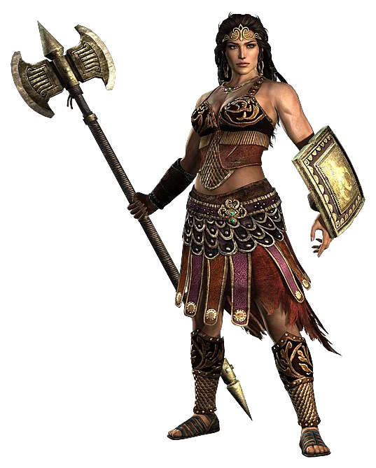
Introduction to Dido
Aeneas first sees Dido while he is looking at a picture of Penthesilea who is leading a battalion of Amazons – women warriors – into battle against the Greeks.

Slide 35
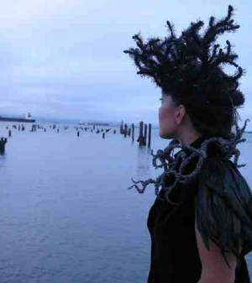
Supposedly the true story of Dido
Also known as “Elyssa” in other stories.
Was a historical person.
Did found Carthage.
The name “Carthage” means “New City” (Qurt-hadasht)
There is another Carthage in Cyprus (and one in Mississippi and one in Missouri).

Slide 36
Conflict with Pygmalion
Dido’s father named Dido and Pygmalion joint heirs of Tyre upon his death.
After Dido’s father died, the people rejected Dido as co-ruler in favor of Pygmalion alone.
Dido then marries her uncle, who is priest of Hercules, and second in power to Pygmalion
Her husband, Acerbus, (Sichaeus in the Aeneid), was extremely wealthy. Pygmalion had him murdered in an attempt to gain his wealth.

Slide 37
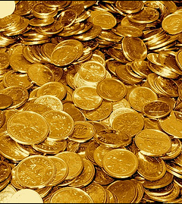
Dido’s strategy
Dido asks to move into the palace.
As an “offering” to the spirit of Sychaeus, she orders the movers to throw all the bags of gold into the sea.
However, what they actually threw into the sea were bags of sand.

Slide 38
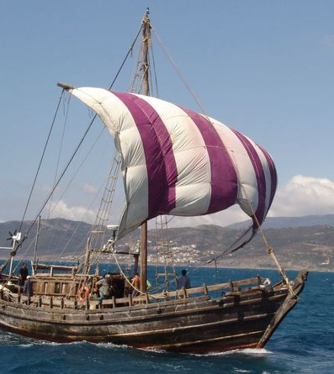
Dido’s flight
Dido then persuades the movers to help her to flee rather than to face the wrath of Pygmalion, when he discovered what she had done with Sychaeus’ ‘wealth’. Some senators and nobles join her as well.

Slide 39
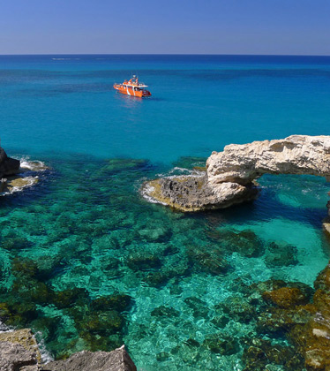
Arrival at Cyprus
The party arrives as Cyprus, south of Greece in the Mediterranean Sea, and the priest of Jupiter joins the expedition. The party also seizes about eighty young temple prostitutes to provide wives for the men in the party.

Slide 40
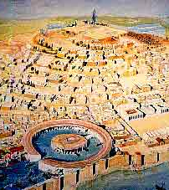
Arrival on the shores of Africa
The party arrives on the coast of North Africa
Dido asks for a plot of land for temporary refuge “the size of an oxhide” until the party can continue their journey.
The locals agreed to her request.

Slide 41
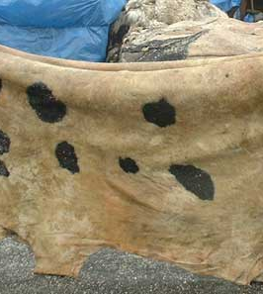
Dido’s shrewdness
Dido then cuts the oxhide into fine strips and lays out the border of the city she plans to build.
She had enough to encircle an entire hill, which is where the city of Carthage was begun.

Slide 42
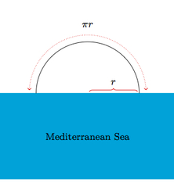
The Dido Problem
This event is commemorated in modern Calculus.
It’s called the “isoperimetric problem.”
What is the largest area that may be enclosed within a fixed boundary? A semicircle.

Slide 43
Dido and Iarbus
Carthage becomes prosperous, and Iarbus, a neighboring king who features in the Aeneid, attempts to make Dido “an offer she can’t refuse.” Marriage or war?
Dido’s envoys work out a solution: a Carthaginian must permanently dwell with Iarbus to teach him Phoenician ways and give their life for the city when necessary.

Slide 44
Dido really has a problem!
No Carthaginian would agree to go live with Iarbus, since his people were so backward and his kingdom didn’t have the amenities that Carthage did.
Dido attempts to solve the problem by creating a funeral pyre and making human sacrifices to the spirit of Iarbus.

Slide 45
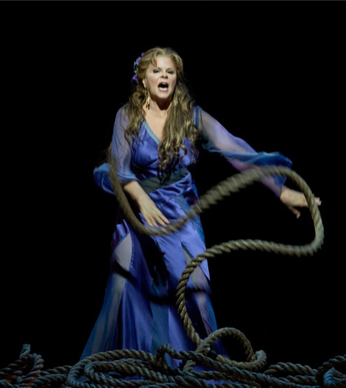
Dido’s solution
Dido herself ascends the mount of sacrifice, the funeral pyre, announcing that she desires to be faithful to the memory of her husband.
She dies as a martyr to the Carthaginian cause and is deified by the city of Carthage.

Slide 46
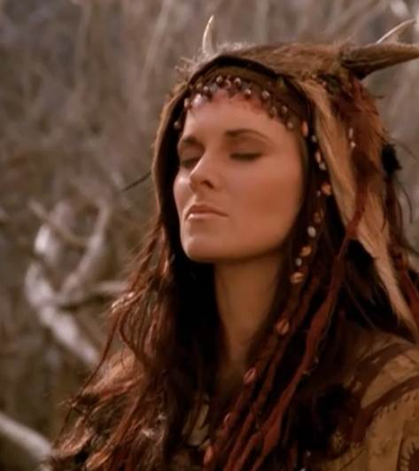
Dido
Dido is compared to an Amazon, a huntress, “with her quiver slung on her shoulder.” She is a woman who “dared to fight and kill men” (1:672). She is modeled after Calypso in the Odyssey. And she will do what Calypso did to Odysseus.

Slide 47
Sympathy for Aeneas
We also find out that Dido has some sympathy for Aeneas:
  Dido is also an exile
  She has also lost her spouse from a violent act. Her brother, Pygmalion, killed her husband, Sychaeus.
  Pygmalion was able to conceal his crime from Dido for some time.
  -Sychaeus appeared to Dido in a dream and urged her to flee to a new land and build a new civilization.

Slide 48
Finally . . . Aeneas tells his story
In Book 2 (2:285-397), Hector appears to Aeneas in a dream and tells him to leave Troy.
  Aeneas puts on his armor and tries to fight
  Aeneas sees Priam killed and thinks of his family (2:612-740)
  Aeneas sees Helen and begins to attack her, but Venus intervenes and forces him to leave (2:741-784).

Slide 49
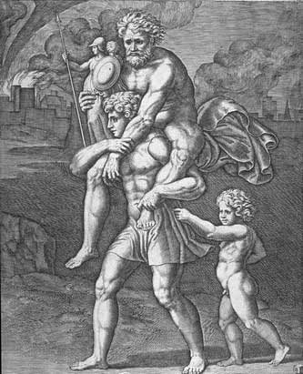
Aeneas and Anchises Flee
Aeneas goes in search of his father who refuses to leave until he sees an omen, a tongue of fire over Iulus’ head, which Jupiter confirms with a thunderclap (2:891-904)

Slide 50
Aeneas searches for Creusa
Aeneas returns to the burning city of Troy to search for his wife, Creusa.
Creusa’s ghost appears to him (2:1003-1025) and tells him to flee from Troy.

Slide 51
Aeneas the Homeric Hero
Initially, Aeneas begins to act like a Homeric hero.
  He goes through an “Iliad” phase, where, like Achilles, he rages in fury against the treachery of the Greeks.
  He is acting out of furor, not only in his anger, but in his refusal to follow the destiny that Hector, Venus, and Creusa reveal to him.

Slide 52
Aeneas the Homeric Hero?
  He sees the hopelessness of acting like Achilles, when he sees Priam, the embodiment of all that is noble about Troy, killed by Pyrrhus, the son of Achilles.
  He then sees the tongues of fire on the head of Iulus, confirmed with thunder, that convinces him and Anchises to leave the city.

Slide 53
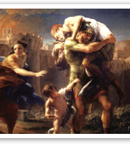
Pietas
In 2:921-924, is one of the most famous images in the Aeneid.
But encapsulated in this image is the role of pietas.
Aeneas has a duty, to his father, his ancestors, his late wife, and his son.

Slide 54
Role of Anchises
Anchises, while having a minor speaking part, has a dramatic influence in the Aeneid.
  Provides wisdom, stability, and guidance for Aeneas.
  Aeneas must “become” Anchises, the wise, self-controlled stable man who is able to govern himself and others before he can leave for Rome.
  When Aeneas follows Anchises as a role model, things go well for him. When he doesn’t, chaos results.
“To you, your father should be as a god;
One that compos’d your beauties, yea, and one
To whom you are but as a form in wax
By him imprinted, and within his power
To leave the figure or disfigure it.”
A Midsummer Night's Dream (1.1.50-4)

Slide 55
Books Three and Four
The wanderings of Aeneas and his men at sea.
The passion of Dido and its results.

