Slide 1
Art as an Expression of Postmodernism –
Visual Expressions of the Loss of Meaning

Slide 2
Art Defined: Form and Content
Art Has Form and Content:
Form means:
The elements of art,
the principles of design and
the actual, physical materials that the artist has used.

Slide 3
Art Defined: Content
Content is idea-based and means:
What the artist meant to portray,
what the artist actually did portray and
how we react, as individuals, to both the intended and actual messages.
Additionally, content includes ways in which a work was influenced--by religion, or politics, or society in general, or even the artist's use of hallucinogenic substances--at the time it was created. All of these factors, together, make up the content side of art.
From http://arthistory.about.com/cs/reference/f/what_is_art.htm December 6, 2011

Slide 4
Postmodernism
“modern-modern” or “hypermodern” acc. to Francis Schaeffer
Loss of metanarratives – no interpretive framework to provide guidance or to help people “make sense” out of the world – it’s all up to you . . .
Denies existence of ultimate principles
The irony of this is that everything is examined under the lens of skepticism and cynicism.

Slide 5
The First Step: Impresssionism
The impressionist style of painting is characterized chiefly by concentration on the general impression produced by a scene or object and the use of unmixed primary colors and small strokes to simulate actual reflected light.
Impressionism, French Impressionnisme, a major movement, first in painting and later in music, that developed chiefly in France during the late 19th and early 20th centuries. The most conspicuous characteristic of Impressionism was an attempt to accurately and objectively record visual reality in terms of transient effects of light and color.
From http://www.ibiblio.org/wm/paint/glo/impressionism/. Dec. 6, 2011

Slide 6
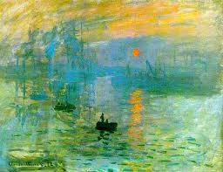
Japanese footbridge at Givenchy
Claude Monet (1840-1926) is the name most associated with French Impressionistic painting. Notice how the subject of the painting is barely recognizable.

Slide 7
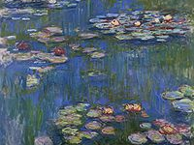
Water Lilies
Another famous Monet painting. Again, while you can tell that water lilies are represented, it’s “blurry”. The focus of the impressionists was not to “make things blurry,” but to deconstruct the object and reconstruct it.

Slide 8
Vincent van Gogh (1853-1890)
Classified as a post-impressionistic painter
Gave up on the idea of universals
Sought to establish an artistic community at Arles, as well as create a new religion for “sensitive people.”
Suffered from poor mental health and had several psychiatric breakdowns, resulting in his dying from a self-inflicted gunshot wound.

Slide 9
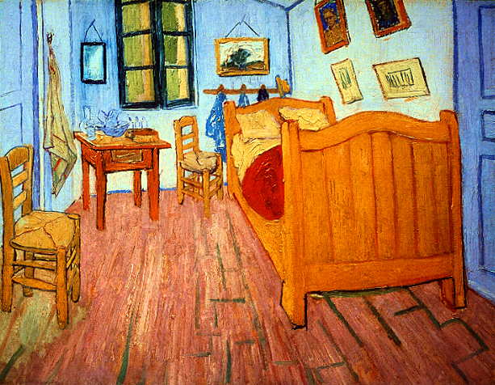
Room at Arles
Not sure what to say about this, except notice the appearance of the pictures on the right wall.

Slide 10
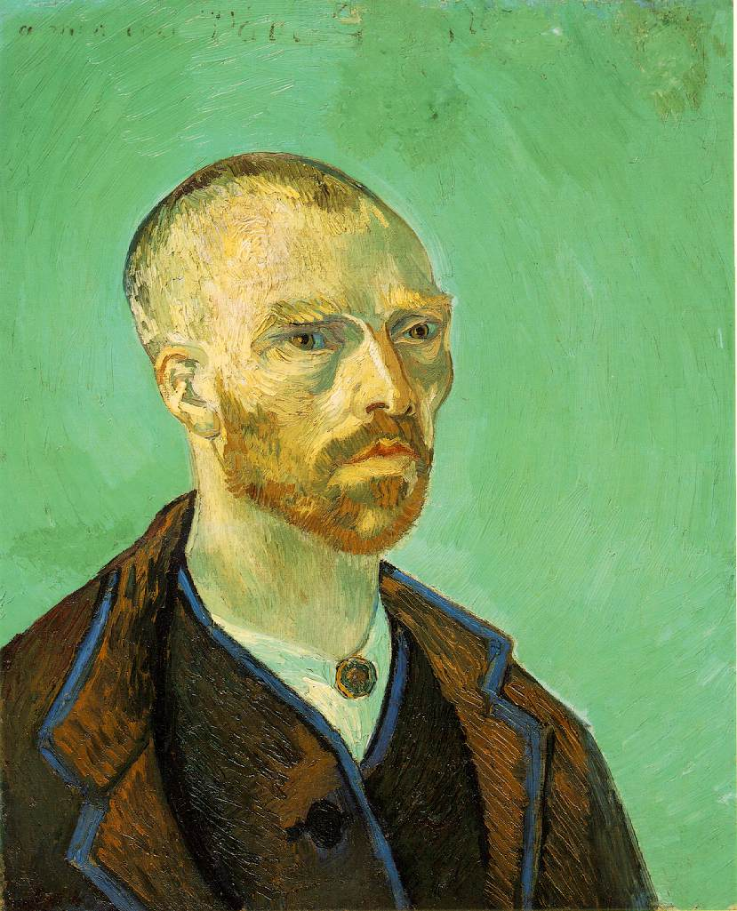
Self portrait dedicated to Paul Gauguin

Slide 11
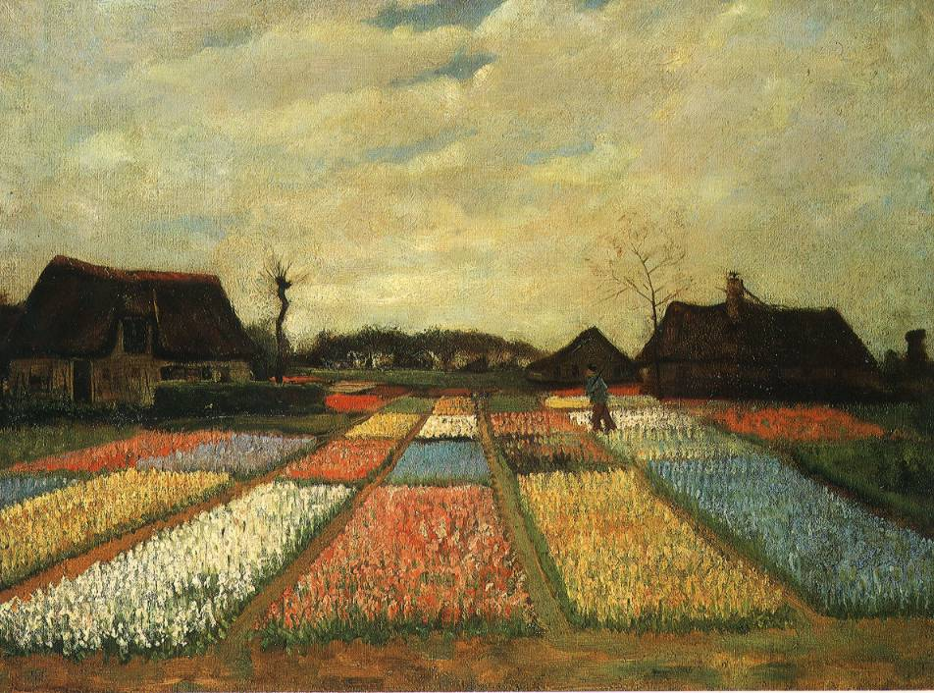
Flower Beds In Holland
Van Gogh is well-known for his landscapes.

Slide 12
Paul Gauguin (1848-1903)
Joined van Gogh’s community in Arles but they quarreled violently and Gauguin left after a few months.
Travelled to Tahiti in search of the “noble savage.”
Sought to find the “universal” by returning to the primitive state and remove himself from the loss of innocence that he found in civilization.

Slide 13
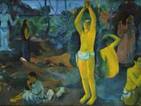
What? Whence? Whither?
Perhaps Gauguin’s most famous painting, it was painted in Tahiti and is meant to be viewed right to left. After finishing this painting, Gauguin too tried to commit suicide, but he did not succeed.

Slide 14
Paul Cezanne (1839-1906)
Considered to be the “father of modern painting.”
Influential in the development of Cubism.
Insisted on the integrity of the painting itself rather than what it supposedly “represented.”
In Cezanne and artists that he influenced, we can see visually the loss of universals and the search for them.

Slide 15
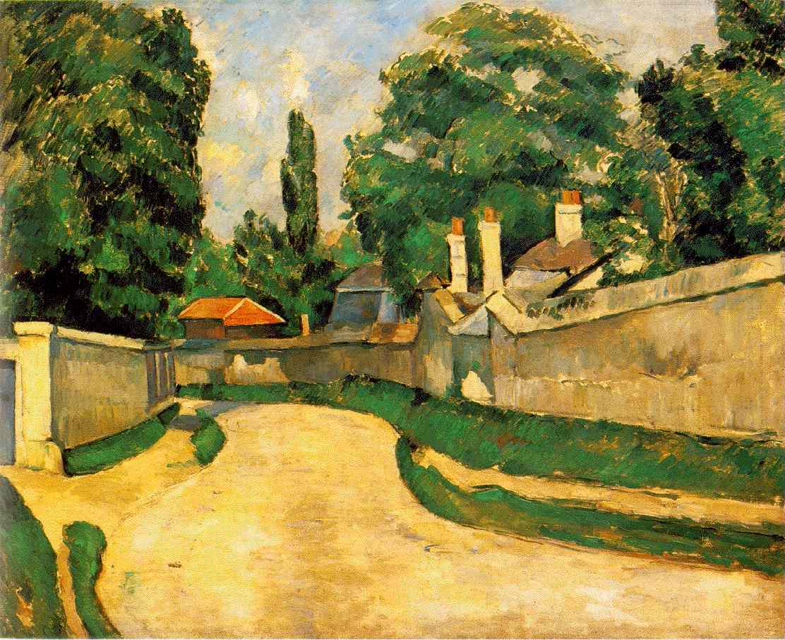
Bord Route
Notice the distortion of this landscape. Other paintings will become more distorted as we go on due to the loss of connection with a universal.

Slide 16
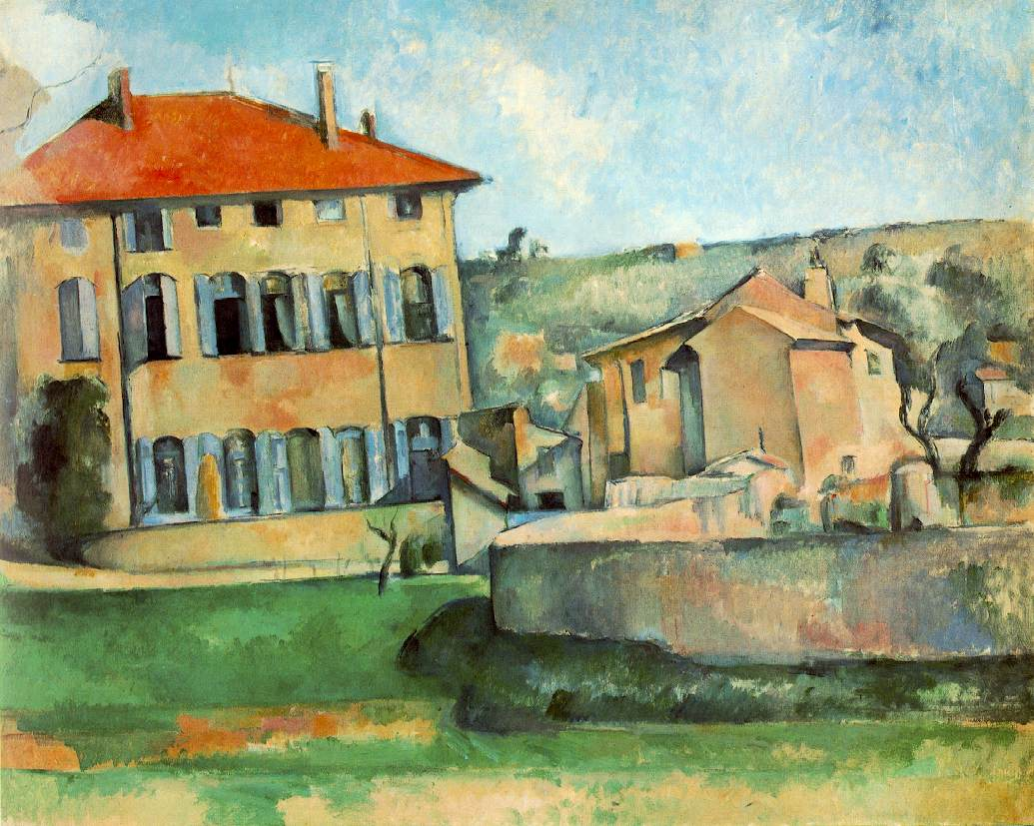
Maison et ferme du Jas de Bouffan
House and farm at Jas de Bouffan

Slide 17
Cubism
Cubism was a revolutionary style of art developed by Pablo Picasso and Georges Braques.
It evolved at the beginning of the 20th century in response to a world that was changing with unprecedented speed.
The Cubists challenged conventional forms of representation, such as perspective, which had been the rule since the Renaissance.

Slide 18
Cubism
Represented objects in geometric shapes and from many perspectives.
Sought to incorporate non-Western cultural expressions (mostly African).
Cubists such as Picasso introduced collage (assemblage of different objects) into painting.
This is similar to pastiche in literature and cinema.

Slide 19
Pablo Picasso (1881-1973)
Long career in painting, sculpture, ceramics
Probably most influential 20th century artist
Was an innovator in art until the end of his life.
Lived a dissolute personal life, mostly in Paris and Barcelona.
Left behind an enormous body of work.

Slide 20
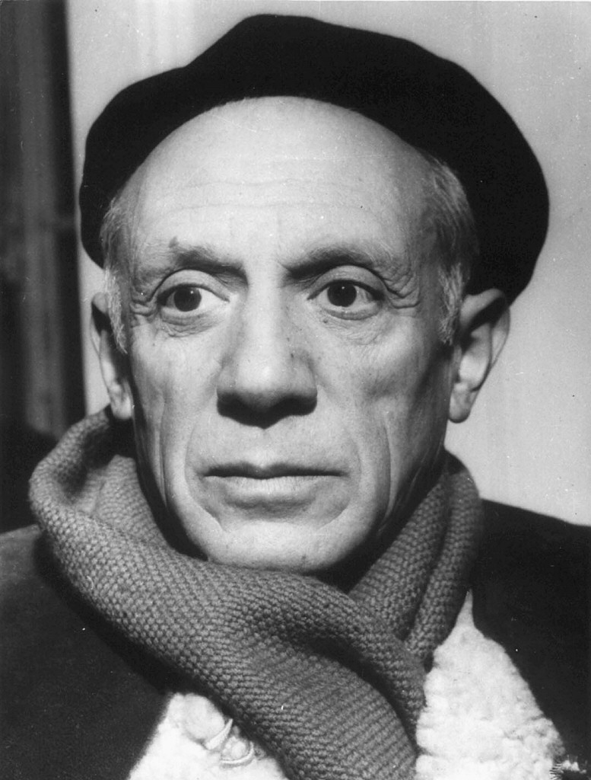
Pablo Picasso

Slide 21
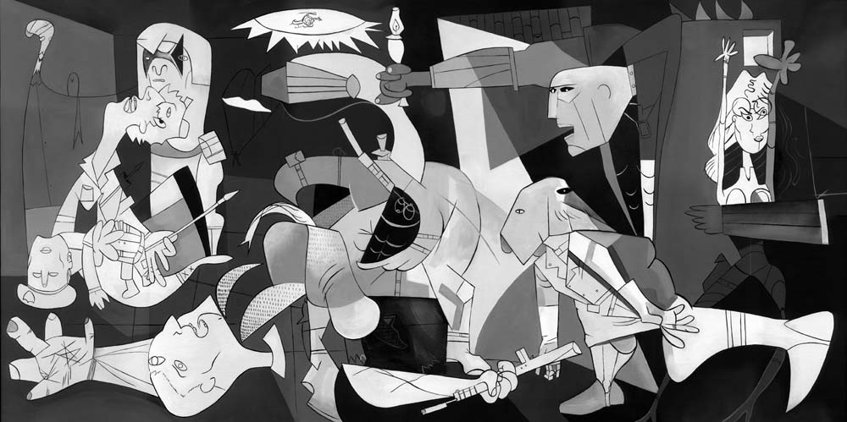
Guernica

Slide 22
Guernica and the Spanish Civil War
Guernica was created in response to the bombing of Guernica, Basque Country at the behest of the Spanish Nationalist forces, on 26 April 1937, during the Spanish Civil War
The Republican government of Spain commissioned Picasso to create a large mural for the Spanish display at the at the 1937 World’s Fair in Paris.
Guernica shows the tragedies of war and the suffering it inflicts upon individuals, particularly innocent civilians.
This work has gained a monumental status, becoming a perpetual reminder of the tragedies of war and antiwar symbol. From www.pbs.org. December 6, 2011

Slide 23
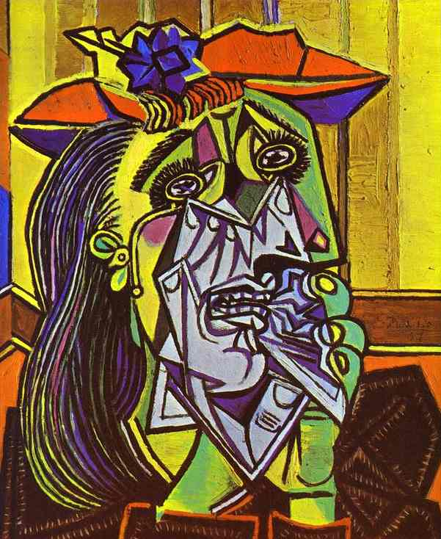
Picasso self portrait

Slide 24
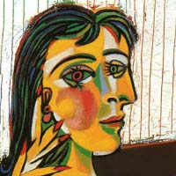
Dora Maar

Slide 25
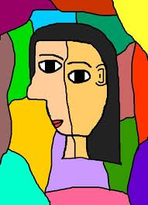
Sherry

Slide 26
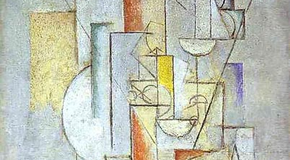
J’amie Eva

Slide 27
Pure Abstraction
Shapes and colors have always had their own emotional force: the designs on ancient bowls, textiles, and furnishings are abstract
Abstraction became the perfect vehicle for artists to explore and unversalize ideas and sensations, independent of particular objects.
From http://www.ibiblio.org/wm/paint/tl/20th/pure-abs.html. Dec. 6, 2011.

Slide 28
Piet Mondrian (1872-1944)
Innovator in pure geometric painting
Lived in Holland, Paris, and New York
Paintings did not sell very well during his lifetime.
Had his first one man show at the Valentin Dudensing Gallery in New York City two years before he died.

Slide 29
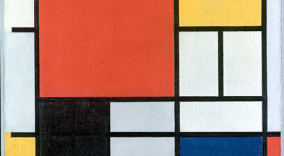
Mondrian -- Komposition

Slide 30
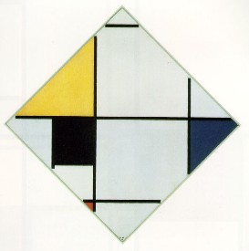
Mondrian--Lozenge

Slide 31
Dada
Dada began in Zurich and became an international movement. Or non-movement, as it were.
Dada had only one rule: Never follow any known rules.
Dada was intended to provoke an emotional reaction from the viewer (typically shock or outrage).

Slide 32
Dada
Dada art is nonsensical to the point of whimsy. Almost all of the people who created it were ferociously serious, though.
Abstraction and Expressionism were the main influences on Dada, followed by Cubism and, to a lesser extent, Futurism.
There was no predominant medium in Dadaist art. All things from geometric tapestries to glass to plaster and wooden reliefs were fair game. Dada self-destructed when it was in danger of becoming "acceptable".
    From http://arthistory.about.com/cs/arthistory10one/a/dada.htm. December 6, 2011

Slide 33
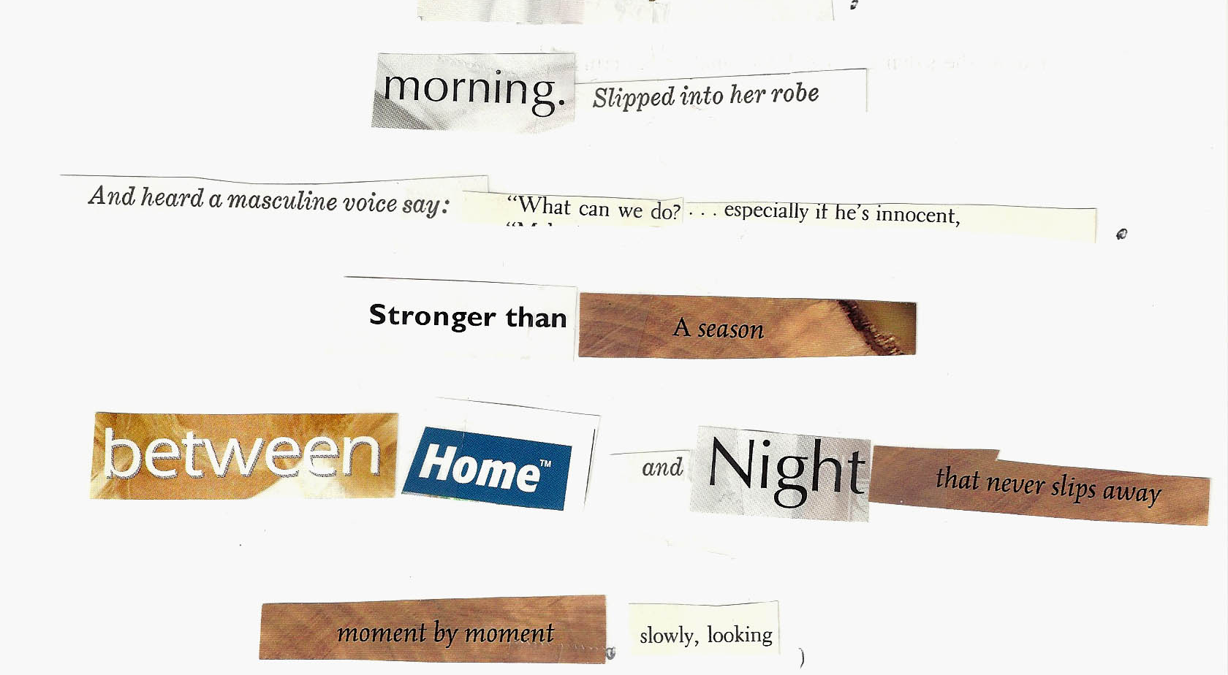
Dada Poem

Slide 34
Text of Dada Poem
You’re period of mourning uncovered death in the fifth position.
Illuminate yourself.
Morning. slipped into her robe
and heard a masculine voice say: “What can we do?…especially if he’s innocent,
Stronger than a season
Between home and night that never slips away
moment by moment, slowly, looking,
do you look inside the flowers blooming last.
From http://lindastudley.com/2011/03/03/the-february-coffee-house-dada-poem/. December 6, 2011

Slide 35
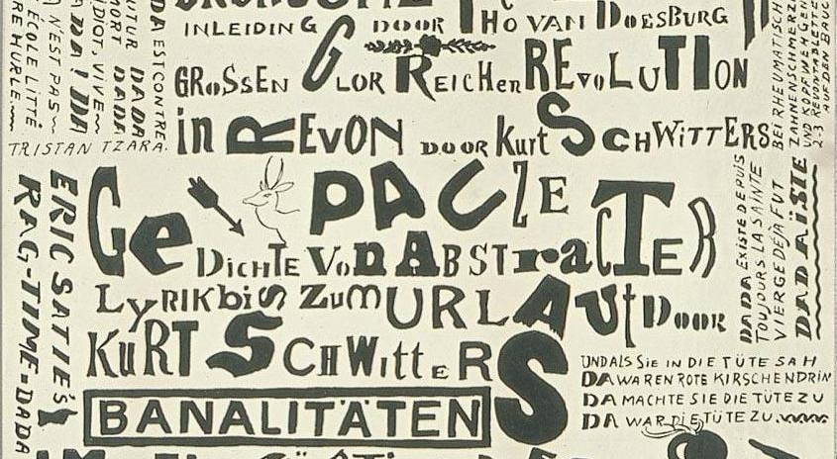
More Dada

Slide 36
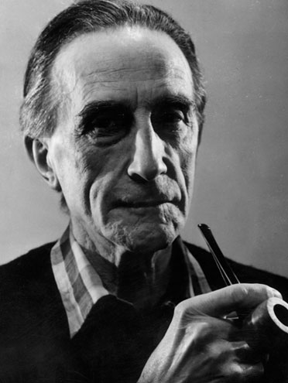
Marcel Duchamp (1887-1968)

Slide 37
Marcel Duchamp
Dada artist
Almost always has a “nonsense” element to his paintings, as well as some “dirty” action.
Early in his career, abandoned painting for “ready made art”.
Schaeffer calls him “the high priest of destruction”
Paintings not suitable for viewing at a Christian Education institution.

Slide 38
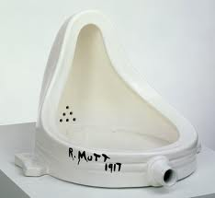
Ready Made “Art”

Slide 39
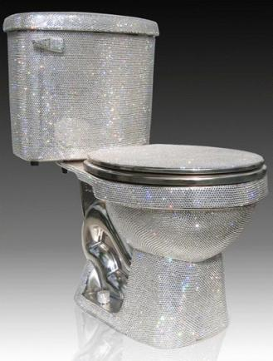
More “Ready Made Art”

Slide 40
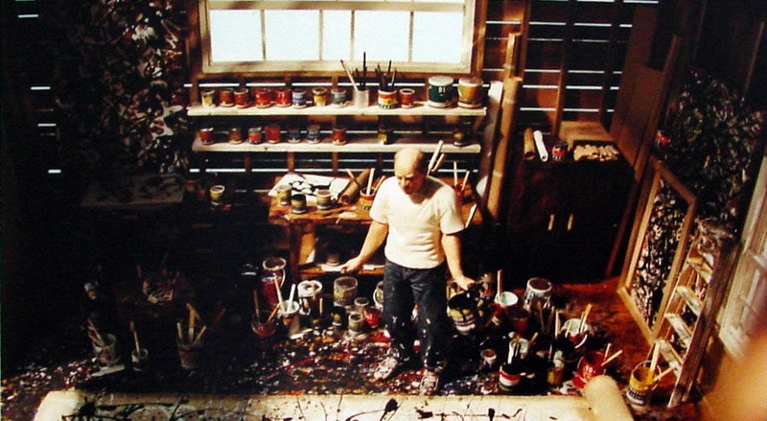
Jackson Pollock (1912-1956)

Slide 41
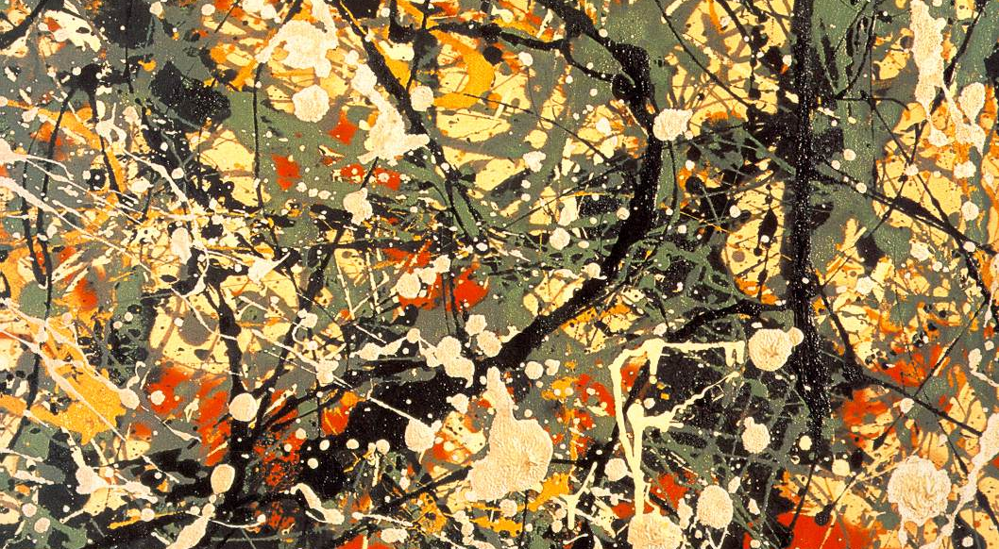
Jackson Pollock

Slide 42
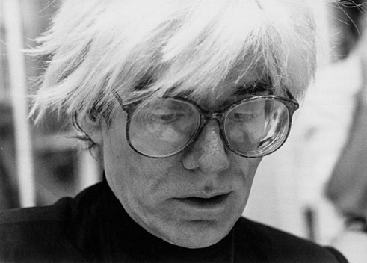
Andy Warhol (1928-1987)

Slide 43
“I'm afraid that if you look at a thing long enough, it loses all of its meaning.”
Andy Warhol

Slide 44
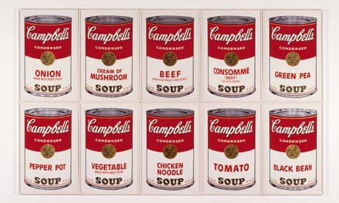
Warhol – Campbell’s Soup

Slide 45
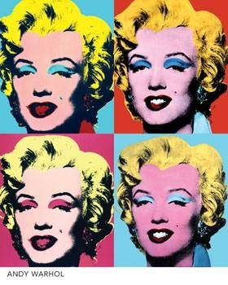
Andy Warhol

Slide 46
Art???
Where is art headed apart from a unifying theme?
Is “ready made art” really art? What is missing?
Is “beauty in the eye of the beholder?” Or is there a standard of beauty that people intuitively recognize?

