Slide 1
Axis of Evil
Events Leading to World War II
1920’s-1939

Slide 2
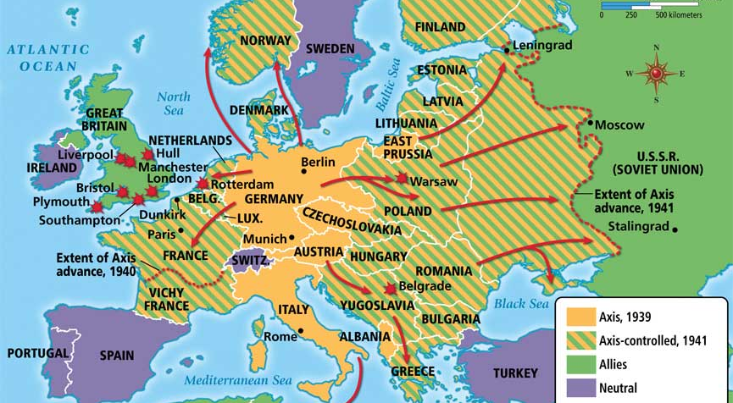
Rise of Militaristic Nations

Slide 3
Miltaristic Dictators
The 1920s and 1930s experienced the rise of militaristic dictators whose aim was to conquer the world.
Each of them played on national and international tensions to build an unbreachable base of power and silence oppositon in their country.

Slide 4
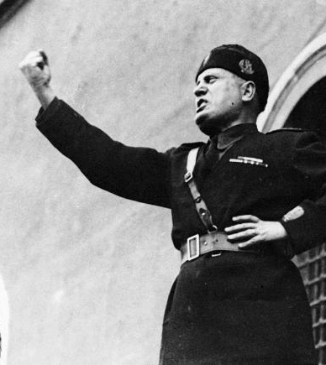
Benito Mussolini (1883-1945)
Il Duce
Widely admired in America in the 1920s for his administrative skills
Promised Italy the glory that Rome had under the Caesars

Slide 5
Fascism
State control of all industries
Dictator leads the nation through central planning
Became the ruling ideology in Germany, Italy, and somewhat in Japan because people felt downtrodden and wanted to unite behind a strong leader who would restore national pride.

Slide 6
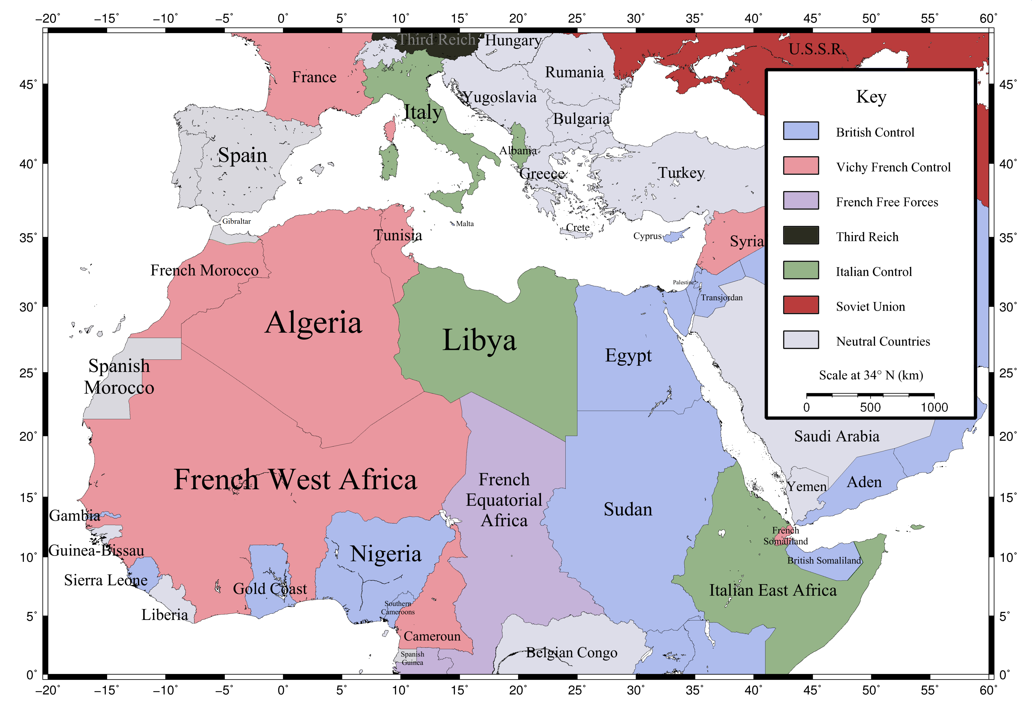
Italy – Capture of Ethopia

Slide 7
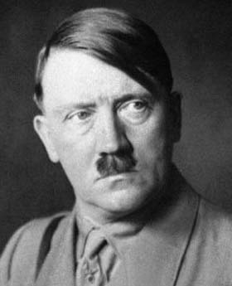
Adolf Hitler (1882-1945)

Slide 8
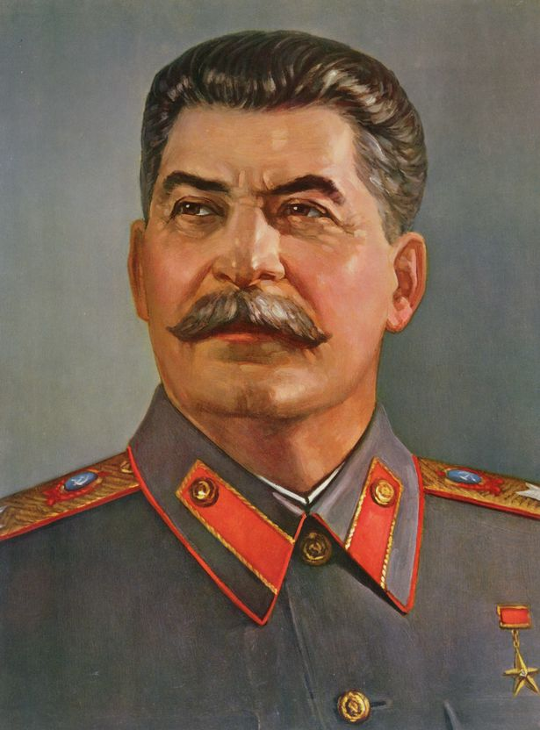
Josef Stalin

Slide 9
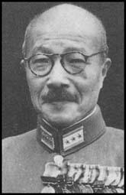
Hideki Tojo

Slide 10
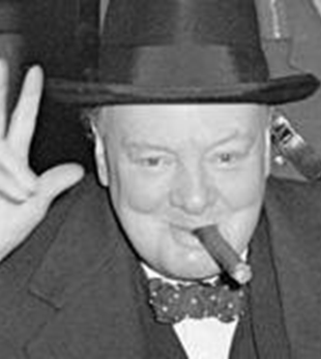
Winston Churchill
Savior of the free world
Essentially his speeches kept England in the war until the United States came to their aid

Slide 11
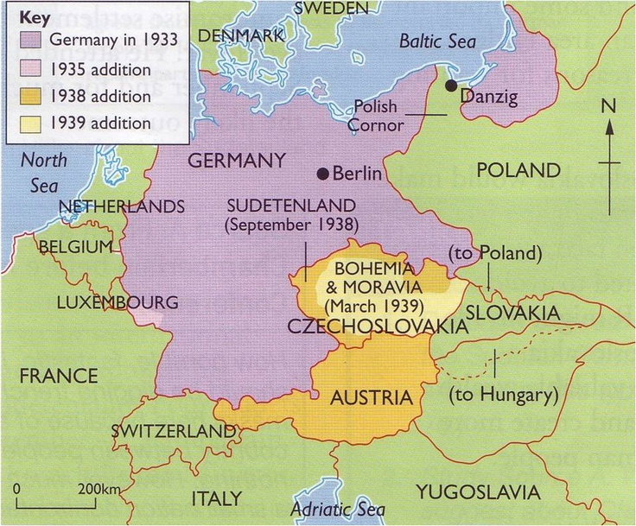
Hitler overruns Europe

Slide 12
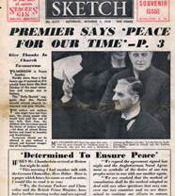
Munich Conference
In September 1938, Hitler hosts Neville Chamberlain, PM of Great Britain, and French PM Edouard Daladier.
Both Chamberlain and Daldier allowed Hitler to take the Sudetenland, but nothing more

Slide 13
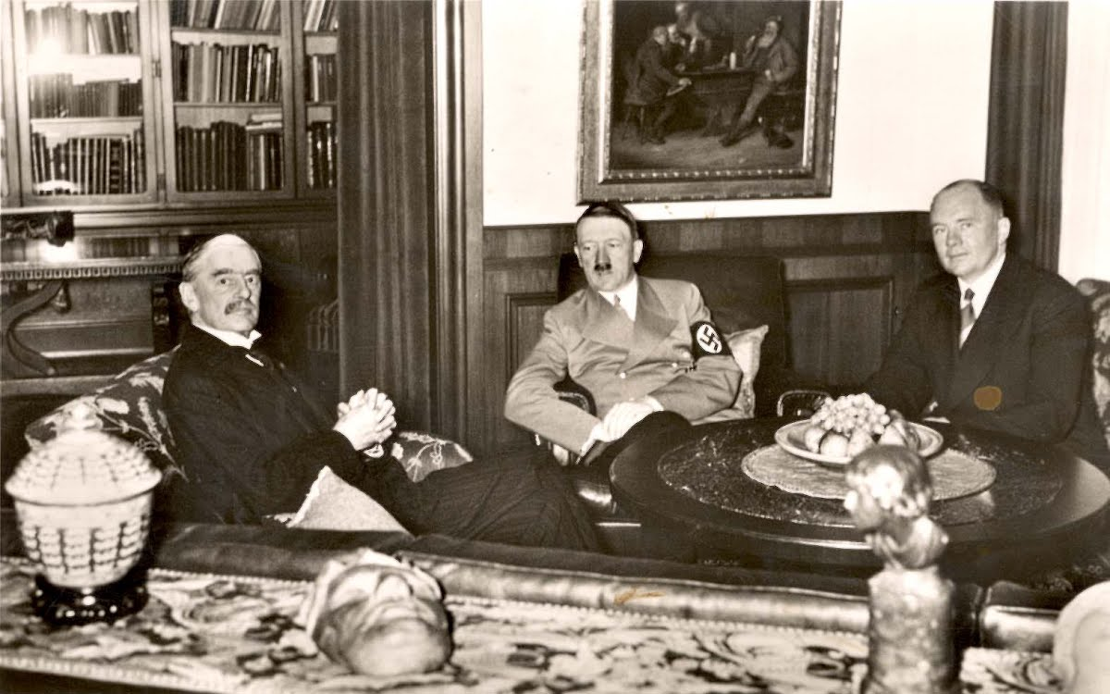
Hitler takes Czechoslovakia
In March, 1939, Hitler takes the rest of Czechoslovakia.
British and French leaders hurriedly sign security agreements with Romania and Poland

Slide 14
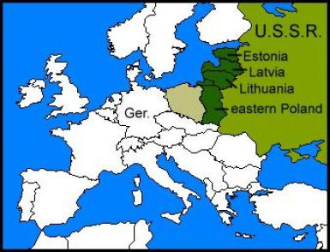
Hitler and Stalin Sign Nonaggression Pact
Hitler and Stalin agreed not to take up arms against each other and carved Eastern Europe into “spheres of influence” where neither country would interfere with the other.

Slide 15
War Begins!
September 1, 1939: 1600 Luftwaffe bomb and strafe military and civilian targets in Poland, while 56 divisions roll across the Polish border.
By the end of the month, Hitler’s conquest was complete. There were over 100,000 Polish casualties eight hours into the first assault.
By the end of the war, 6 million Poles would die, half of them in concentration camps.

Slide 16
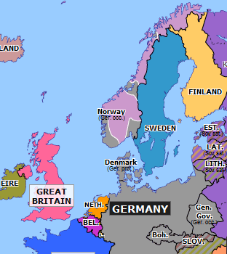
Hitler marches on
In March, 1940, Hitler adds Denmark and Norway to his conquests, both being neutral nations

Slide 17
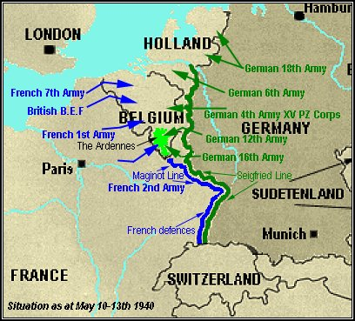
Marching on to France
Following the acquisition of Denmark and Norway, Hitler turns his attention to France. May 10, 1940, Germany attacks the Low Countries. Luxembourg falls in two days, Holland in five days, and Belgium in eighteen days.

Slide 18
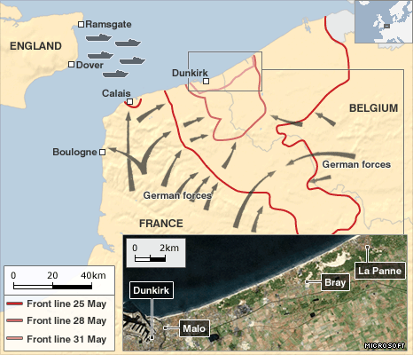
France Surrenders
After the conquest of the Low Countries, France, aided by British troops is overrun by the Nazis in six (!) weeks.
The government quickly abandons Paris, leaving it unoccupied for the Nazis.
France is forced to surrender on June 22, 1940

Slide 19
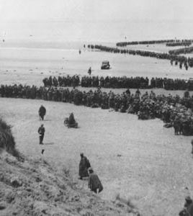
Britain Stands Alone
For the rest of 1940 and 1941, Great Britain stood alone against the Axis powers
  “The Finest Hour”
  Miracle of Dunkirk
  Battle of Britain

Slide 20
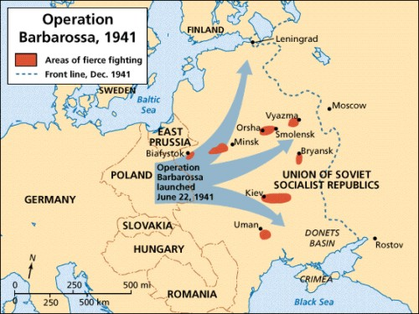
Hitler Opens Another Front
With almost the entire continent of Europe in his possession, Hitler opens up the Eastern Front.
On June 22, 1941, he launches Operation Barbarossa and invades the USSR.

Slide 21
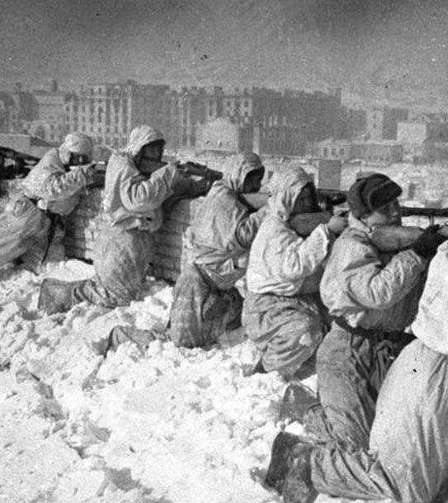
Eastern Front
We don’t hear much about the Eastern Front since America was did not fight in that theater, but the Eastern Front would have been the bloodiest war in all of history, with Germany losing about 8 million men and the USSR losing about 12 million

Slide 22
American Isolationism
In spite of the fact that the world was at war, America continued to be committed to isolationism. While most Americans were sympathetic to the Allies, the believed American involvement was unnecessary. Their mistaken beliefs included
  Effectiveness of Maginot Line
  Germany outrunning supply lines
  Support for Hitler evaporating in Germany

Slide 23
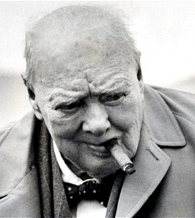
Churchill’s Strategy
Churchill’s strategy was to stay in the war until he could persuade America to join the war effort.
  American Lend Lease Act, March 11, 1941, providing for $7 billion for aid to Allies
  Eventually, the US distributed $50 billion in aid to 38 countries on the side of the Allies

Slide 24
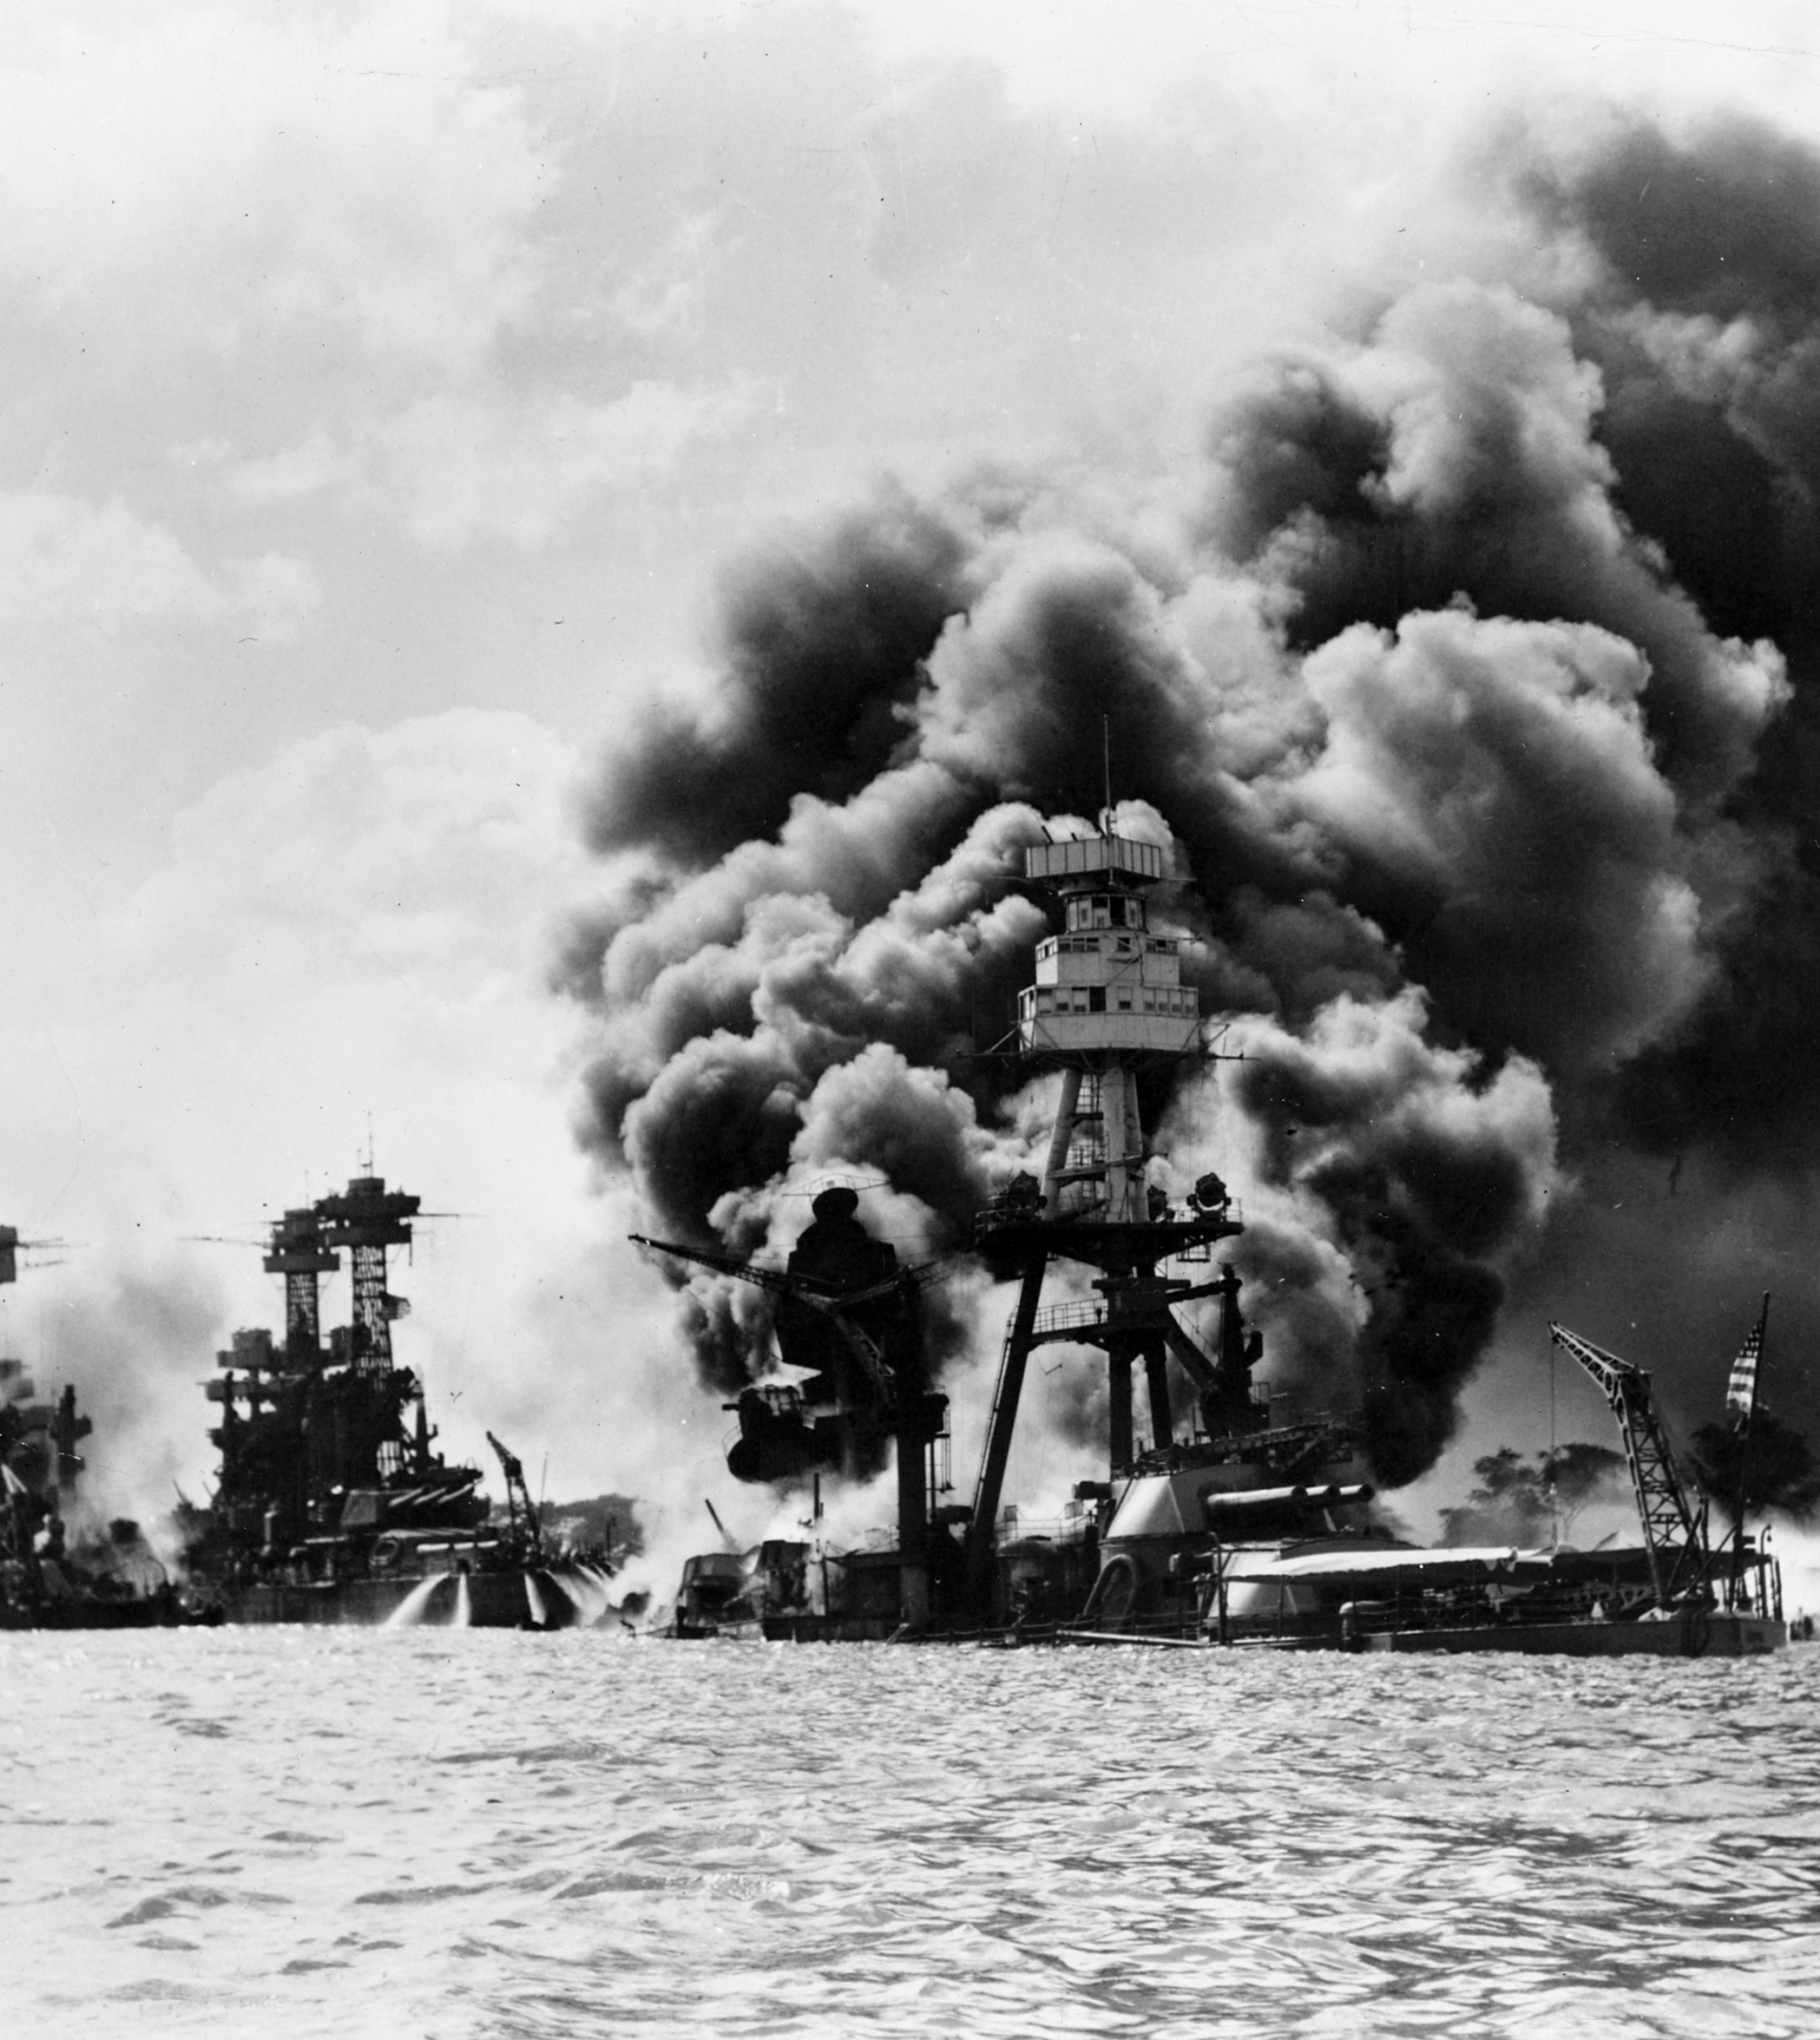
Next Up
Pearl Harbor
America enters the War
Pacific Theater
D-Day
V-E Day
V-J Day

