Slide 1
Thrasymachus’ argument
Are there cases where justice is to protect the interests of the stronger?

Slide 2
Thrasymacus’ Argument
Justice is (protecting and maintaining) the interests of the stronger . . .
We concluded last class period that Thrasymachus’ argument had some problems.
But it’s not quite as obviously wrong as it seems.

Slide 3
Plausibility
It seems that there are cases when “justice is (maintaining and protecting) the interests of the stronger.
It also seems that some of these cases pose genuine harm to all when the interests of the stronger are not protected and maintained.

Slide 4
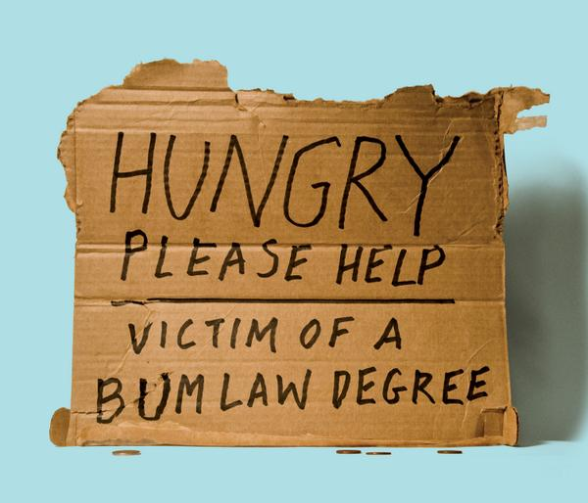
When interests of stronger are not served

Slide 5
Law School Admissions
In the class that Florida Coastal admitted in 2013, more than half the students were unlikely to ever pass the bar.
Americans are projected to incur nearly $1.3 trillion in student debt over the next 11 years.
The odds of a graduate getting a job that justifies incurring the schools’ typical debt are essentially 100 to 1.
http://www.theatlantic.com/features/archive/2014/08/the-law-school-scam/375069/

Slide 6
Justice? Stronger?
Would it not be more just to admit only students who have previously demonstrated academic aptitude and the foundational knowledge and skills necessary to succeed in law school?

Slide 7

Epic Receipt!

Slide 8
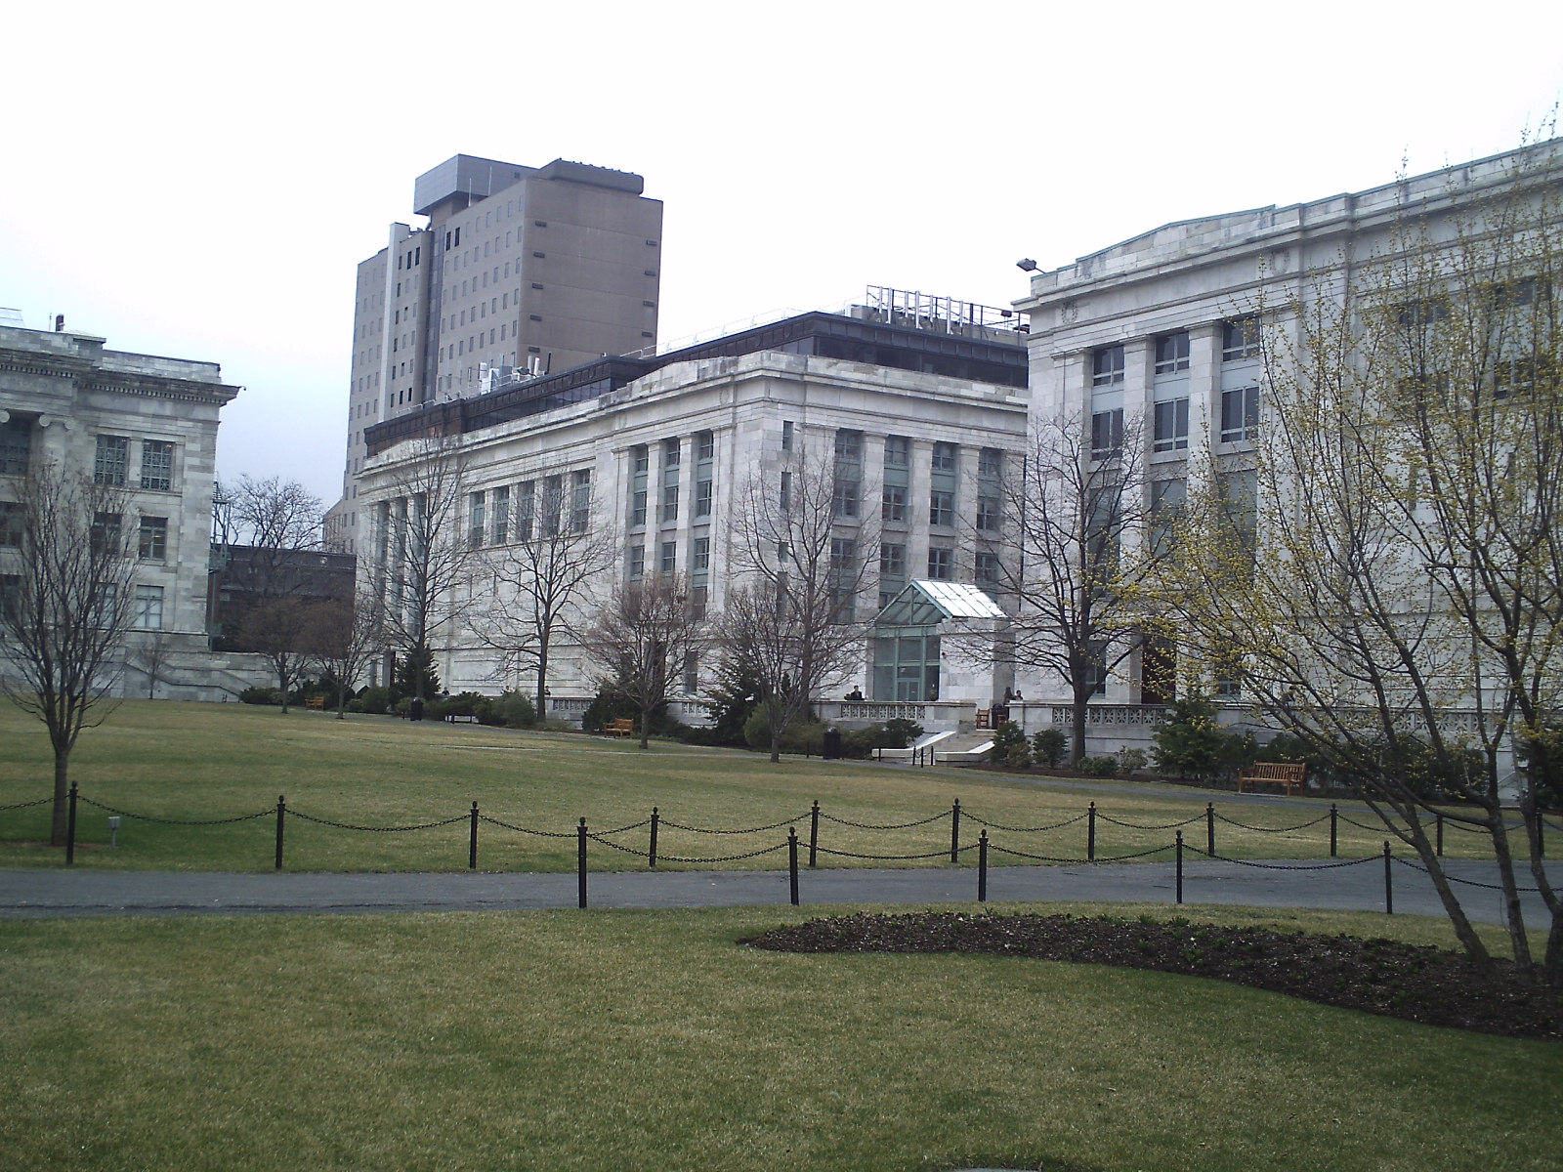
Medical School

Slide 9
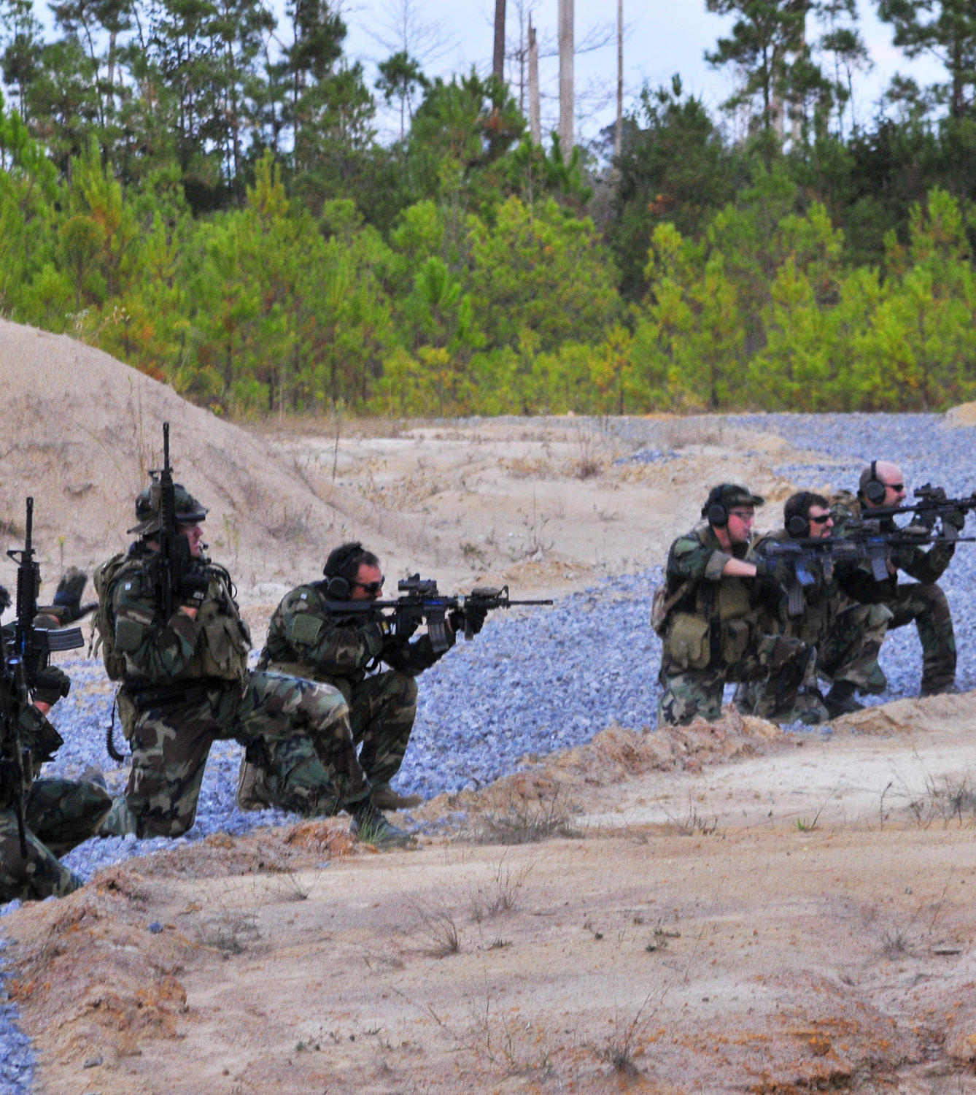
Elite Military Forces
It also seems that in putting together elite military forces such as the Navy Seals, Thrasymachus’ argument is correct.

Slide 10
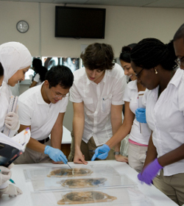
Argument
Isn’t it in the interests of everyone to only admit the best qualified people to medical school? Is it wrong to deny entrance to medical school to people who don’t have the aptitude and the preparation to succeed to prepare to practice medicine?

Slide 11
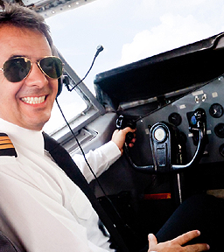
Pilots
Likewise, it seems that justice in terms who pilots airplanes is to protect and maintain the interests of the stronger.

Slide 12
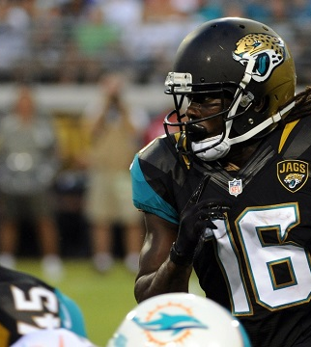
Professional Athletes
Another case in point: Professional athletes:

Slide 13
Elite Military Units
It also seems that in putting together elite military units, Thrasymachus’ argument holds up.

Slide 14
Hmm. . .
So, while it seems that Thrasymachus is right in reference to these “hard cases,” is there something that we are missing when we conclude that “justice is in the interest of the stronger?” What key understanding seems to override this argument in each of these cases?

Slide 15
Ultimate vs. Proximate Ends
Each of the above situations has an ultimate end beyond preserving the interests of the stronger:
  Medical school: prepare qualified doctors to serve the interests of the patients
  Elite military forces: protect and defend those for whom they fight
  Professional athletes: to win to enhance the value of the franchise that they play for

Slide 16
Ultimate vs. Proximate ends
  Pilots: to provide safe, reliable transportation for the sake of the passengers.
  In all of these cases, when we take the side that justice is in the interests of the stronger, it appears that it is so prima facia. However, when we examine each situation more closely, it can be determined that justice is not (protecting and maintaining) the interest of the stronger, but those whom they serve.

Slide 17
Closing Thrasymachus’ Argument
Questions????
Comments????

