Slide 1
The Cold War
1945-1991

Slide 2
Holocaust
The Holocaust is the name of the systematic killing of over six million European Jews that Germany carried out from 1933-45. In addition, Slavs, Poles, Roma, and disabled people were also systematically murdered
Two-thirds of the Jewish population of Europe was murdered during the Holocaust. Many entire villages and towns were depopulated.

Slide 3
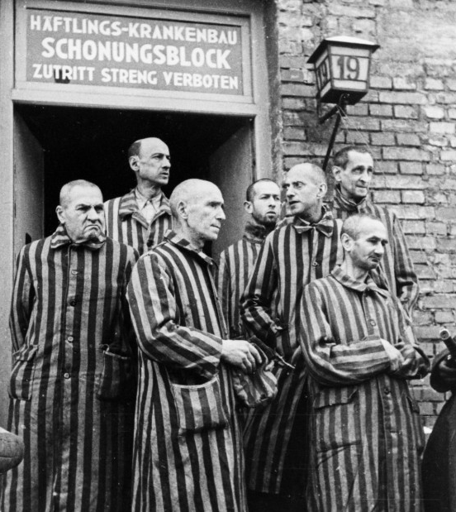
Death Camps
Jews were systematically rounded up and taken to concentration camps.
The sick and elderly were led to gas chambers. Those who were healthy were put to work, fed poor diets in rat and lice infested dwellings, and often died of disease or malnutrition.

Slide 4
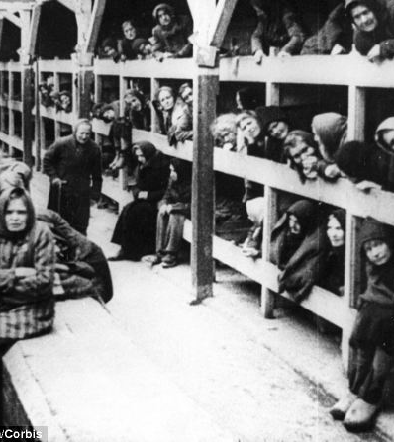
Death Camps
The magnitude of the Holocaust was not known until the Allies began liberating the death camps in the final days of World War II. Most were shocked and horrified at the conditions in the camps.

Slide 5
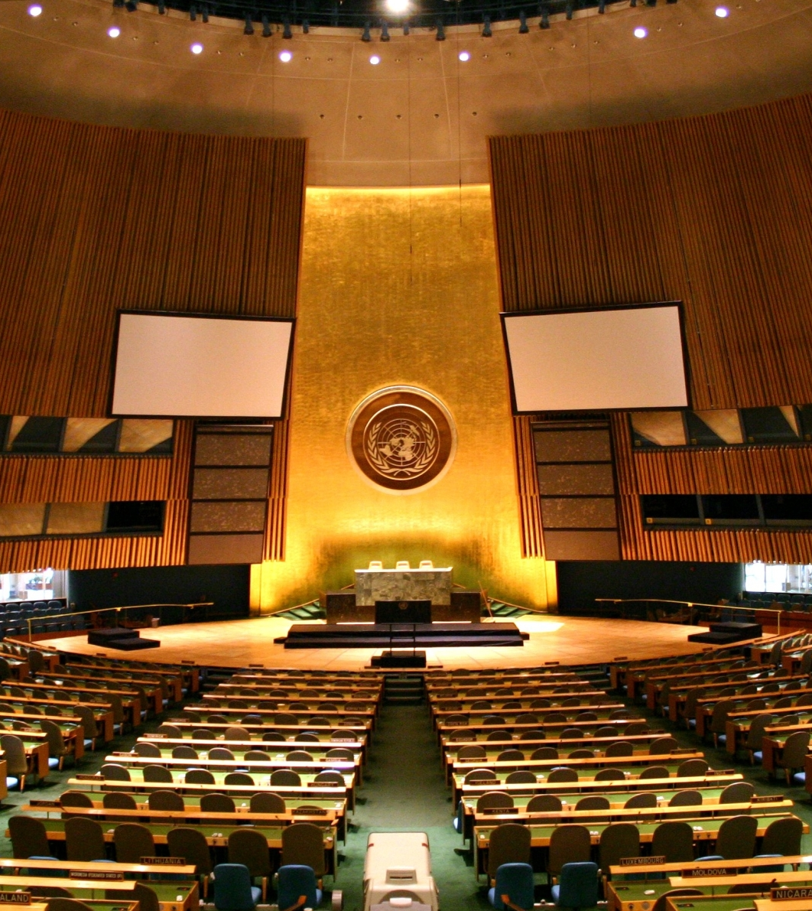
United Nations
The United Nations was founded in 1945 to bring about “collective security.”
Member nations may express opinions and have diplomatic changes with other members.

Slide 6
United Nations
The hope behind the United Nations was that as a forum for diplomatic exchange and united military action when necessary, that the dream of world peace would be achieved.
Its record has been mixed at best, and today, it tends to be an anti-American debating society located in America and paid for by American taxpayers.

Slide 7
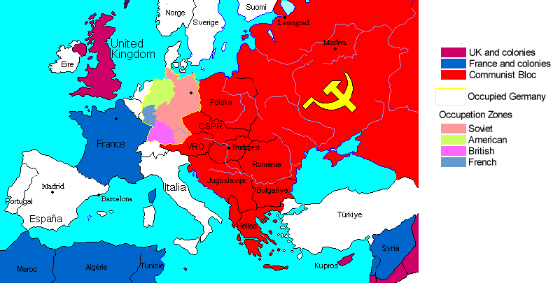
Occupation after World War II

Slide 8
Cold War
The Cold War was a time of hostility and competition between the two remaining world powers after World War II – the US and the Soviet Union.
The Cold War featured four things:
  Permanent Soviet Occupation of Eastern Europe
  “Domino Theory” of the Spread of Communism
  Arms Race
  Occasional “proxy wars”

Slide 9
Marshall Plan
A comprehensive program providing aid to rebuild war-torn Western Europe.
$12 billion (approximately $120 billion today) was given for the purposes of
  Relief
  Rebuilding
  Reform

Slide 10
Marshall Plan
Sixteen nations were given aid in the Marshall Plan. The Soviet Union and her satellite nations were invited to participate but declined.
Both Allied and Axis nations were aided. The thinking was that a lasting peace was possible only if Germany once again became a strong economic power.
Another goal of the Marshall Plan was to halt the spread of Communism.

Slide 11
Success of Marshall Plan
By 1953, every nation who received aid from the Marshall Plan had a stronger economy than they did before World War II.

Slide 12
Revolution in China
In 1949, the Communists under Mao Zedong won a civil war in China that had been ongoing since the 1920s.
The Chinese government, led be Chaing Kai-Shek, had to relocate to the island of Formosa.
The US did not extend diplomatic recognition to Communist China, called “Red China” when I was growing up, until the 1970s.

Slide 13
Korean War 1950-1953
Most serious conflict of the early Cold War
After WWII, the country was divided at the 38th parallel between North (Communist) Korea and South Korea.
On June 25, 1950, North Korea invaded South Korea. The UN sent troops to support South Korea.
Communist China sent troops to aid North Korea.

Slide 14
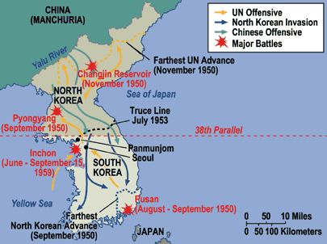
Korean War

Slide 15
MacArthur Recalled
General Douglas MacArthur, a hero of World War II, was in charge of the UN Forces in Korea.
MacArthur and President Truman were on a collision course in terms of policy:
  Truman: limited war to avoid open war with China.
  MacArthur: “No substitute for victory”
General MacArthur made public statements opposing the President’s policies. Because of this, he was removed from command on April 11, 1951.

Slide 16
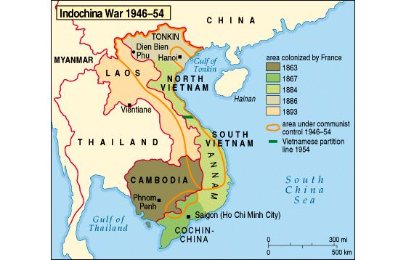
Outcome of the war
Prewar boundaries restored
Demilitarized zone set up between North Korea and South Korea.
Limited war against Communism “migrated” to Vietnam, which, in many ways, was a mirror image of Korea

Slide 17
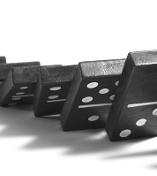
Domino Theory
The Cold War “containment" notion was born of the Domino Theory, which held that if one country fell under communist influence or control, its neighboring countries would soon follow.

Slide 18
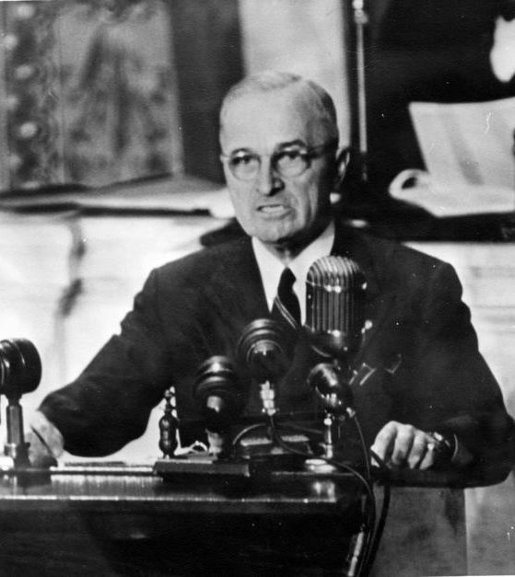
Containment
Containment was the cornerstone of the Truman Doctrine as defined by a Truman speech on March 12, 1947. It then became the foundation of American foreign policy through the Reagan administration and beyond, for about 50 years.

Slide 19
Second Red Scare
Following WWII, the democratic United States and the communist Soviet Union became engaged in a scene of largely political and economical clashes known as the Cold War. The intense rivalry between the two superpowers raised concerns in the United States that communists and leftist sympathizers within America's borders might actually be working as Soviet spies and thus posing an alarming threat to national security.

Slide 20
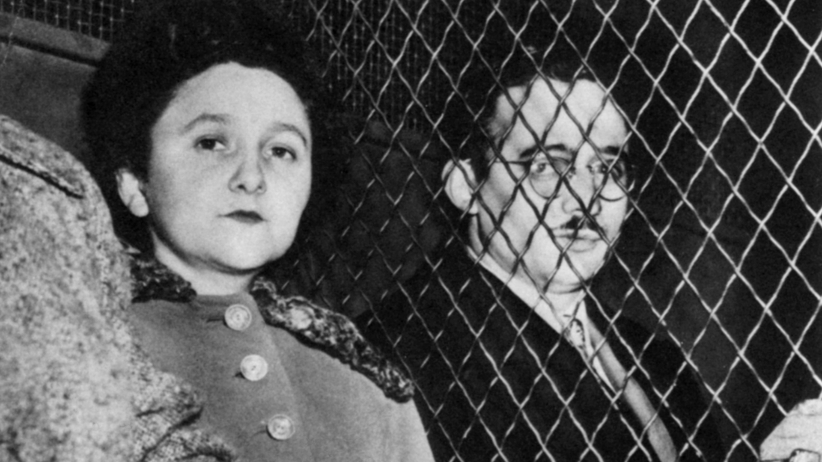
Rosenbergs
During the 1940s, Julius Rosenberg was an agent for the Soviet Union.
His brother-in-law, David Greenglass, worked at the Manhattan Project, designing the atomic bomb. He took notes and sketches of the plans for the atomic bomb, which his sister Ethel typed up and gave to Julius for the Soviets.

Slide 21
Arrest and Conviction
In 1950, Julius and Ethel Rosenberg were arrested and charged with conspiracy to commit espionage, along with David Greenglass and Martin Sobell.
Their case went to trial in 1951. Greenglass agreed to testify against the Rosenbergs in exchange for a lesser sentence.
Steadfastly proclaiming their innocence, the Rosenbergs were convicted of espionage and sentenced to death. They were executed on June 19, 1953.

Slide 22
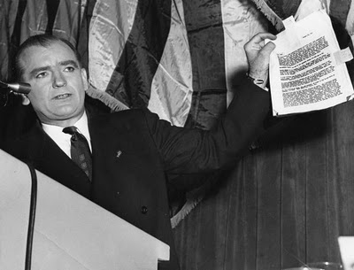
McCarthy Hearings
Joseph McCarthy was elected to the US Senate in 1946 and rose to prominence in 1950 when he claimed in a speech that 205 communists had infiltrated the State Department.

Slide 23
McCarthy Hearings
The McCarthy hearings, conducted by the Senate Committee on Investigations, investigated:
  Alleged Communists in the State Department
  Voice of America radio
  Hollywood (the Blacklist)
  The US Army (accused the Army of being “soft on Communism”)

Slide 24
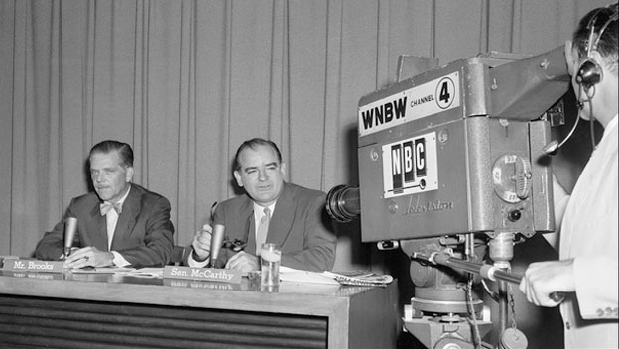
McCarthy Hearings
The McCarthy hearings were nationally televised from April-June 1954.
McCarthy was investigating army security, but the Army in turn charged him with seeking preferential treatment for a former member of his staff who had joined the Army

Slide 25
McCarthy Hearings
Televising the McCarthy hearings proved to be McCarthy’s undoing, as his aggressive interrogations, obnoxious demeanor, and constant interruptions of high ranking Army officers did not endear him to the viewers.
As a result of this, he lost his political power and was censured by the Senate in December, 1954. His reputation was ruined, and he died in May, 1957 from the effects of alcoholism.

Slide 26
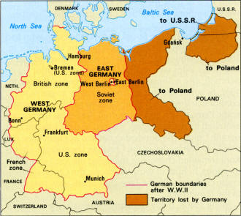
Berlin Wall
As the only “free” city in Soviet occupied Eastern Europe, West Berlin was the destination for refugees from Communism
In 1961, the East German government decides to build a wall to solve the refugee problem

Slide 27
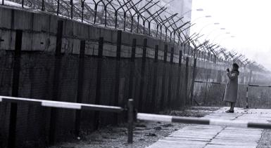
Berlin Wall

Slide 28
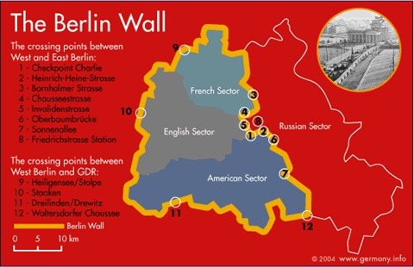
Berlin Wall

Slide 29
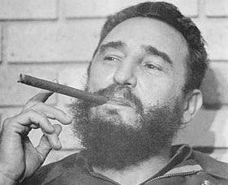
Cuba
1959 Revolution.
Fidel Castro leads a takeover of the dictaror Fulgencio Batista
Establishes Communist state
  Bay of Pigs, 1961
  Cuban Missile Crisis, 1962
  Cuban blockade

