Slide 1
The Cold War: Part Two
1963-1991

Slide 2
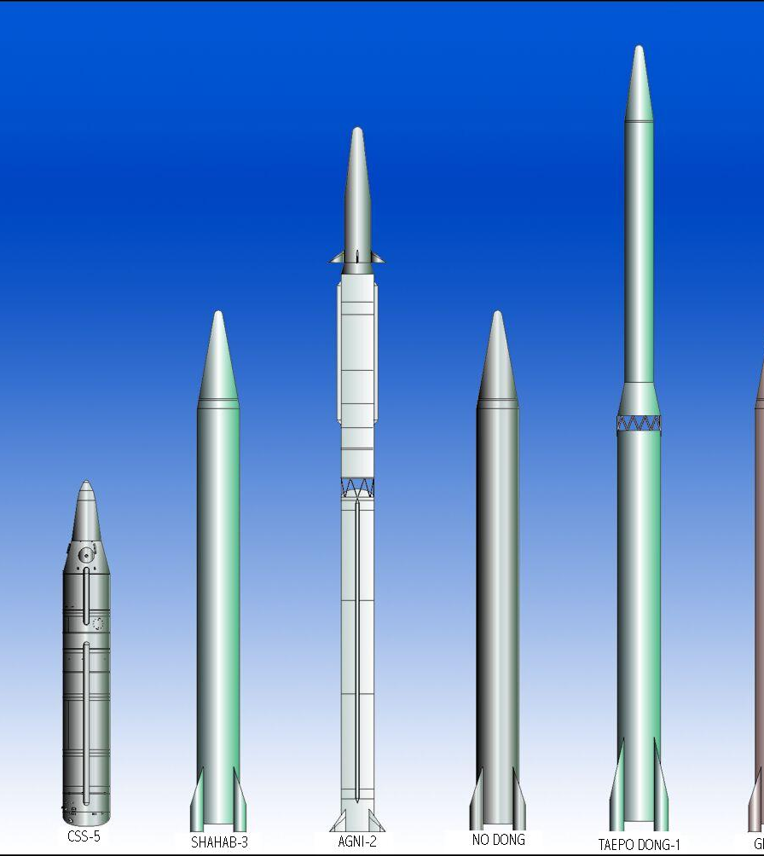
Cold War Basics
US vs. USSR
Enough nuclear weapons for Mutually Assured Destruction (MAD)
“Cold” because it was an arms race rather than a nation-to-nation combat
Featured “proxy wars” – Korea and Vietnam

Slide 3
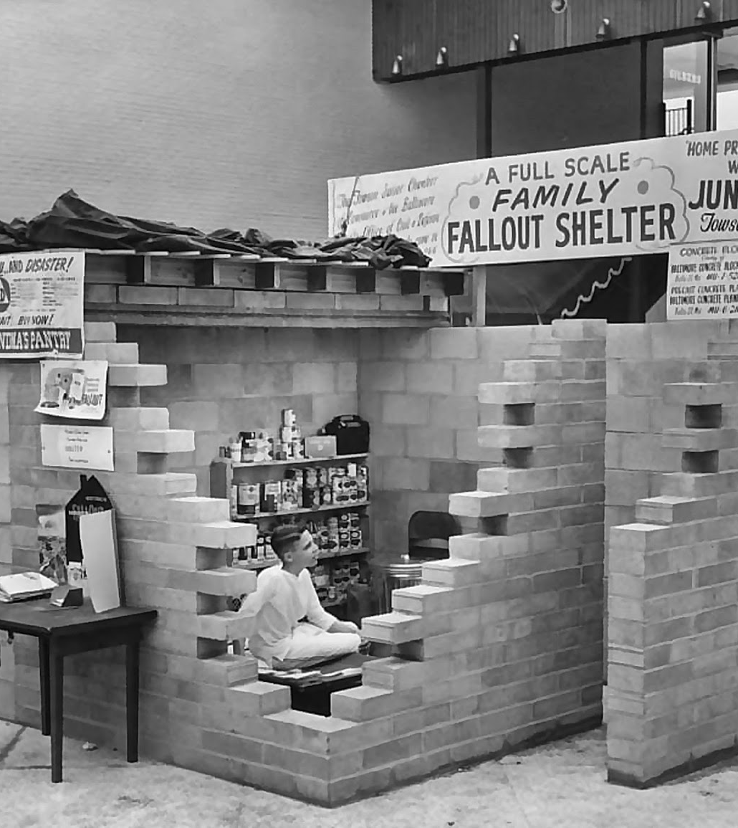
Fallout Shelters
People took the nuclear threat seriously enough that families and communities built fallout shelters to protect them from nuclear disaster

Slide 4
The 1960s
The 1960s were a decade of unrest and social upheaval in the US. There were many causes of this, but some of the most significant were:
  The Kennedy Assassination
  The Vietnam War
  The “Credibility Gap”
  The Development of Youth Culture
  The Civil Rights Movement

Slide 5
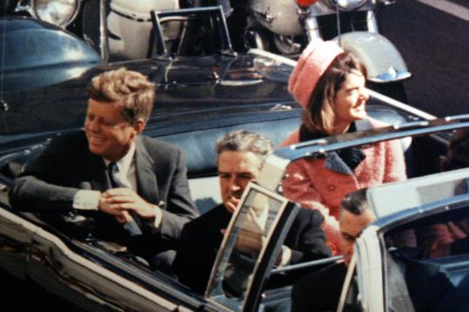
Kennedy is Assassinated
On November 22, 1963, President John F. Kennedy was shot by a sniper while riding in a parade in Dallas, TX.
There continues to be controversy over whether the gunman, Lee Harvey Oswald was acting alone, or if this was part of a larger conspiracy.

Slide 6
Kennedy Conspiracy?
Adding fuel to the conspiracy theory is the fact that Lee Harvey Oswald was murdered the next day while in police custody by Jack Ruby.
Some believe that Vice President Johnson was ambitious and well connected enough to order a hit on the President. Others see the fingerprints of FBI Director J. Edgar Hoover on this.
The Warren Commission, who investigated the assassination, did not find evidence of a conspiracy.

Slide 7
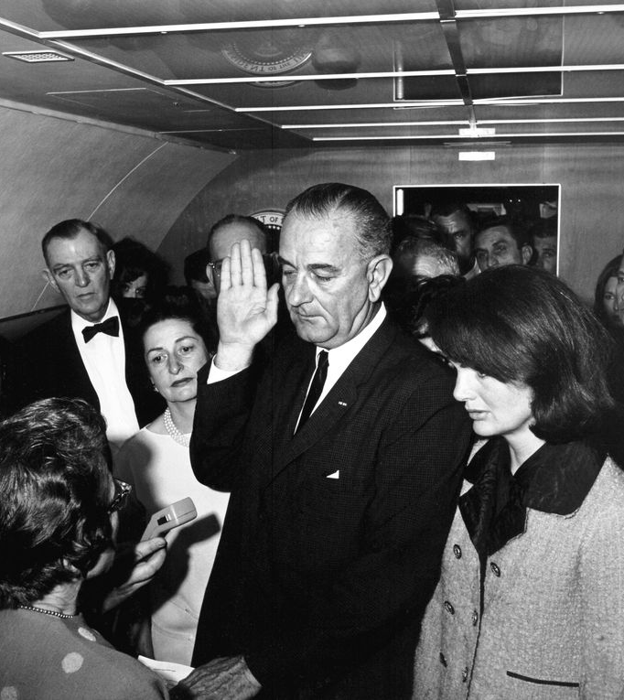
LBJ Becomes President
Lyndon Baines Johnson, the Vice President and former Senate Majority Leader, is sworn in as President on Air Force One.

Slide 8
Four Weak Presidents
Lyndon Baines Johnson (1963-1969)
Richard Milhous Nixon (1969-1974)
Gerald R. Ford (1974-1977)
Jimmy Carter (1977-1981)

Slide 9
LBJ is known for three initiatives
Civil Rights Legislation that resulted in the Voting Rights Act of 1965, which outlawed the practice of poll taxes and literacy tests to keep minority citizens from voting. This was seen by many as the culmination of the Civil Rights Movement that achieved national prominence in the 1950s

Slide 10
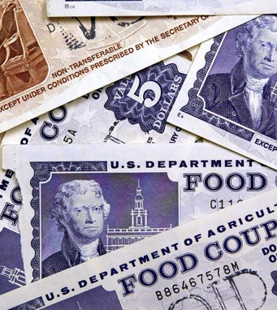
The Great Society
The Great Society was a series of programs that established much of the modern welfare system. Medicare, Medicaid, Welfare Payments, Food Stamps, and Aid to Families of Dependent Children were started in 1964-65

Slide 11
The Vietnam War
The Gulf on Tonkin incident on August 2, 1964 provoked American involvement in the war.
It was claimed that the USS Maddox was fired on by North Vietnamese missiles while patrolling in the Gulf of Tonkin, off the coast of Vietnam. There were also claims of a second incident on August 4.
Later investigations showed that both of these reports were highly doubtful.

Slide 12
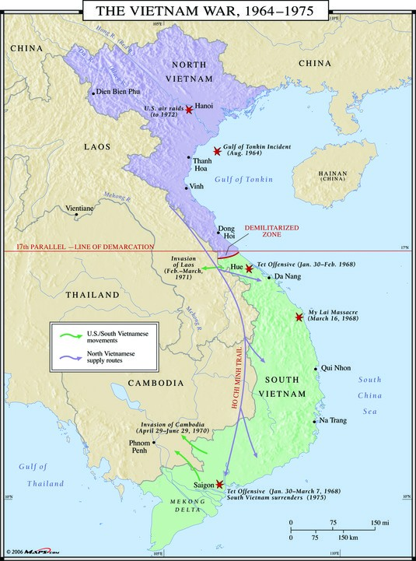
Gulf of Tonkin Resolution
Nevertheless, Congress authorized the President to conduct military operations in Southeast Asia without a declaration of war. This began a 10 year involvement in Vietnam that was costly in lives and spending and very unpopular with the American people.

Slide 13
Vietnam War
At its peak, the US deployed almost 400,000 men to Vietnam.
This was the first war in which live footage was shown on network news.
Americans were treated to the slaughter of their own troops while watching the news in the comfort of their homes.
Over 58,000 American lives were lost in Vietnman

Slide 14
Why Was This War So Unpopular?
It appeared that President Johnson’s escalation of American involvement was founded on dubious premises (the Gulf of Tonkin incident that probably really wasn’t, the domino theory of the expansion of Communism . . . )
This appearance of deception by the government began to lead to a great distrust of the government by the American people.
It was far away, didn’t seem to have anything to do with American interests, and the reasons for American involvement were not simple to explain

Slide 15
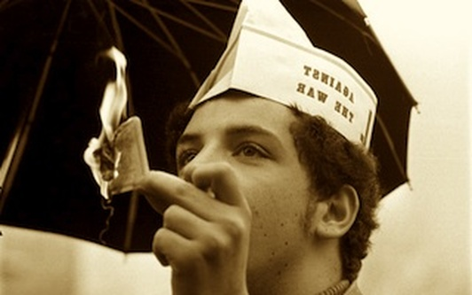
The Draft
From 1940-1973, the US Military used conscription (the draft) to fill personnel needs that volunteers could not fill.
Upon reaching 18 years of age, men were (and still are) required to register for Selective Service. Over two million soldiers were drafted during the Vietnam War

Slide 16
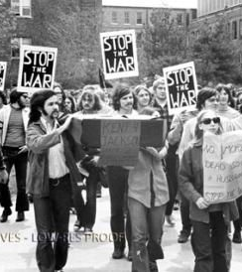
Protest Movements
Protests against the war broke out all across America, but particularly on college campuses.
This was the era of the “credibility gap.’ For each new escalation in Vietnam, the President promised victory. However, all that these led to were further escalations in American involvement.

Slide 17
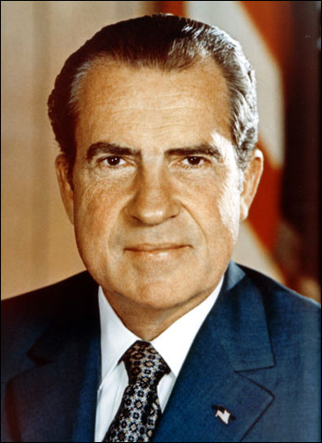
Nixon gets elected
In the 1968 election, President Johnson had lost the support of his own party and did not run for re-election. Richard M. Nixon, Eisenhower’s Vice-President, won the election on a peace platform.

Slide 18
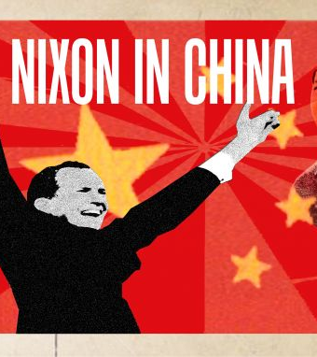
3 Features of Nixon Administration
Withdrawl of American troops from Vietnam and peace treaty (took two terms to do this)
“Détente” – a new approach to relations with Communist nations
Watergate and impeachment

Slide 19
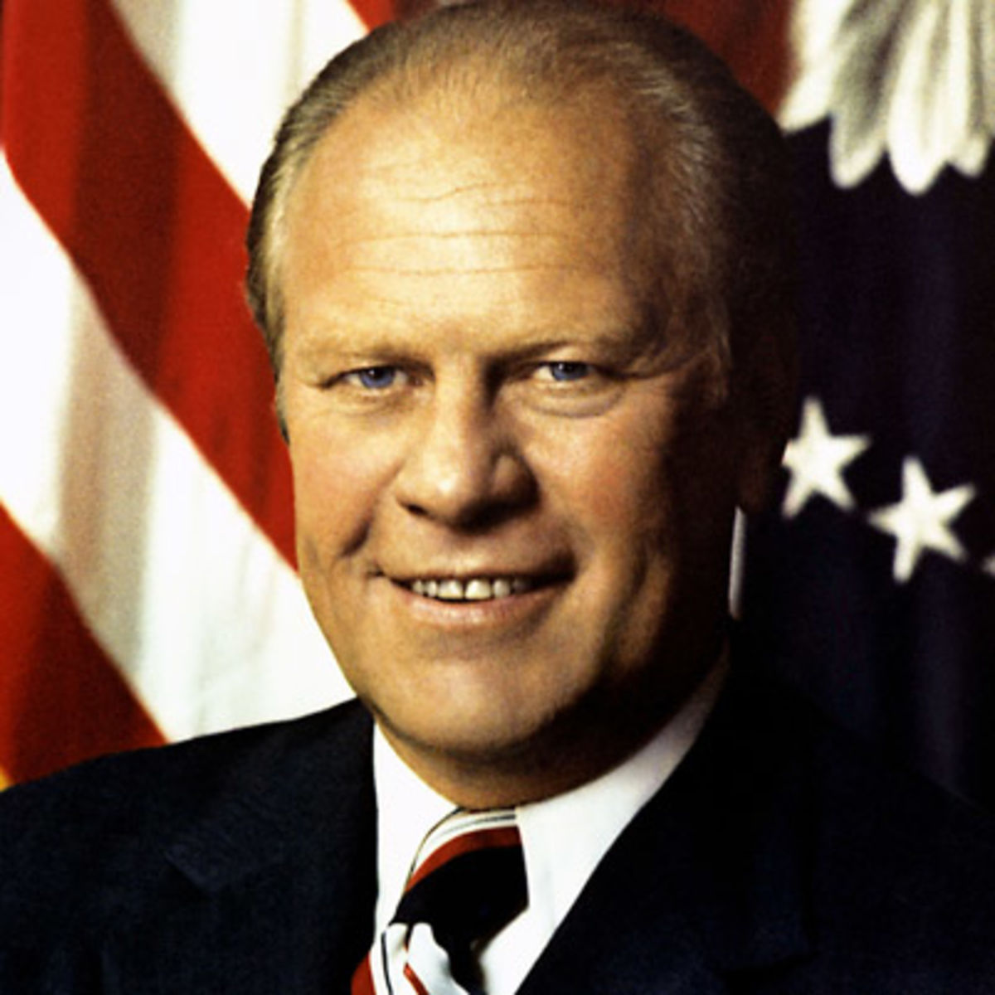
Nixon Resigns To Avoid Impeachment
Watergate Scandal and obstruction of justice.
Nixon probably would have been removed from office and perhaps even prosecuted in crimminal court.
Nixon resigns on August 9, 1974, and is immediately pardoned by the new President, Gerald R. Ford

Slide 20
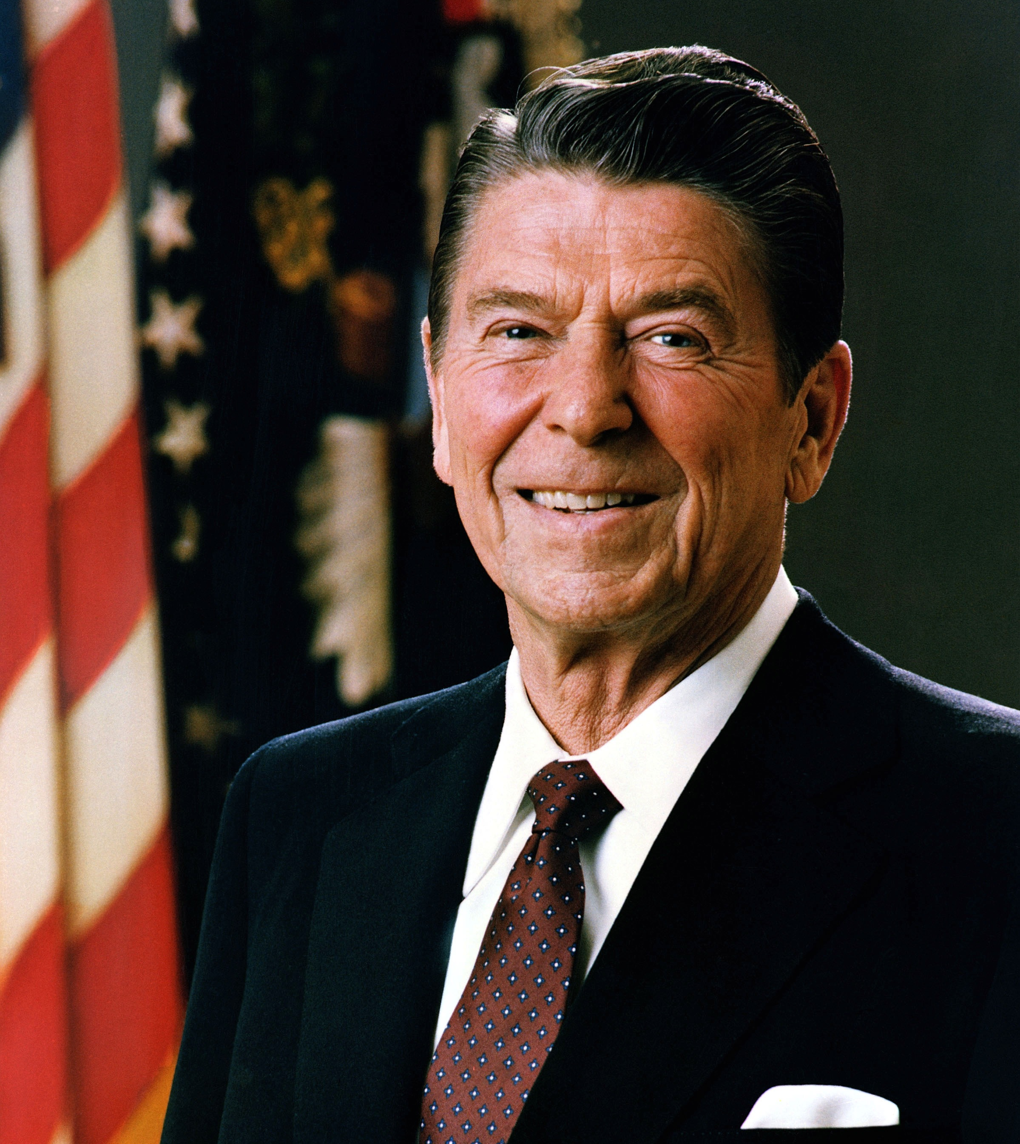
Election of Ronald Reagan
Both Ford and Jimmy Carter were weak Presidents.
In the aftermath of Vietman and Watergate, the media had taken an adversarial role to the office of President. Trust between the office of the President and the American people had broken down

Slide 21
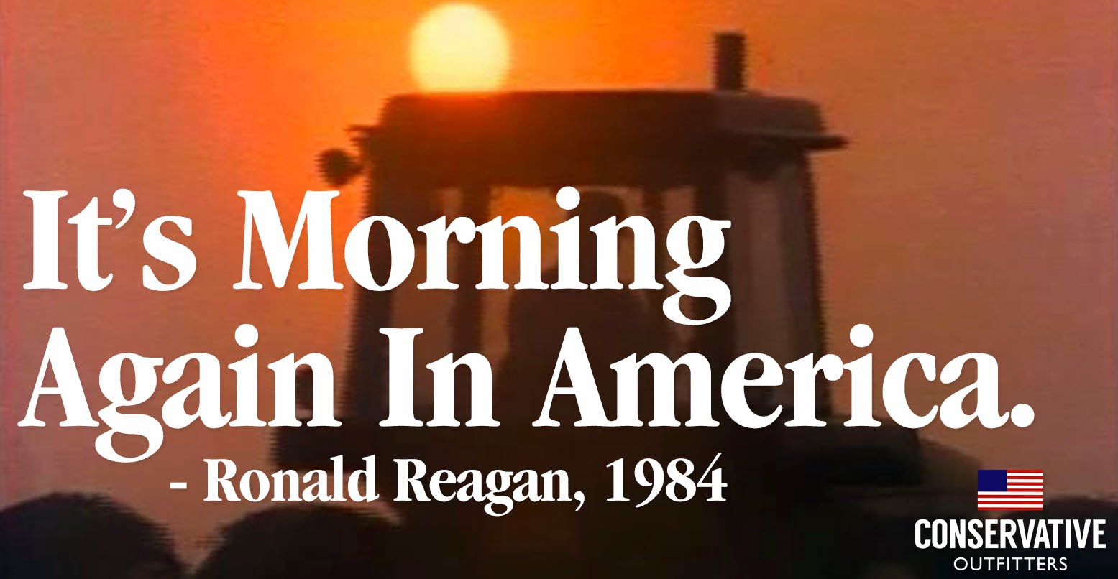
The Reagan Presidency

Slide 22
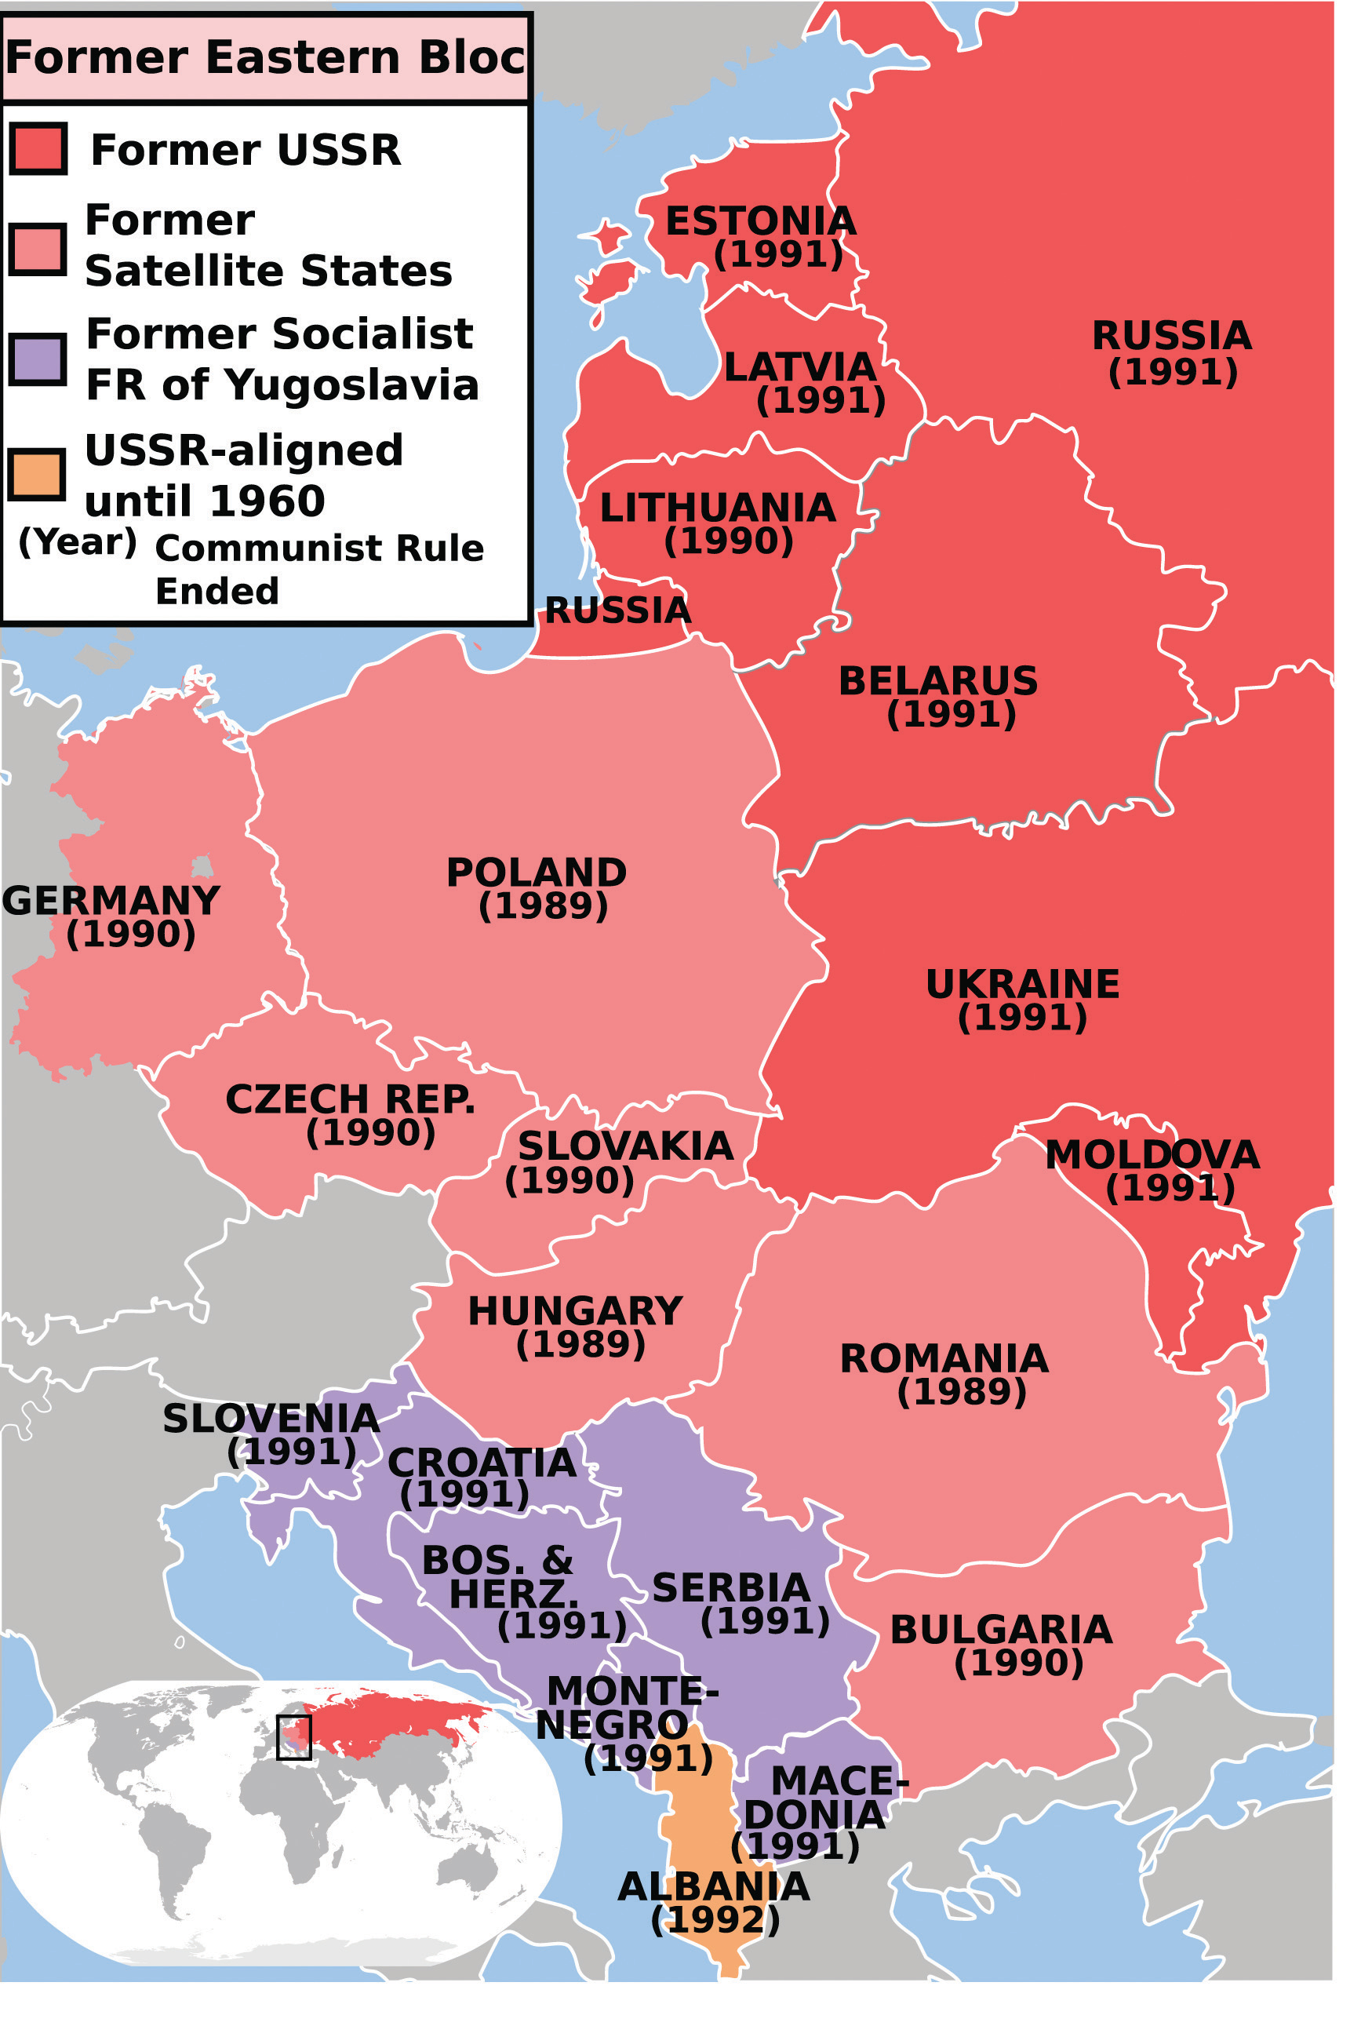
End of Cold War
Reagan’s approach – increase defense spending. Therefore, the USSR would have to increase defense spending as well, not only to defend themselves, but also their satellite nations.

Slide 23
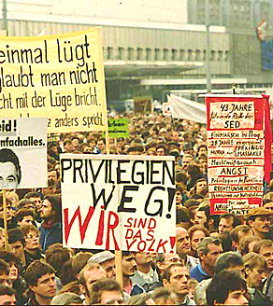
End of Cold War
Many people saw Reagan’s approach as utter foolishness.
However, when the Soviet government was unable to provide basic needs to its citizens, and their satellite nations as well, these nations began to crumble from within.

Slide 24
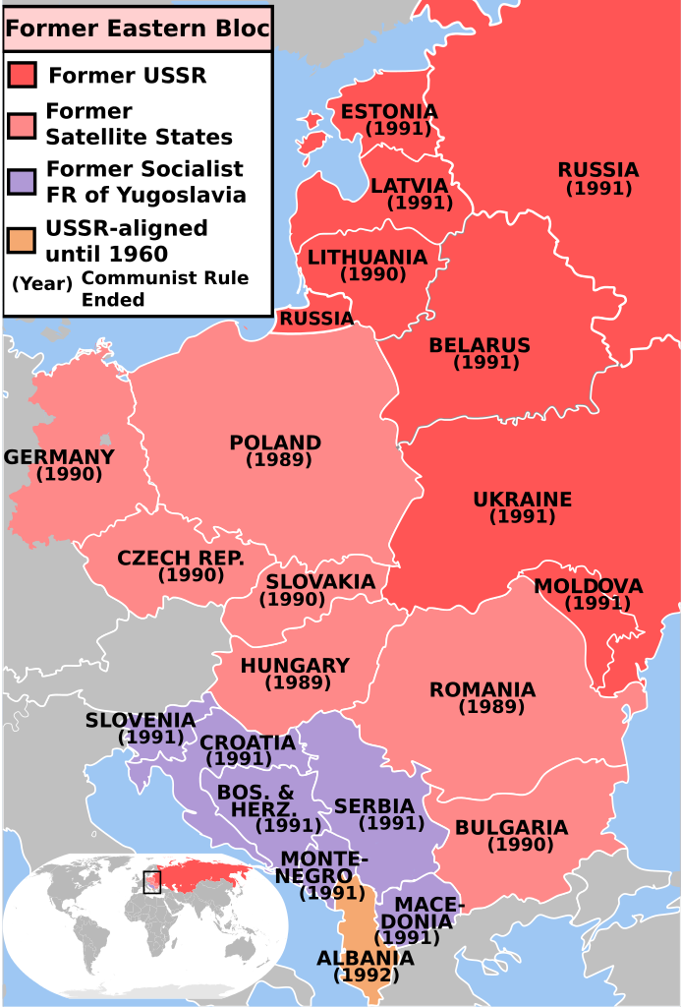
Progress of Communism’s Fall

Slide 25
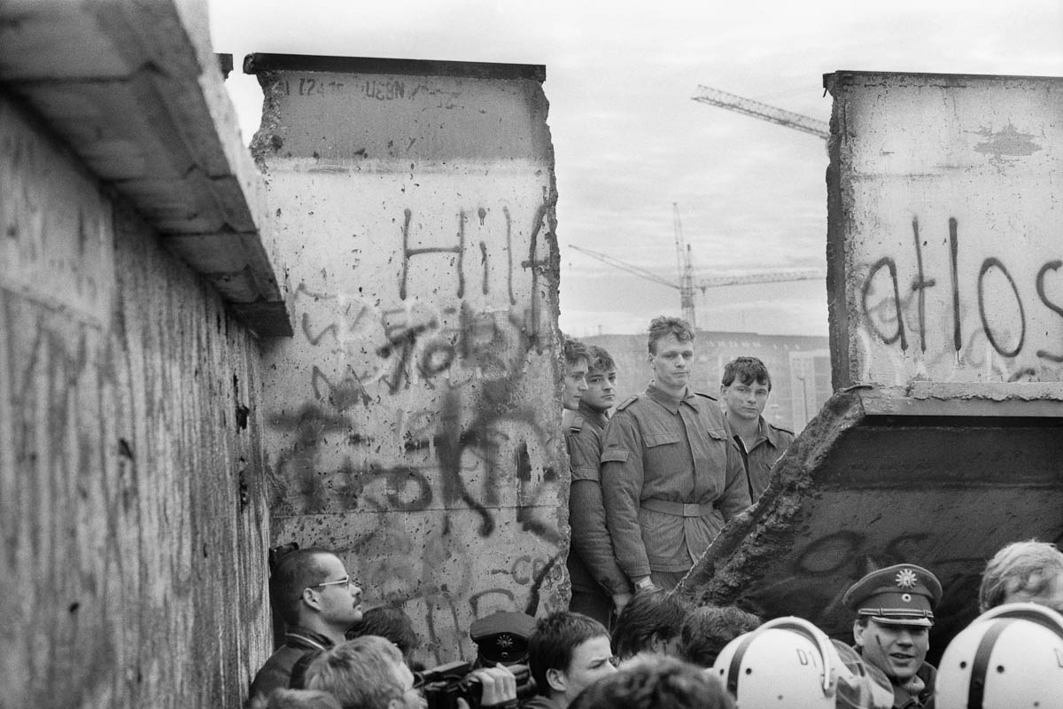
Berlin Wall is Destroyed
Perhaps the greatest symbol of the destruction of Communism was the destruction of the Berlin Wall from 1990-1992

Slide 26
Cold War Ends
The Cold War is over in 1992.
Rejoicing did not last long, as the First Gulf War in 1992 inaugurated Fourth Generation Warfare

