Slide 1
Boom to Bust
The Great Depression
1928-late 1930’s

Slide 2
Postwar Economic Prosperity
The 1920’s was the most economically prosperous decade in American history until that point.
More businesses started each year than ever before
Corporations became much larger as manufacturing was done on a far greater scale than previously
Unemployment was lower than any time previously in US History

Slide 3
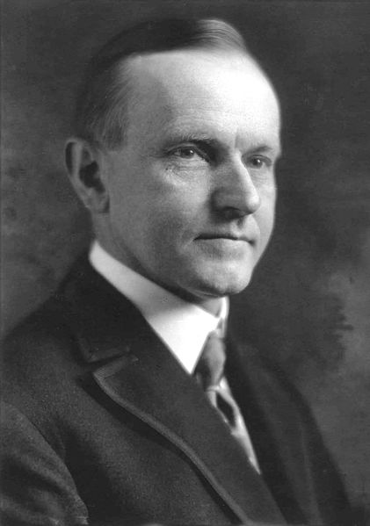
Postwar Economic Prosperity
Under President Calvin Coolidge’s business friendly policies, taxes were lowered, and government budget surpluses were created every year.

Slide 4
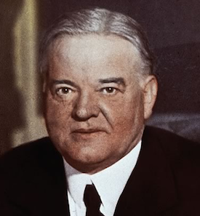
Hoover predicts poverty’s end
“We in America today are nearer to the final triumph over poverty than ever before in the history of any land. We shall soon, with the help of God, be in sight of the day when poverty will be banished from this nation . . . “

Slide 5
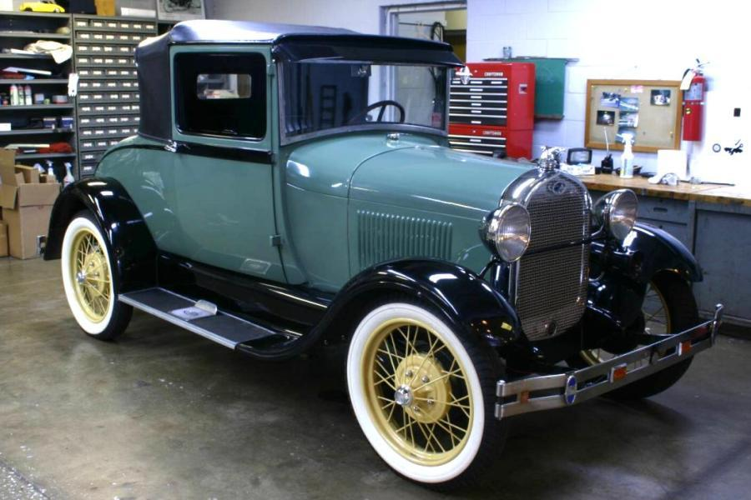
A Consumer Society
By 1930, almost 30 million cars were on the roads.
Credit corporations were set up to enable people to pay on time for cars and other goods.
Most of America now had electricity, which created demand for consumer goods

Slide 6
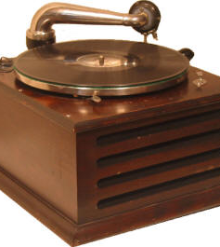
New Products
Record players
Refrigerators
Electric irons
Telephones
Electric Lighting
Magazines with mass advertising

Slide 7
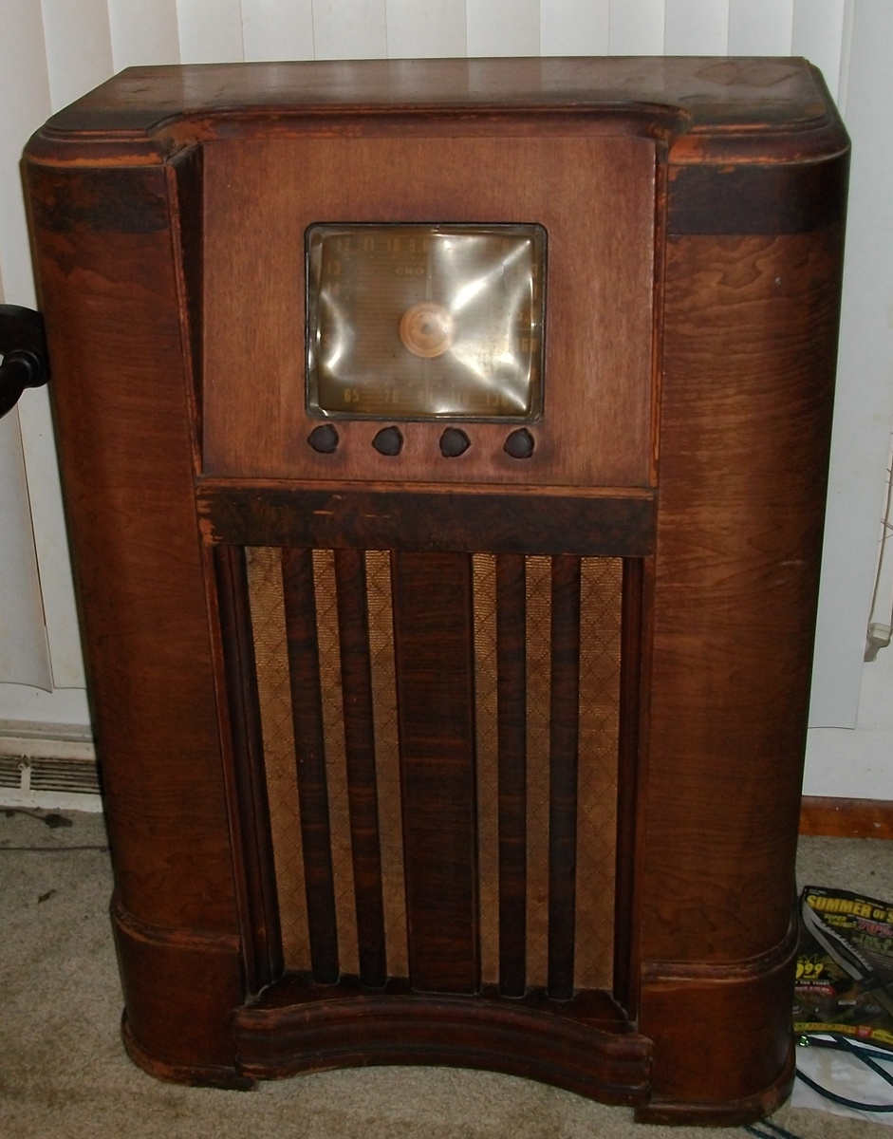
Radio
Radio became the dominant media in the 1920s.
KDKA in Pittsburgh broadcasted the first election returns in 1920. Very quickly, other radio stations were set up and programs were nationally syndicated.
Radio would be the dominant media until the 1950s.

Slide 8
So, what happened?
It seems like everything was going great!
People and businesses making money
New products
Higher standard of living
Unprecedented growth in economy
The problem was, government, businesses, and consumers acted as though the exponential economic growth of the 20s would last forever!

Slide 9
Causes of Depression
Spiraling of consumer debt and inability to pay
Speculation
People bought land with the hopes of selling it for a huge profit. Often, this didn’t work out and they couldn’t make the payments on the land.
South Florida – Hurricane in 1926
Stock Market – buying stock on margin (credit) and hoping the price of the stock would continue to rise.

Slide 10
Why was this bad?
If banks offered loans and credit too freely, what would happen if some catastrophic event took place and people decided that they would rather clear out their bank account and have cash?

Slide 11
Stock Market Crash
How did this affect so many Americans? Most people didn’t own stock!
October 24, 1929 (Black Thursday), fear spread throughout the market. Stock prices had been falling throughout October, but on Black Thursday, sellers began to try to dump their stock.
The leading financial institutions pitched in to bail out the market, but not before prices had fallen significantly

Slide 12
Black Tuesday
October 29, 1929, more than 16 million shares were dumped on the market.
Investors lost $30 billion on that day alone.
The hope was that this was a temporary recalibration of the stock market

Slide 13
Great Depression
ALL of the causes of the Great Depression originate in government action
As the government attempts to implement proposed solutions to the Great Depression, many of these will have the effect of furthering the Depression, and even saddling future generations of Americans with debt.

Slide 14
Great Depression
Actually, there were four consecutive major depressions that form what we now call the “Great Depression”
Consequences of World War I and Treaty of Versailles. European nations were heavily indebted to US for cost of war. When Germany could not make reparation payments, Great Britain and France could not make payments to US . . . .

Slide 15
Great Depression
Policies of the Federal Reserve System. The Federal Reserve Bank is the Bank of the US that loans money to banks.
Throughout the 1920s, they inflated the money supply, encouraging the boom and making credit easily available.
After the Stock Market Crash, they raised interest rates, which prolonged the economic crisis.
3. Smoot-Hawley Tariff: The highest tariff in US History, it had the effect of closing America off to foreign trade because other nations retaliated with high tariffs on imports from the US.

Slide 16
“Thanks Hoover!”
President Hoover receives much of the blame for the Great Depression.
The popular version of history is that Hoover got America into the Depression and Roosevelt got America out of the Depression.
The reality is that many factors beyond President Hoover’s control caused the Depression, and that initiatives taken by Presidents Hoover and Roosevelt furthered the Depression.

Slide 17
Economic Downturn
The American economy didn’t collapse all at once in October 1929.
A “market correction” was inevitable after the enormous economic boom of the 1920s.
Economic growth is dependent on many variables.
“Record Breaking” economic growth without interruption is not sustainable.

Slide 18
Unemployment . . . Poverty . . . Despair
Unemployment, poverty, and despair are typically what we think of when we think of the Great Depression.
Buying, selling, investing . . . Are all dependent on emotional factors
Hoover was trying to keep morale high. He thought a “depression” was less emotionally loaded than a “panic” or a “recession”!

Slide 19
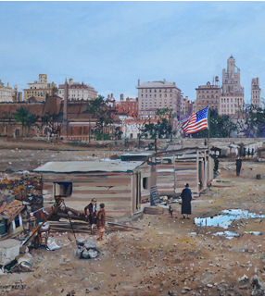
Common people
Inflation of money supply led to loss of purchasing power
Loss of purchasing power led consumers to not purchase
Decrease in demand led to slowing of production and worker layoffs
Increase in unemployment to less purchasing and consumption . . .

Slide 20
Hoover takes initiative
President Hoover’s reputation is that he did nothing to try to end the Depression.
This is an unfair reputation. President Hoover was willing to take government initiative in areas where the government had never been involved before. FDR’s policies were actually nothing more than a continuation of Hoover’s policies.

Slide 21
Hoover’s initiatives
1929: Tax cuts of $140 million + increase of $420 million on public works (what President Obama called “shovel-ready”) jobs.
1932: Revenue act which increased taxation by imposing national sales taxes , raising personal income tax, corporate income tax, and gift and estate taxes.
Expanded credit in hope of stimulating the eonomy

Slide 22
Hoover’s initiatives
Increasing taxation on declining wages? How will that “jump start” business initiatives, consumer spending, etc.?
Increasing government spending when everyone else must necessarily decrease spending?

