Slide 1
The Great Depression
1929-1941
Part Two

Slide 2
The Depression Worsens
By 1932, it was apparent that America was experience a deep economic downturn:
  Gross National Product (GNP), the total of all goods and services produced in the US:
    1929: $104 billion
    1932: $41 billion
  5000 + banks failed
  86,000 + businesses closed
  250,000 families evicted from homes
  Over ¼ of the population had no income at all.

Slide 3
Bonus Army
Probably the episode that eliminated any chance of President Hoover being reelected.
The “Bonus Army” earned its name from the practice of the US government giving veterans of war bonuses for their service. The bonus certificates promised to World War I veterans were not redeemable until 1945.
43,000 people – 17,000 veterans and their families marched on Washington in the spring and summer of 1932 to request an early payment of their bonus.

Slide 4
Bonus Army
President Hoover refused to meet with any of the soldiers or discuss their demands.
Meanwhile, they began to camp out on the edge of Washington DC.
On July 28, government agents told the Bonus Army that they must disperse. They refused, and went after the DC Police with bricks. Policemen began to fire on the veterans, killing two and wounding others.

Slide 5
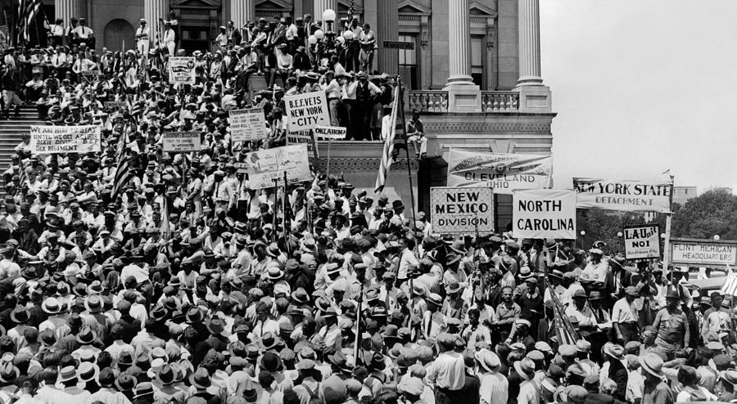
Bonus Army at Capitol

Slide 6
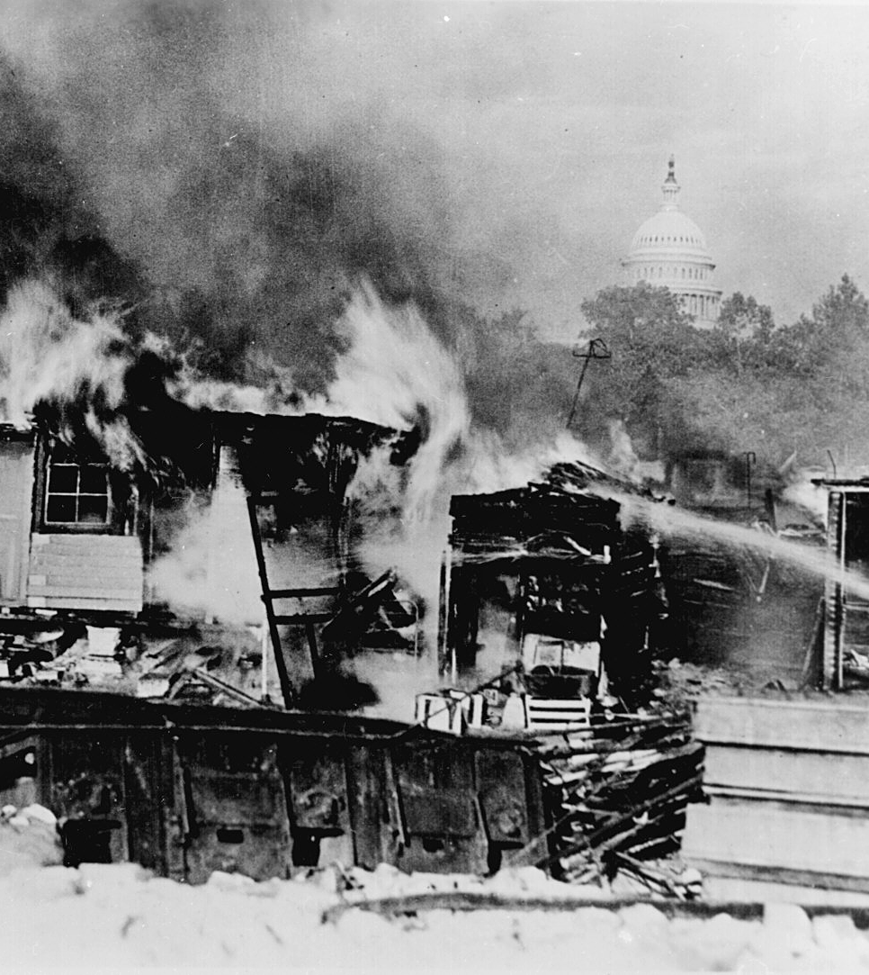
Bonus Army
President Hoover then directed Federal troops under General Douglas MacArthur to destroy the camps and disperse the marchers. General MacArthur went after them with tanks, tear gas, and bayonets.
For many people, this episode symbolized what they perceived to be the lack of empathy from the Administration for hurting people.

Slide 7
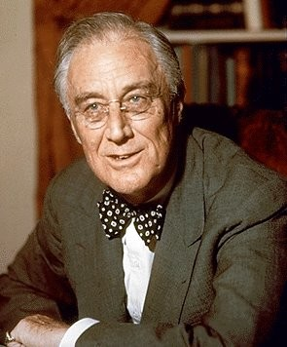
1932 Election
Franklin Delano Roosevelt (FDR), the Democratic Governor of New York, won the Presidential Election by an overwhelming majority in 1932. Democratic majorities were elected to both houses of Congress.

Slide 8
Government Provided Relief
Relief is aid provided to people in need.
Prior to the Roosevelt administration, relief was generally not seen as a federal responsibility, but was entrusted to churches, nonprofit organizations, local, and state governments.
The thinking was that local agencies who actually knew the people they were trying to help were better able to “separate the needy from the greedy.”

Slide 9
Relief expands Federal Power
Federal poverty relief expands federal power, as needs and allocations are determined by government agencies.
Relief cannot go unfunded, therefore, taxes need to be raised.
The net effect was a redistribution of wealth from those with means to those without

Slide 10
The New Deal
President Roosevelt promised Federal intervention to alleviate poverty and unemployment. He introduced many new government programs, in what was called the
“New Deal.”
FDR’s goals for the New Deal:
  Relief
  Recovery
  Reform

Slide 11
First Actions
Special Session of Congress in March, 1933
  The “Hundred Days”
  “Bank Holiday” – closed banks for four days to avoid runs on banks
  Took America off Gold Standard and forced Americans to turn in gold in exchange for paper money
  Congress remained in emergency session from March 9 until June 16.

Slide 12
New Deal Programs
New Deal legislation created a large number of programs that were known by their initials: CCC, WPA, PWA, AAA, TVA, FDIC, and others.
The idea was that government spending would put people back to work and stimulate the economy. This was the beginning of the large national debt that the US has today and of deficit spending by the Federal government.

Slide 13
Work Relief
The idea behind New Deal agencies was that they would provide work relief.
Instead of giving people handouts, the government would create public works projects – roads, bridges, parks . . and put people to work on these projects.
This broadened the activity and authority of the Federal government exponentially.

Slide 14
Important Programs
Civilian Conservation Corps (CCC): put young unmarried men under the supervision of the army in reforestation and soil conservation projects.
Public Works Administration (PWA): built public facilities – schools, courthouses, hospitals, prisons, roads . . . All over the country
Works Progress Administration (WPA): tried to employ people in almost any kind of job. People believed that it was “make work.”

Slide 15
Important Programs
Agricultural Adjustment Act (AAA): Provided price supports for farmers. Induced farmers to plow up cotton and slaughter pigs in attempting to keep prices higher.
Federal Deposit Insurance Corporation (FDIC): Provided federal insurance for bank deposits.
Tennessee Valley Authority (TVA): Built dams that would provide flood control and electrification for residents in the Tennessee Valley.

Slide 16
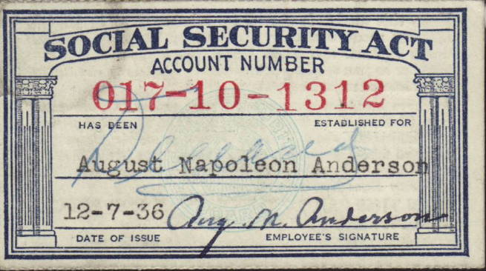
Important Programs
Social Security Act: In 1935, Congress passed this piece of legislation instituting old age pensions and unemployment insurance.
  Thought there would always be more “payers” than recipients.
  Is now “paying” more than its “receiving”

Slide 17
Supreme Court Reaction
While Roosevelt continued to seek to expand federal powers into new areas, he faced opposition from the Supreme Court, who ruled that several New Deal programs were unconstitutional.
Roosevelt responded with his “court packing” plan, attempting to expand the Supreme Court to 15 justices so that he could pick the majority of them.

Slide 18
Success???
In spite of all these efforts, the Depression continued until the 1940s.
It could be argued that the federal government prolonged the Depression. By seizing the initiative in relief and in regulating business with legislation such as minimum wage, frequent inspections, and onerous regulations, entrepreneurship was discouraged. Unemployment remained at 20-25% through the 1930s.

Slide 19
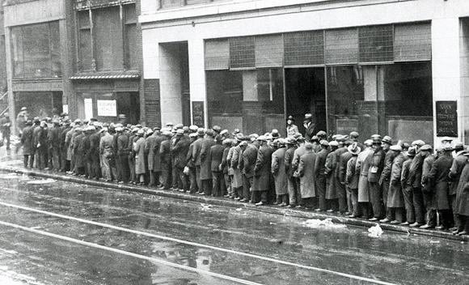
Bread Lines

Slide 20
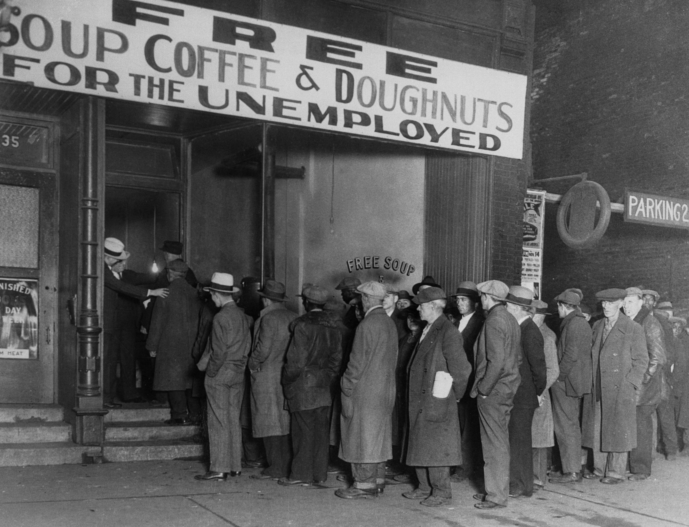
Soup Kitchens

Slide 21
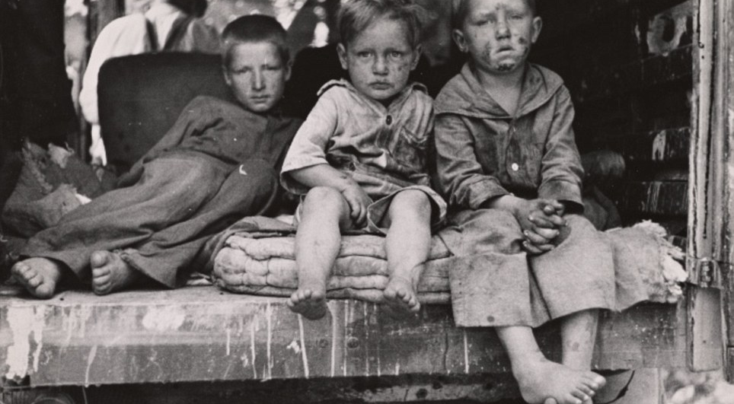
Malnutrition

Slide 22
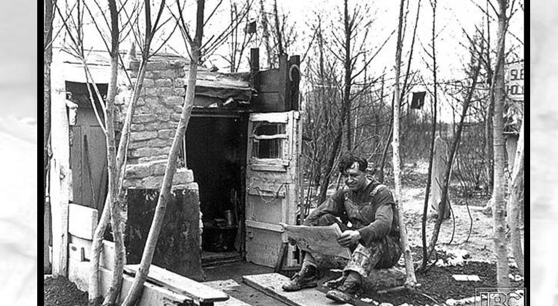
Homelessness

Slide 23
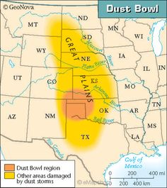
Dust Bowl
From the early 1900s, farmers eked out a precarious existence in the Great Plains.
From 1932-1936, falling prices combined with unprecedented drought made farming nearly impossible.

Slide 24
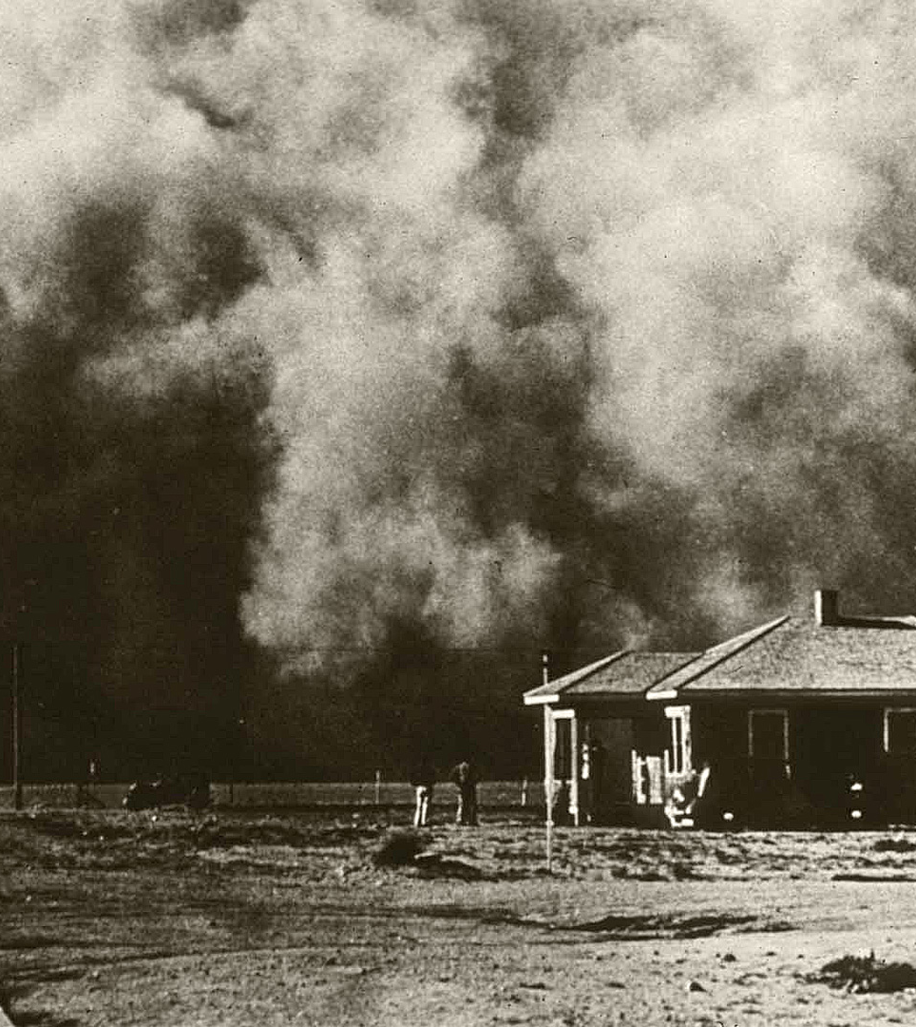
Dust Bowl
Prairie winds combined with drought to take off the topsoil and create huge dust storms, even filling houses and nearly suffocating people who went outside.
Many counties in the Great Plains experienced a loss of 2/3 to ¾ of their population.

Slide 25
The Dust Bowl brought ecological, economical and human misery to America during a time when it was already suffering under the Great Depression. What circumstances conspired to cause the Dust Bowl?
Economic depression
extended drought
unusually high temperatures
poor agricultural practices
resulting wind erosion

Slide 26
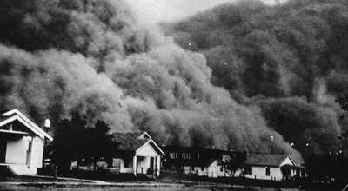
Dust Bowl, Oklahoma

Slide 27
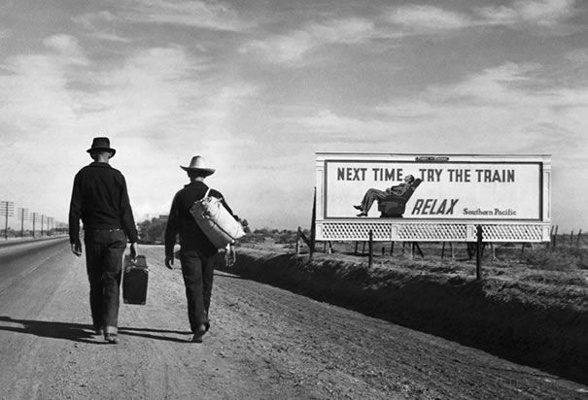
Okies and Arkies
Since their land was now worthless, many of these farmers became migrant workers, working their way across the plains into California by picking cotton and other crops. These people were desperately poor. John Steinbeck’s The Grapes of Wrath captures the lifestyle of the Okies and Arkies

Slide 28
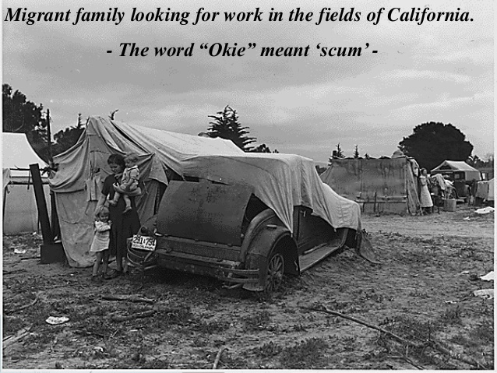
Attitude toward migrants

Slide 29
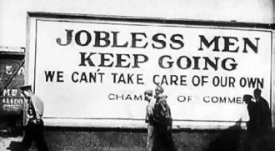
Welcome! Now go home!

Slide 30
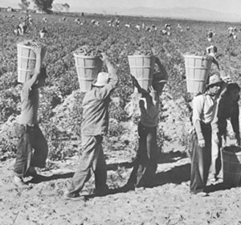
Picking grapes in California

