Slide 1
Iliad: A Timeline
What happened over the forty days?
Source: Eva Brann, “Odysseus At War,” in Homeric Moments. (Philadephia: Paul Dry Books. 200)2. 60-62.

Slide 2
Beginning
Days 1-9:
  There is a plague throughout the Greek camp (1:53). Many warriors are dying of sickness.
Day 10:
  --Achilles calls an assembly.
  -- Chryseis, Agamemnon’s war prize, must be returned to Chryses, priest of Apollo, to stop the plague
  --Agamemnon takes Briseis from Achilles in compensation of Chryseis.

Slide 3
Beginning
Day 10
  As a consequence of Agamemnon taking Briseis from Achilles and publicly shaming him, Achilles withdraws from the fighting.
Day 11
  Odysseus returns Chryseis to Chryses to stop the plague

Slide 4
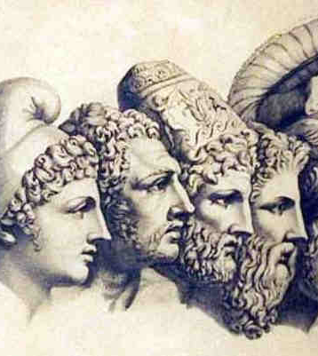
First Assembly of the Gods
Day 12: Zeus grants the prayer of Achilles and Thetis to give the Trojans the advantage.
(Days 1-12 take place in Book 1).

Slide 5
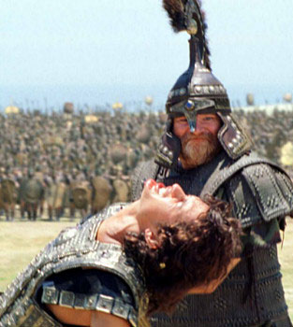
Action
Days 13-15:
  Duel between Paris and Menelaus.
  Greeks build walls.
  Duel between Hector and Ajax (Books 2-8)

Slide 6
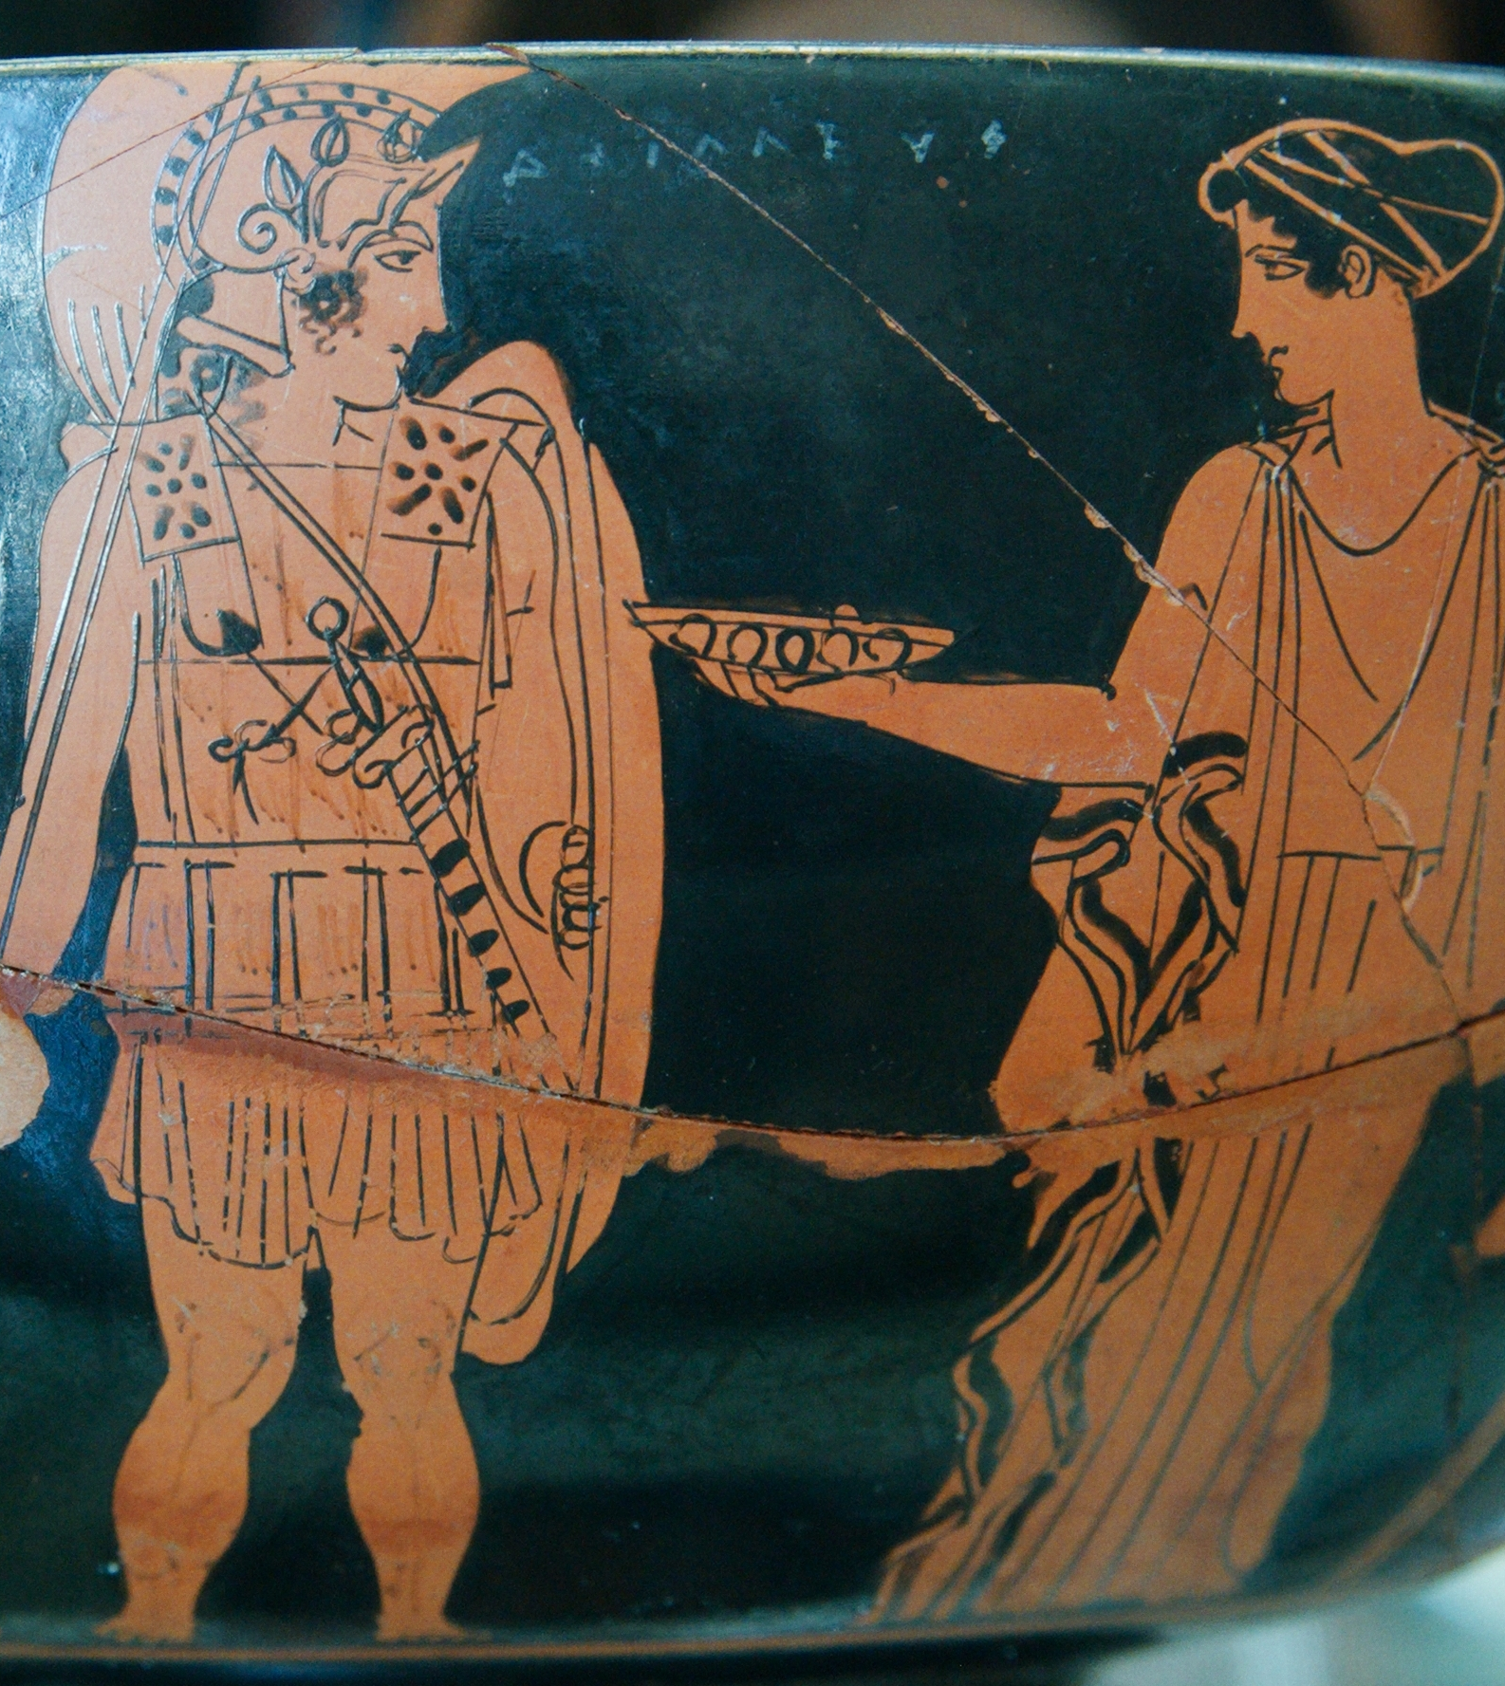
Action
Day 16
  Odysseus and company visit Achilles (Book 9)
Night 16
  Odysseus and Diomedes go on a night raid (Book 10)
Day 17
  Ships set on fire
  Duel between Hector and Patroclus
  Achilles returns to battle (Books 11-17)

Slide 7
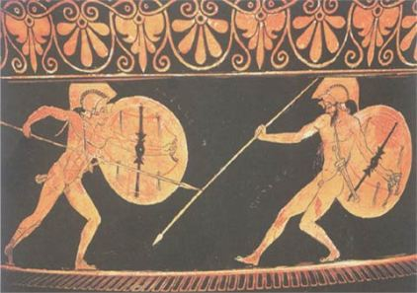
Action
Day 18: Achilles and Hector duel (Books 19-22)
Days 19-20: Funeral games (Book 23)
Days 21-30: The gods debate among themselves (Book 24:107)

Slide 8
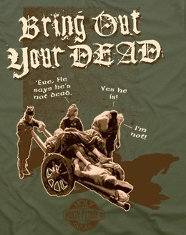
Last Assembly of the gods
Day 30: Thetis is sent to order the release of the bodies of the dead (Book 24:31, 112).
Night 30: The bodies of the dead are returned (Book 24).

Slide 9
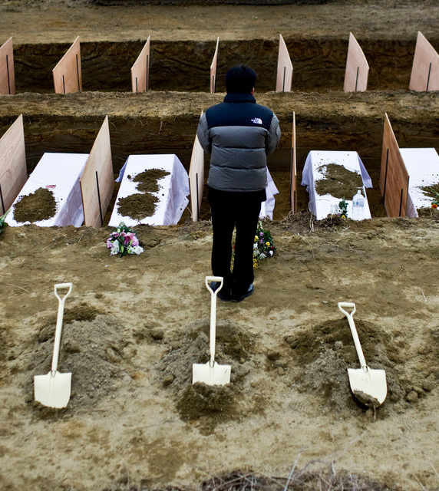
Afterword
Days 31-40: Preparation for funerals
Day 40: A hero’s funeral (Book 24).

