Slide 1
Republic, Books II and III
Justice implemented in the city

Slide 3
Justice Refined
In Book I, the subject of justice was discussed and the conversational parties were led to somewhat of a consensus of what justice is.

Slide 4
Good
3 Forms of the Good
  That which is good in itself
  That which is good in both its means and ends
  That which may not be good in itself but its outcome is good

Slide 5
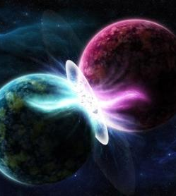
Plato’s concept of reality
1. The world of appearances = image of the world of reality, that is, this world. What we have in this world are imperfect copies of the true realities in the world of reality.
2. The world of reality=ideal world where perfect virtues of truth, beauty, justice, and goodness exists.

Slide 6
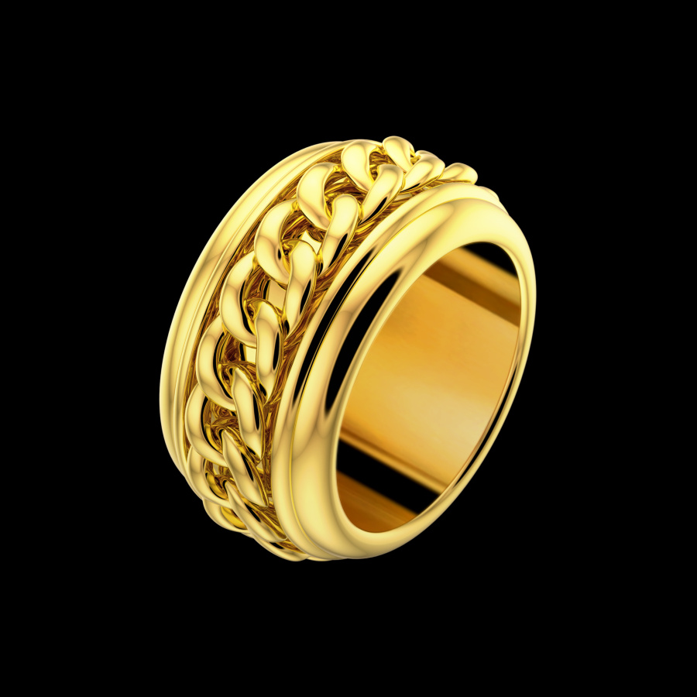
Ring of Gyges
Character
Invisibility
The Ring of Gyges (358d-361d) demonstrates that without an objective virtue of goodness that is beyond the world of apperances, that justice is impossible

Slide 7
Accurate prediction of Just Man
362a: “They’ll say that the just man who has such a disposition will be whipped; he’ll be racked; he’ll be bound; he’ll have both his eyes burned out; and at the end, when he has undergone every sort of evil, he’ll be crucified and know that one shouldn’t wish to be, to to seem to be, just”

Slide 8

Eye Chart
If we can “make the same letters bigger and in a larger place . . . “ (368d).
“The bigger . . . May be easier to observe closely” (369a).

Slide 9
Consequences of Eye Chart
Hinge on which the book turns
Specifies the working model of justice from an ethereal ideal to how it applies to communities.

Slide 10

Needs of the City
369b: not self sufficient
369c-371a: labor is divided and specialized
374e: begins to make case for guardians – who and what the book is largely about

Slide 11
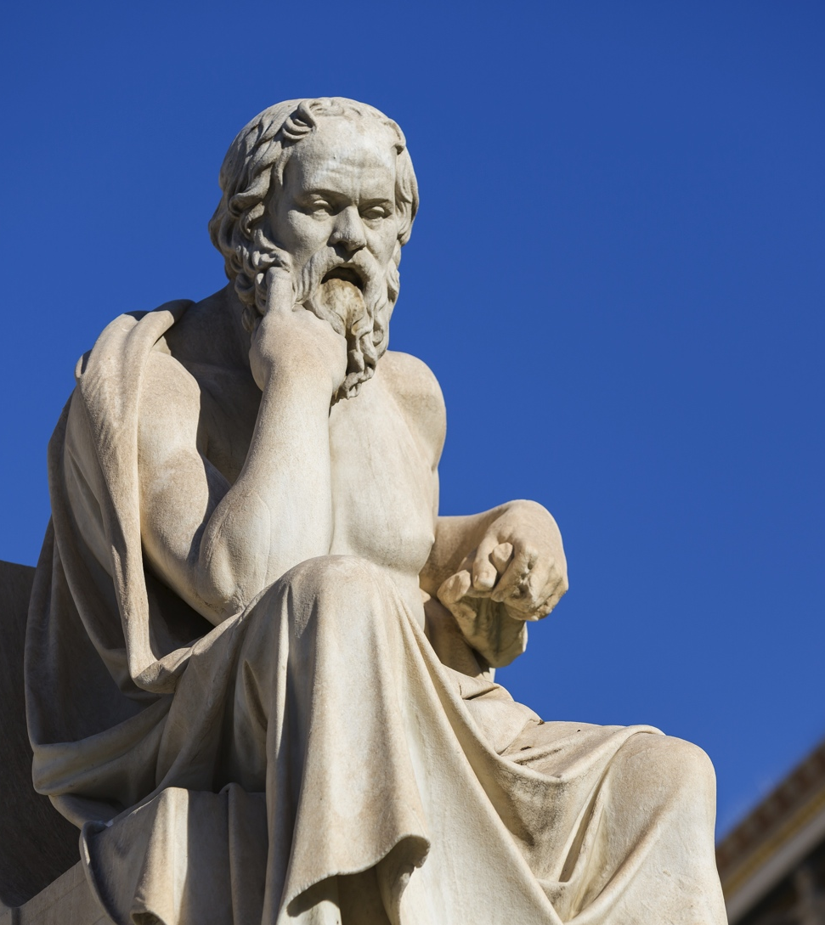
Guardians
375: Guardians must be able and prepared.
376c: They must be philosophers and love learning
376c and d: Must be specially reared and educated

Slide 12

Components of Guardian’s Education
Music: corresponds to liberal arts/heart
Mathematics: geometry, astronomy, higher mathematics/mind
Gymnastics: physical education/will

Slide 13
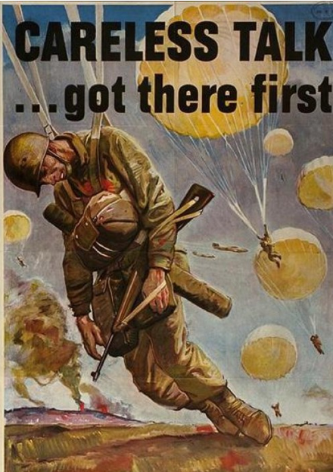
Censorship
Content of education of guardians is heavily regulated.
Note how Homer, et. al. are changed to conform to the required virtues for governing

Slide 14
What Plato’s Censorship Shows Us
1. Education is primarily moral. Plato is seeking to build virtue into the guardians first, and then knowledge.
2. Education is formative. Rather than “containers to be filled,” there is a formative value from music, mathematics, literature, and the discipline of physical fitness that is a good apart from the tangible benefits of such activites.

Slide 15
Censorship, cotd.
3. Inevitably, choices must be made in what is included in one’s education or what is excluded. For Plato, if it would not build the virtues necessary for guardianship, it was left out.

Slide 16
The Noble Lie
378a: The “noble lie” is an alteration of the truth to encourage virtue. In Book III, we will see that the Noble Lie is built around Plato’s belief in inequality.
Plato recognizes the need to create “myths” to undergird a sense of purpose and identity for the “city that is formed in speech.”

Slide 17
Classic Sense of Myth
The word myth, in its academic definition, means a story with deep power and symbolic meaning. When studied in the academic sense, it's that meaning that is important, not whether the story actually happened or not. Thus ancient 'myths’. . . Were important for what they said and the effect they had on those societies . . .

Slide 18
“Myth” Summarized
“Myth is a story capable of changing lives and cultures.” Myths are sometimes true, as C. S. Lewis referred to Christianity as “the true myth”. Their truth or falsehood is secondary to their formative value.

Slide 19
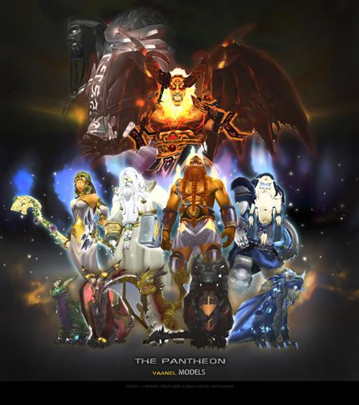
Myth and Noble LIe
In Book III, Plato begins to develop more city myths and the noble lie.
386a-390c: Plato makes the case to invent a religion that will inspire people to gives their lives for the Republic, rather than inheriting the Pantheon of gods.

Slide 20
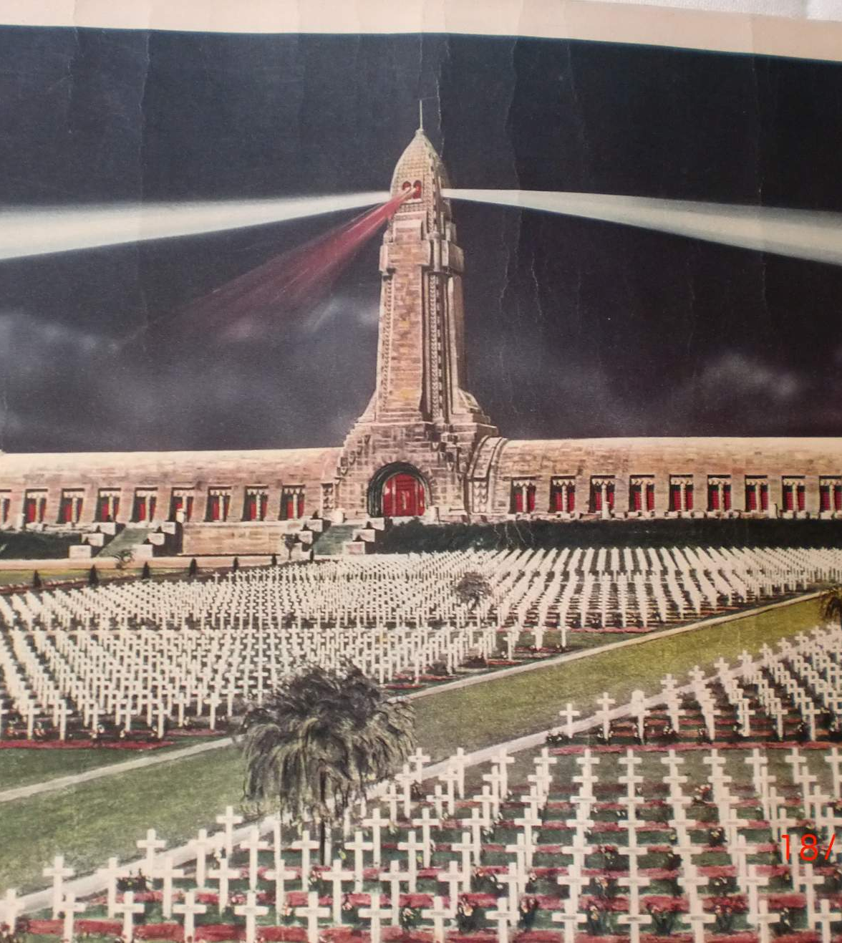
Facing Death
Plato sees the function of religion as giving courage to those who are facing death (387 d, e). Religious faith will motivate men not to dread death but to be prepared to sacrifice for fellow men.

Slide 21
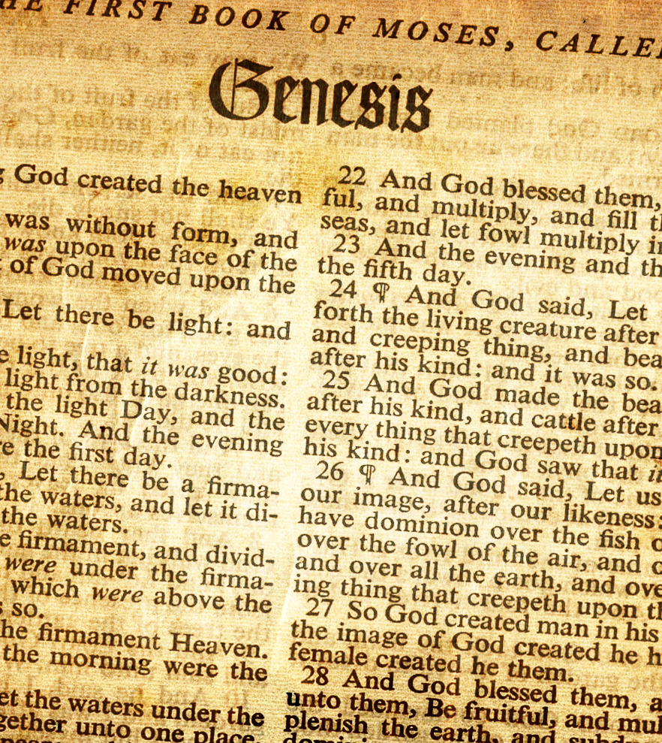
Stories of Origins
“Origin” stories play a powerful role in people’s lives.
It can even be said that “origin determines destiny.”
Plato recognizes the power of origins and (391c-394d)

Slide 22
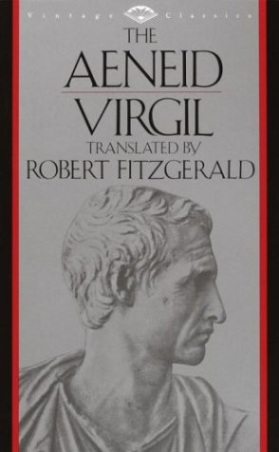
Virgil’s Aeneid
Caesar Augustus will later harness the power of the stories of origins as he commissions Virgil to write the Aeneid, an epic poem that tells the story of the origin and destiny of the people of Rome.

Slide 23
Education, Cotd.
After the account of the origin stories and alternative history that this “city created from speech” will have, Socrates and co. have a lot to say about education, particularly music.
It sounds as though they are in favor of banning all sorts of things. In terms of the recommendations re: instruments, etc., they recognize that music has a formative value.

Slide 24
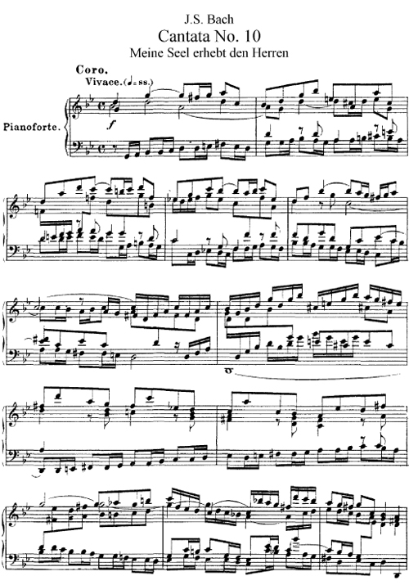
Music
Since guardians must embody the virtue of moderation, guardians need to play, sing, and listen to music that will form this virtue in them, rather than exciting their passions.

Slide 25
Music
Whether or not you agree with Plato’s prescription, he does recognize that music has an emotional influence on us that literature, mathematics, and physical exercise don’t have.
Music also helps us to hear and visualize mathematical relationships, which Plato believes is the purest form of thinking, because they correspond to the ideal world.

Slide 26
Myth of the Metals
Chief component of the “noble lie”
People have a “metal” in them that determines what their function in society is.
This myth is to encourage national solidarity.

Slide 27
Book III
The Myth of the Metals and Other Stuff Continued from Book II

Slide 28
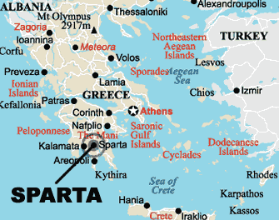
Emulating Sparta
Arthur Herman, author of The Cave and The Light: Plato Vs. Aristotle and the Struggle for Western Civlization, argues that Plato idealized the government of Sparta for his “city in speech.”

Slide 29
Metals and corresponding virtues
Gold = governing class = intellect
Silver = auxillaries (warriors) = passion
Bronze = artisans = will
This was to be a system where talented children could be upwardly mobile, but once it was determined where your destiny lies, it was no longer upwardly mobile for you.

Slide 30
Plato’s Sexual Ethic
First, what’s good:
  He condemns pedophila, which was widely practiced among upper class males (403a).

Slide 31
Child Rearing
Communal marriage is proposed near the end of Book III.
This is one of the most controversial ideas in the Republic and one I don’t think is particularly important in its relation to the whole.
Children would be raised by the community rather than individual families.

Slide 32
A Debauched Society
Temple prostitution was part of the civil religion of Plato’s day. It was expected that males would make use of the services offered.
While monogamy was the norm insofar as marriage took place, faithfulness in marriage was not an expectation among males.
Paul’s first letter to the Corinthians gives some examples of common behavior with regard to immorality

Slide 33
Plato’s take
Plato held the body to be a “prison house for the soul.”
“Moderation,” in its strictest sense, meant that one had control of their passions.
Plato sees physical relations as a “necessary evil” to bring children into the world.

Slide 34
Communal Marriage
This is perhaps the most distasteful part of the Republic to many of us.
I think Plato was actually trying to reduce the difficulties caused by the passions.
  He hated the political strife that went along with important people arranging marriages and allying themselves with other important families.
  It seems that he sees nothing good in cult prostitution

Slide 35
Nuptial Festivals
Oddly enough, the nuptial festivals in Book IV may be calculated to reduce the damage done by the passions, while we would tend to think that such practices would increase the passions.

Slide 36
Private property
Guardians were not to have private property. They are not to be focused on the own gain, but to be maintained by the state as to be incorruptable.
Again, we see the influence of Sparta here, which had no private property.

Slide 37
Child Education
Children would then be assessed as to where they fit into society. A “bronze” or “iron” child of gold parents would be sent to the bronze or iron community to be raised. A “gold” child of bronze or iron parents would be sent up to the gold community.

Slide 38

Plato and Divergent
Veronica Roth’s Divergent trilogy is modeled after the Republic in these ways.

Slide 39

Plato and Brave New World
Aldous Huxley’s 20th century dystopian novel, Brave New World, has a family structure modeled after the Republic with some scientific adaptations such as “test tube babies.”

Slide 40
Concluding Questions
Where should rulers be in relation to the law? Above the law? Under the law? Why?
What grounds exist to justify lying by the government? What if no grounds exist for the government to mislead its citizens?
What role do stories of origins play in the formation of people? Give examples.

Slide 41
Concluding Questions
How does education serve a “moral” or “formative” purpose? In what ways can we appropriate Plato’s thoughts concering this without necessarily agreeing with many aspects of his proposal?

