Slide 1
Plato’s Republic
Books VI-VII

Slide 2
Virtues necessary in Philosopher Kings
By the end of Book V, Plato has made his case that kings must be philosophers or those who philosophize.
Now, he is going to summarize the virtues that must be present in those who are in the guardian classes.

Slide 3
Governing Virtues
1. Always in love with learning (485b)
2. Love the truth and hate falsehood (485c)
3. Love wisdom (485c)
4. Does not love sensual pleasure (485e)
Not a lover of money (486a)
Not terrified of death (486b)

Slide 4
Governing Virtues
Courageous (486b)
Not proud (486b)
Generous (486b)
Learns quickly (486c)
Has a good memory and exercises it (486c)
Musical (486d)
Is able to see the “idea” behind each “thing”

Slide 5
Governing Virtues
Finally, the virtues of wisdom, courage, moderation, and temperance must be apparent to all in the live of the prospective guardian

Slide 6
Human Nature
This discussion of virtues necessary for governing leads to a discussion of human nature in general.
490d: Why are the many bad?
491a: Many are corrupt.
Some people are useless (remember, the eugenics discussion – “useless eaters, human weeds, some people are put on earth to be a burden to the rest of us” . . .)

Slide 7
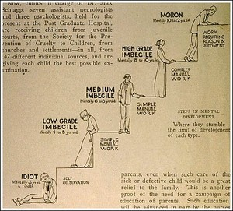
Human Weeds?

Slide 8
Human Nature
Finally, in Plato’s discussion of human nature “some . . . Imitate a philosophic nature.”
491e: The best natured people become the worst apart from proper nurture. The person with the nature of the philosopher king will become the opposite, unless he is properly nurtured.

Slide 9
Transition to Knowledge
This discussion of the virtues necessary for guardians leads Plato to begin to communicate his theory of knowledge. The philosophers begin to take about “how we know what we know,” which, in philosophy, is called epistemology.

Slide 10
Theory of the Forms
Many beautiful and good things and acts only one beauty itself and good itself; i.e., one Form vs. many instances
A Form is “the being” of a thing – its essence.
Things are visible but not intelligible; Forms are not visible, but are intelligible.
Plato uses the difference between sight and the other senses to form an analogy

Slide 11
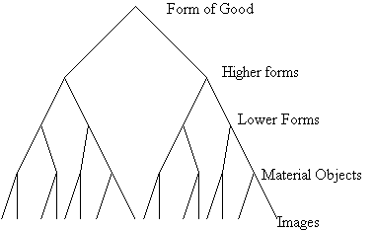
Theory of the Forms

Slide 12
Analogy of the Sun
Three things required for sight: (1) a physical object to see, (2) an apparatus to see with (the eye), (3) a light source (like the Sun) to illuminate the object allowing the eye to see.
Similarly, three things required for thought: (1) a thought object (Forms); an apparatus to think with (psyche or soul or mind); (3) a ‘thought’ source (the Form of the Good) to ‘illuminate’ the thought objects (Forms) that allow the mind to think.

Slide 13
Analogy of the Sun/The Good
Just as the Sun in the Visible Realm by its Light is the Cause of Sight (and of the existence of objects of sight) so the Form of the Good in the Intelligible Realm by its reason is the cause of knowledge and of the existence of the objects of knowledge.
As The Eye is to the Mind, visible Objects are to Forms, snd the Sun is to the Form of the Good.

Slide 14
The Divided Line
In the Analogy of the Divided Line, he is teaching the same thing as he is in the analogy of the sun..

Slide 15
The Divided Line
Two World view (again)
As you ascend the line things get more real and more knowable. You can only have Conjecture or imaginings about images, beliefs, about visible objects, partially justified beliefs about Mathematical objects. Knowledge (a fully justified true belief) is possible only under the guidance of the Form of the Good.

Slide 16
Divided Line Explanation
https://www.youtube.com/watch?v=Yi3ubdALbo8

Slide 17
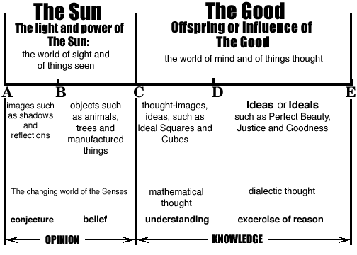
The Divided Line

Slide 18
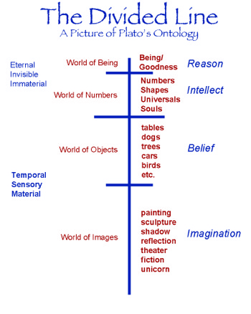
Another Conception of the Divided Line

Slide 19

Book VII

Slide 20
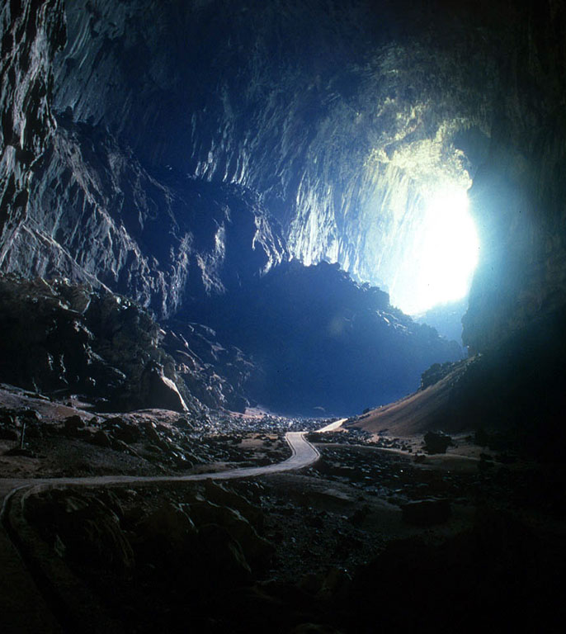
Allegory of the Cave
The allegory of the cave is perhaps the dominant metaphor in the Republic. This is what it is most remembered for.

Slide 21
Divided Line and Cave
The Divided is a like a map whereas the allegory of the cave is like a description of a journey one has taken using the map provided. The Allegory of the Cave tells us of Socrates’ journey from the bottom to the top of the Divided Line.

Slide 22
Claymation Allegory of the Cave
https://www.youtube.com/watch?v=69F7GhASOdM

Slide 23

Adaptation of Allegory of the Cave

Slide 24
Lessons Learned from Cave
According to Plato, the senses are the least reliable means of perception.
The duty of those who are educated is to bring those who are bound in chains in the darkness of the cave into the light of knowledge and truth.
Those who are in the cave will mock and laugh at the reports from those who have been “above.”

Slide 25
Lessons Learned from the Cave
Once people get used to being “above”, they will want to stay “above” (517d).

Slide 26
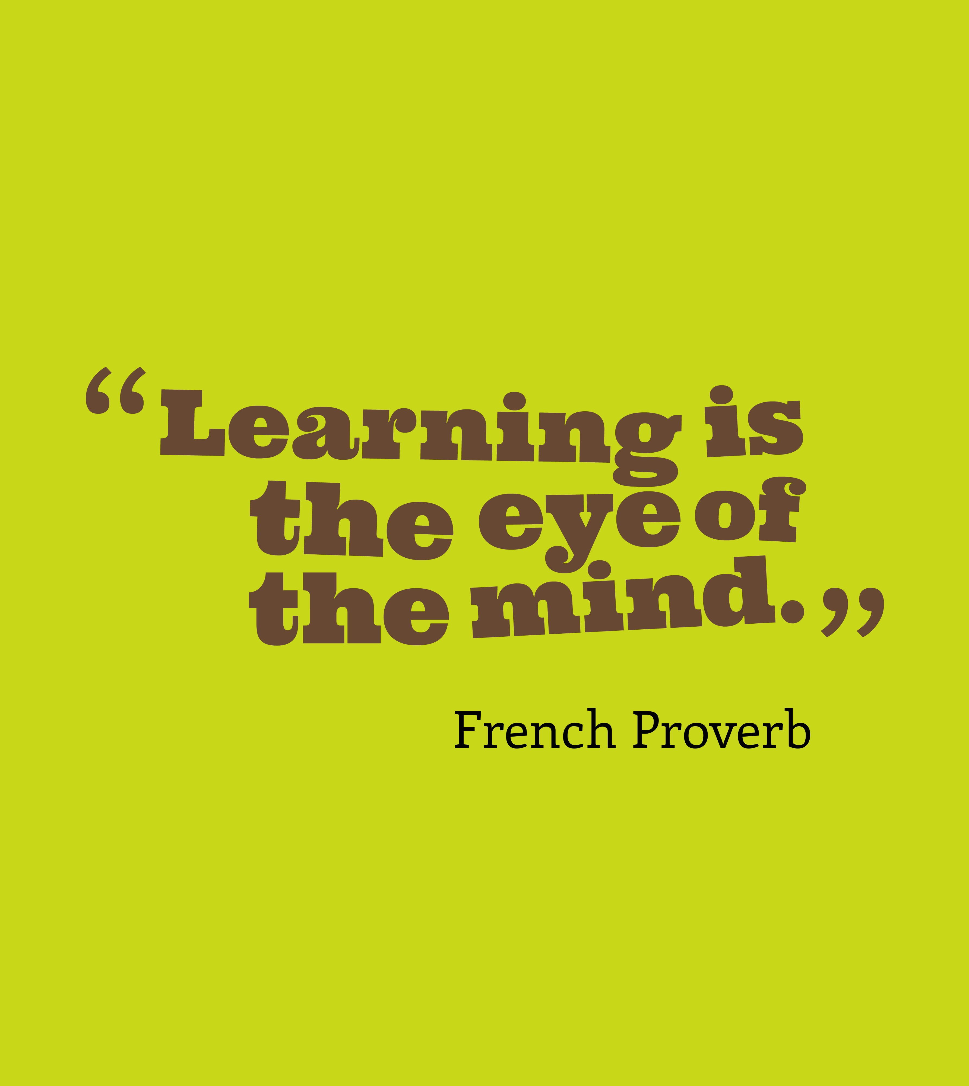
Mind Compared To Eye
The human mind is compared to an eye that is “not rigthly turned” (518c). The purpose of dialectic is to turn the eye in the right direction.

Slide 27
Review--Education
Then, they discuss music, mathematics, and gymnastics again. In this discussion, he reiterates that education is not merely about developing knowledge and sikks, but that the most important aim is to create a virtuous person. It’s the person of good character who will govern best.

Slide 28
Formative Effect of Education
“You are like a man who is afraid of the many in your not wanting to seem to command useless studies. It’s scarcely an ordinary thing, rather it’s hard, to trust that in these studies, a certain instrument of everyone’s soul – one that is destroyed and blinded by other practices – is purified and rekindled, an instrument more important than to save ten thousand eyes” (527e).

Slide 29

Formative Effects of Education
Disciplines of education make you into a certain kind of person apart from the skills and knowledge that you learn. For example, memorizing multiplication tables makes you an exact person.

Slide 30
Formative Effects of Education
Geometry = awarness of spatial dimensions
Scripture memorization = grow in godliness
Language learning = precision and fluency in expression

Slide 31
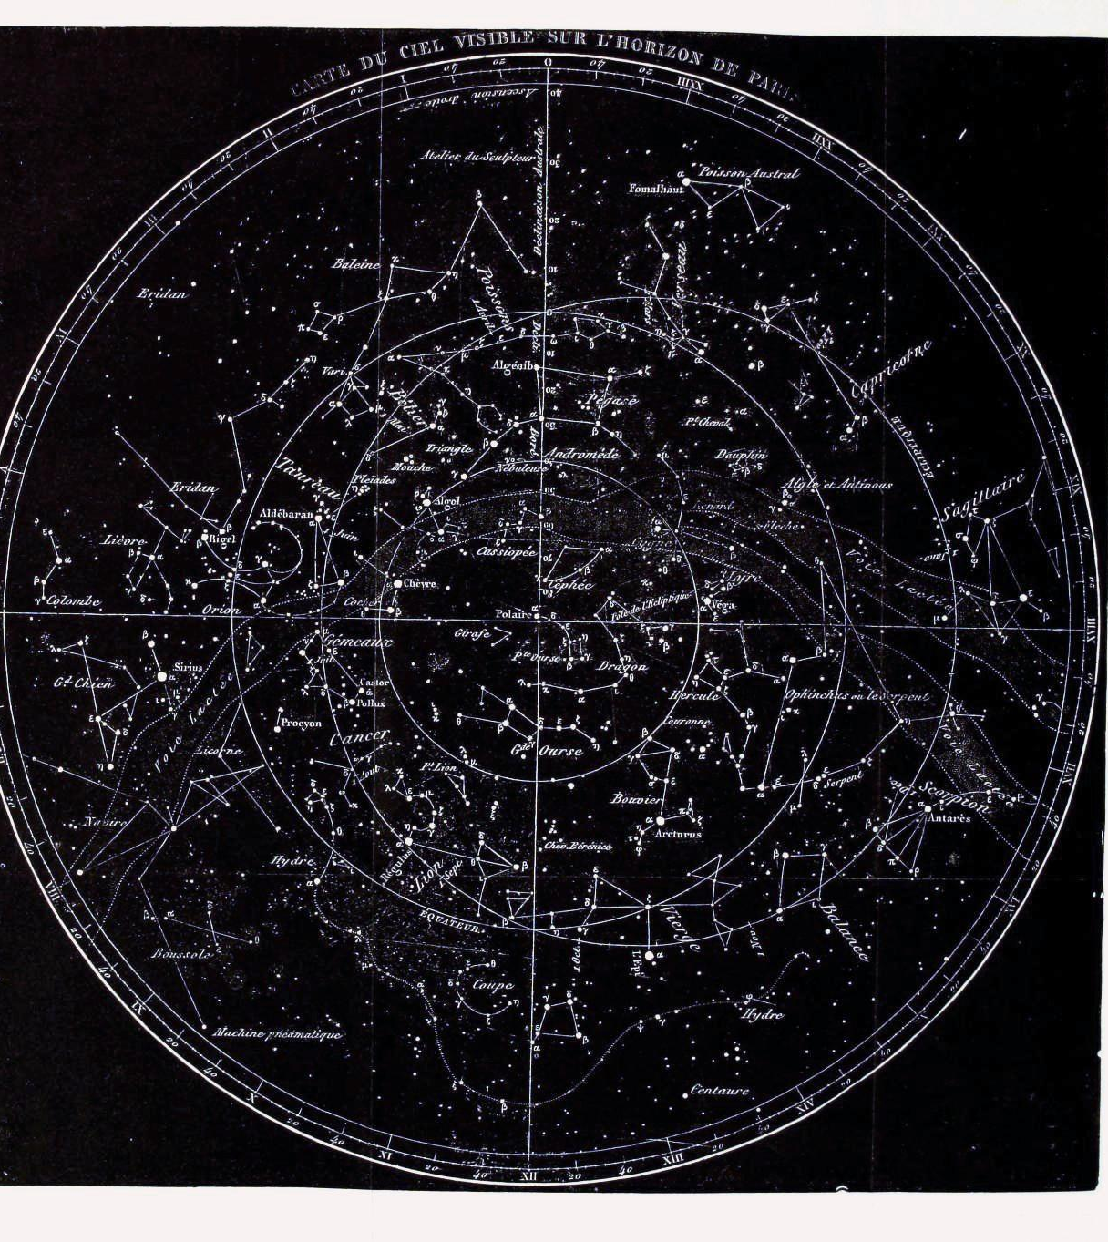
Astronomy
Plato gives special mention to astronomy, because one could access the concept of the forms from the study of the stars, planets, and constellations.

Slide 32
What Dialectic Does
“The release from the bonds and the turning around from the shadows to . . . The light . . .to the sun, and once there . . . Looking at the things that are rather than as before as shadows of phantoms cast by a light that . . . Also has the quality of the shadow of a phantom. All this activity . . . Has the power to release and leads what is best in the soul up to the contemplation of things that are . . .” (532c).

Slide 33
Studies of Free People
After reviewing the plan of education and the stages in the advancement into guardianship, Plato then differentiates between the studies of free people and the studies of the slave.
“The free man ought not to learn any study slavishly. Forced labors performed by the body don’t make the body any worse, but not forced study abides in a soul” (536e).

Slide 34
Liberal Arts
It is the free person who has the privilege of studying the liberal arts. (Liberal comes from liber, Latin for “free”). It is free people who are taught how to think and taught the classics of ages past up through the present.
It is the slave who receives an education merely to develop skills and make one employable.

Slide 35
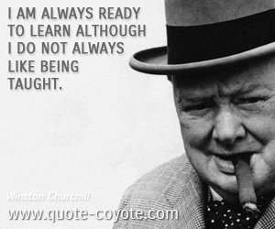
Lifetime Preparation
Finally, Plato concludes this section on the preparation of the guardians by stressing that they will need lifetime education and equipping for their task.

