Slide 1
Republic, Book IV and V
More on Property and Ed-yoo-mi-ka-shun.
Highlighting what Mr. Clay finds interesting in Books Four and Five

Slide 2
Private Property
Adeimantus objects to the lack of private property for guardians (419-420)
  They won’t be happy
  It’s their fault
  Others have big houses, fine clothes, etc.
  They can’t even travel!

Slide 3
Socrates’ response
If the practioners of all the arts become wealthy, they will lose interest in their arets (421 c-e)
He advocates a managed economy rathter than a free market economy to keep this from happening.
Indirectly, Socrates answerd that the guardians are made happy because of the health of the city and excelling in her craft (421b)

Slide 4

Managed Growth
Socrates points to the necessity of managing growth to keep the population at such a level that it won’t outgrow the infrastructure.

Slide 5
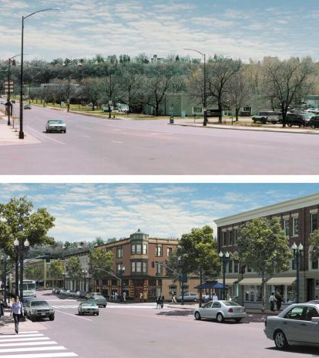
“Smart”Growth
Socrates was actually onto a 21st century concept with he brings up the subject of managing growth.
“Smart growth” is urban planning that includes high enough pop. Density to make services within walkable distances

Slide 6
Advantages of Smart Growth
Cities are “walkable”
Public transit is reliable
Children, adolescent, and elderly are not homebound because they can’t drive.
Property values are either stable or growing.
Environmentally friendly.

Slide 7
Disadvantages of Smart Growth
Harms poor people
  Causes gentrification in cities
  Generally pushes poor people out of the cities
  Pushes home prices beyond the affordability of middle class Americans
  Creates traffic congestion going in and out of cities

Slide 8
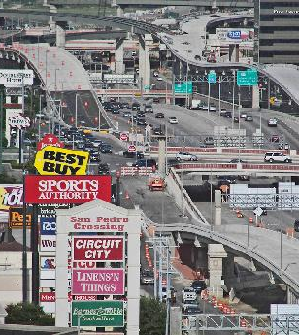
Aesthetics
Here is what you get when you don’t have smart growth policies and urban planning

Slide 9

. . . Or this

Slide 10
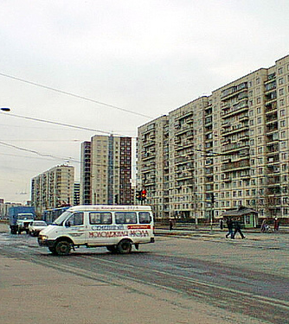
. . . Or this
Actually, they planned this!!! It’s Soviet era worker housing. In Eastern European countries, most people still live in buildings like these. I think Plato would have like these for the “bronze” and “iron” classes.

Slide 11
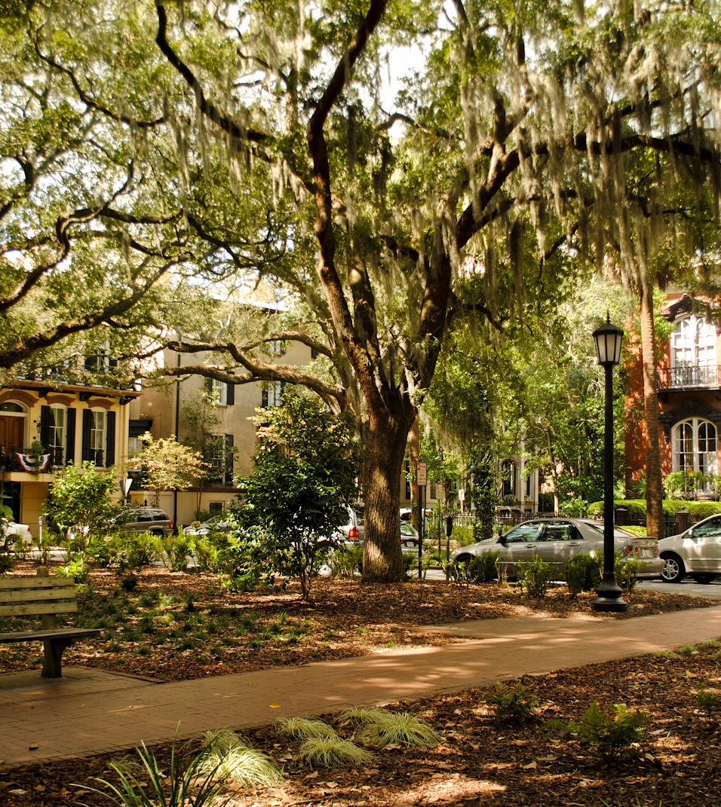
Aesthetics
Here is what you have when you have smart growth and urban planning in place.

Slide 12
Child Rearing
“Friends have all things in common.” The community is the family.
The city is in harmony when every child grows to bring out the virtue of his metal.

Slide 13
Changing a Culture
Plato is inventing “a city in speech” which will have a culture radically different from Athens.
His prescription is that once the educational practices are decided on, there is to be “no innovation.” For example, in 424d, we read, “the guardians must build the guardhouse.” Educating is “the guardhouse” in this metaphor.

Slide 14
Virtue
They then go on to discussing the outcomes of education – virtue
  Courage 429 b-c
  Justice 429d
  Moderation
Moderation (432a) is a virtue that is to stretch across all classes, “making the weaker and the stronger sing the same chant together.”

Slide 15
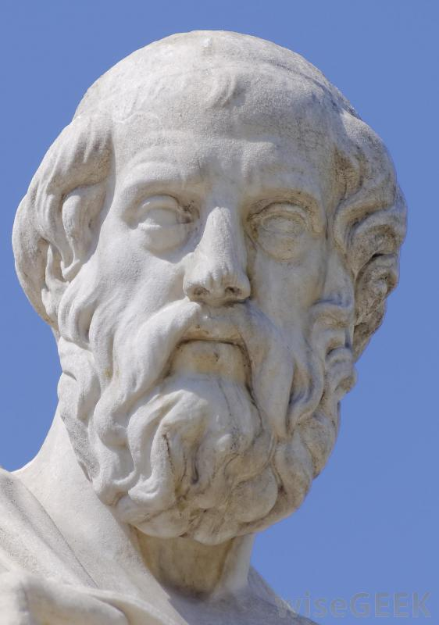
Justice
Justice must reside in the guardian class (432a).
“Extreme evil-doing = Meddling across the classes”
People must mind their own business rather than seeking after unjust gain.
It would be unjust for people to move into classes for which they are not suited.

Slide 16
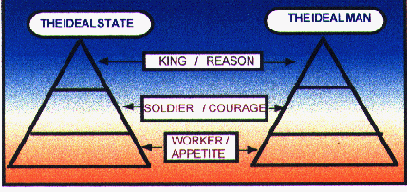
Plato’s idea of the just state and the just man
Note how the virtues correspond to the classes they represent.

Slide 17
Constitutionalism
425b-427b: Rather than creating complex legislation, Plato puts his trust in the competence of the guardian class. They will be able to govern through the virtues of justice, wisdom, and moderation.

Slide 18
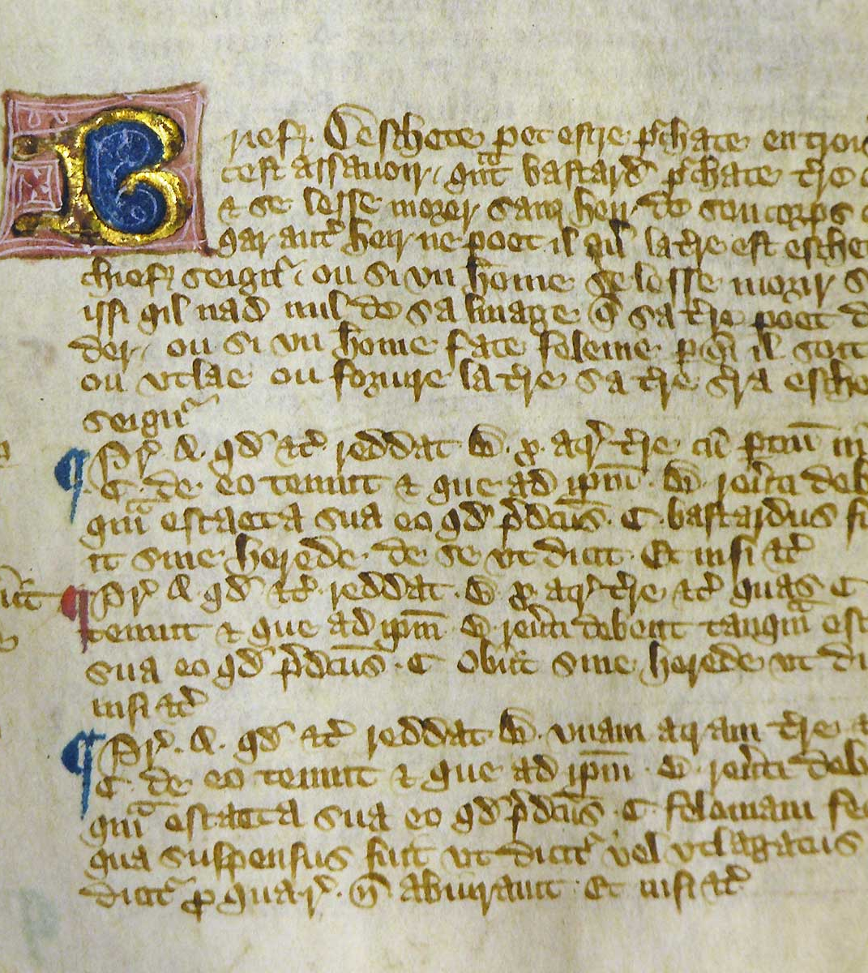
Unwritten Constitutionalism
Seen in the best light, English constitutionalism has been built through the Common Law tradition rather than a written constitution.
People are “under law,” including the sovereign, through 800 years of judicial precedent, i.e., “the Rights of Englishment”

Slide 19

Prescription for Injustice
Seen in it’s worst light, putting men in charge without a constitution and allowing them to govern according to their competencies leads to dictatorship, abuse of power, and tyrrany

Slide 20

A Conflict of Visions, Thomas Sowell
Thomas Sowell analyzes why attempts to create outcomes rather than to set processes in motion that lead to justice end up having unintended consequences.

Slide 21
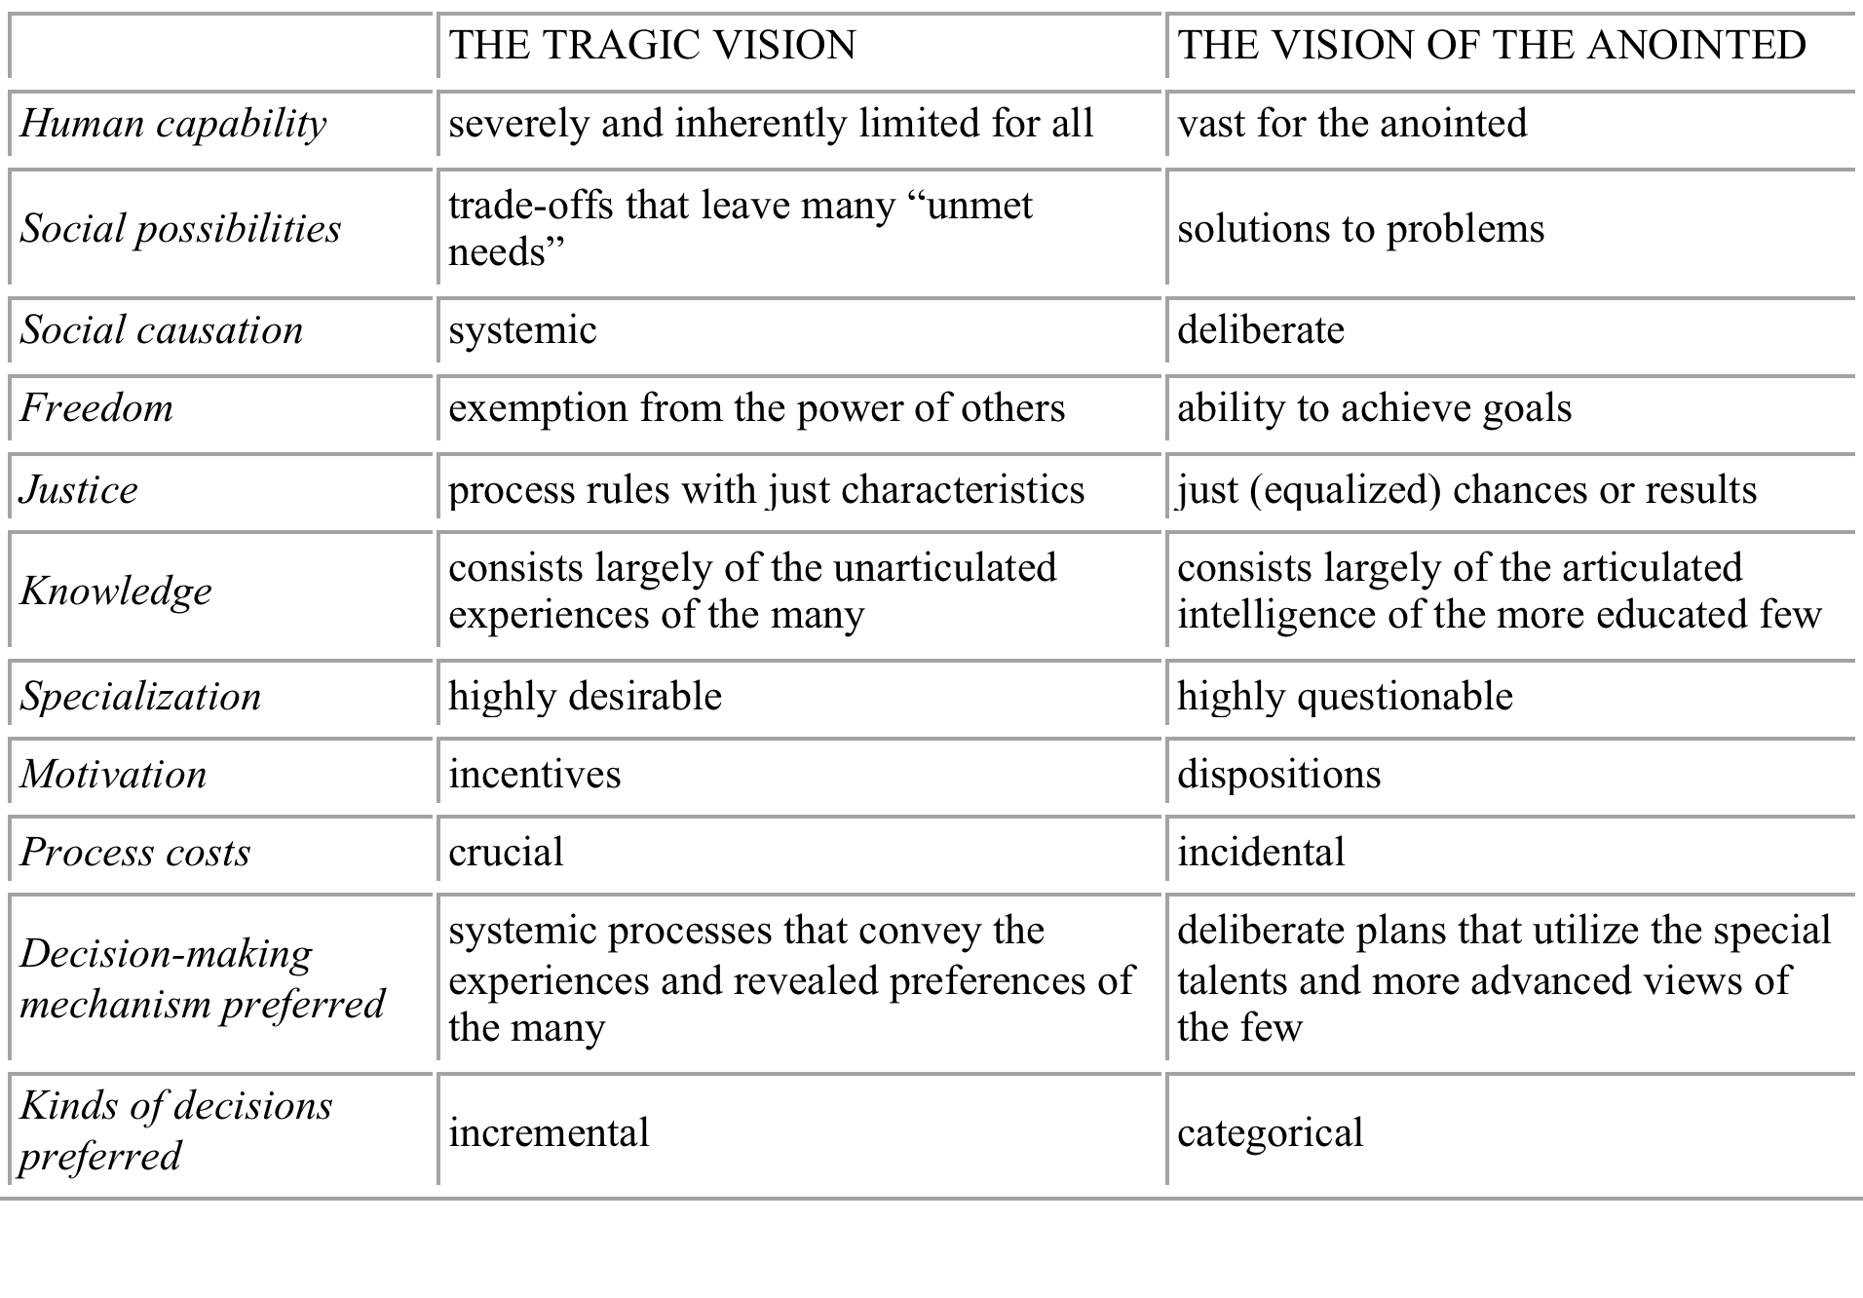
Sowell, A Conflict of Visons

Slide 22
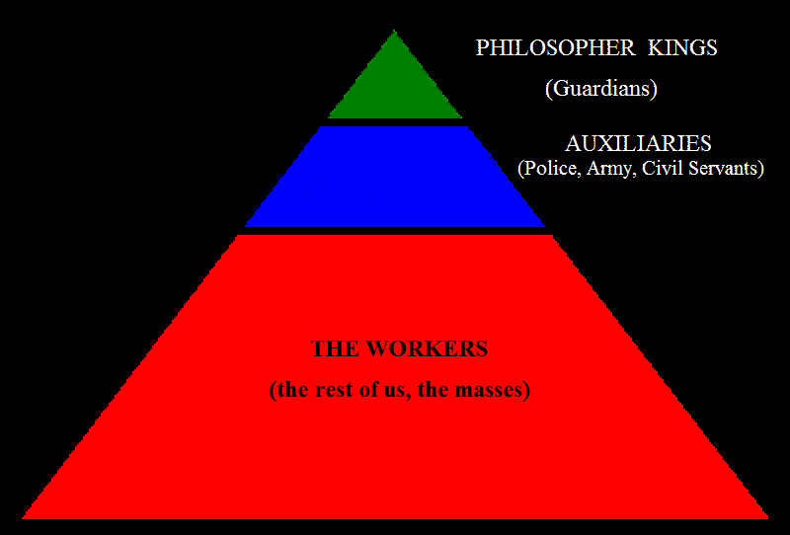
Distribution of Population

Slide 23
Human Nature
440c-442d: Socrates develops a valuable insight into human nature when he describes the soul as having a “calculating part” and a “desiring part.” He takes a while to make his point, but what he wants is for rulers to rule from the “calculating” part rather than the “desiring” part.

Slide 24
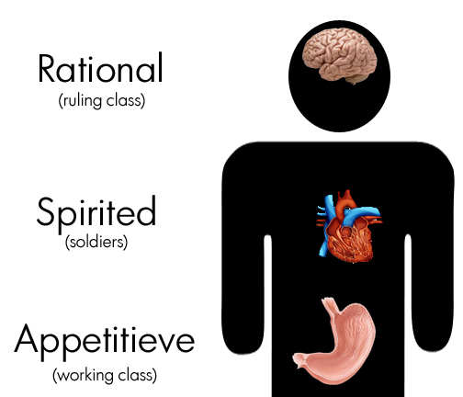
Souls and Virtues of Government
In 445c, they begin an examination of the the souls of men and the corresponding virtues of government

Slide 25
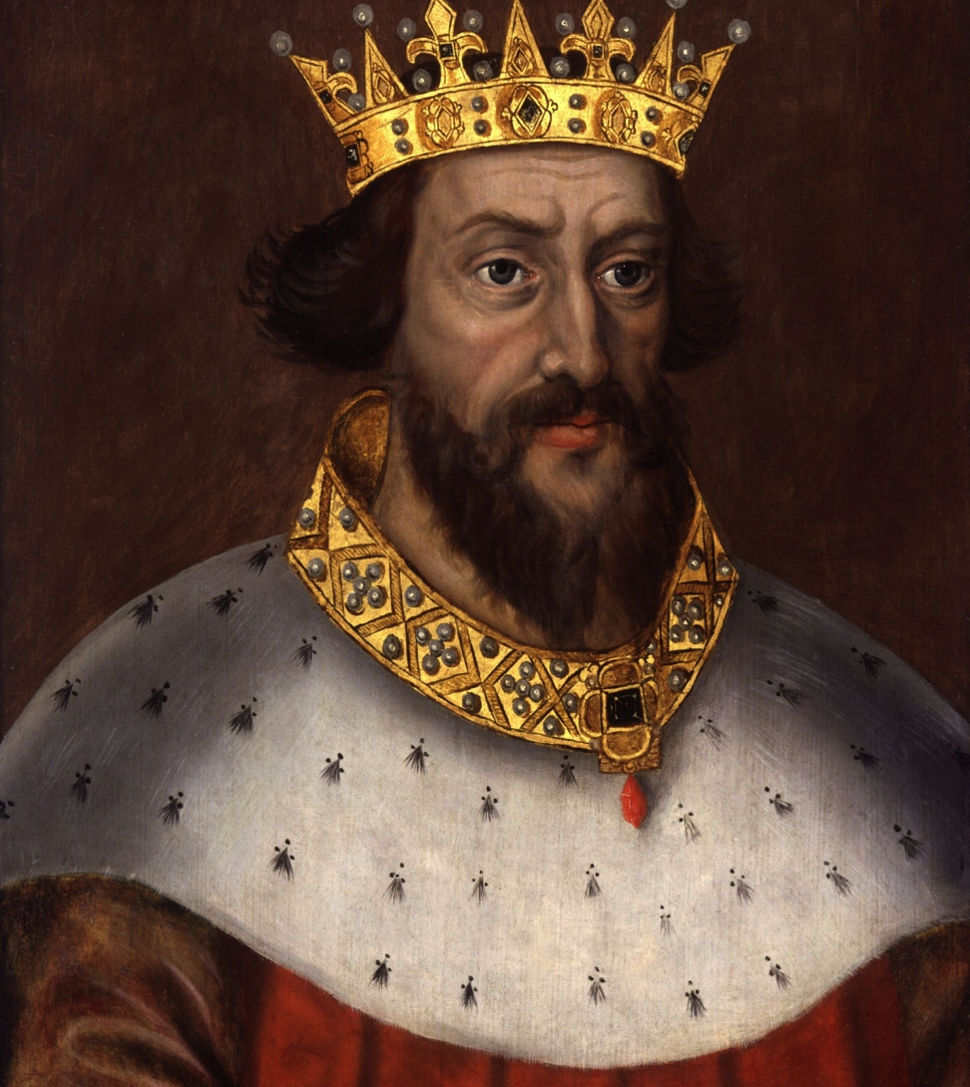
Kingship
445d: an exceptional man rising to the top.
  No laws or principles need to change
  Probably won’t last long

Slide 26
Book V
Gender roles, war, and thesis of the dialogue

Slide 27
Four Forms of Badness
Socrates starts to discourse on the four forms of badness. He will come back to this in Book VIII. However, he gets sidetracked with the mention of “the things that friends have in common” (449c).

Slide 28
Back to the Family
They go through the whole child rearing discussion again (which we won’t).
451c: The community of the republic is compared to a “herd.” Thus, we see the “breeding” that is mentioned in Book III and Book V.

Slide 29
Principles of Gender Roles
1. It is recognized that generally as a class of people, males are physically stronger than females.
2. However, the education of males and females will be identical (452a).
  He then gives us a rather gross description of coeducational exercising (452b).

Slide 30
Questions posed about gender roles
Are men and women of the same constitution?
Is there anything about guardianship that would prohibit females from participating?
If the answer to the first question is “yes” and the second question is “no”, then justice dictates that guardians be both male and female (454c).

Slide 31
Beauty of Biblical Complimentariaism
Ontological Equality
Galatians 3:26 For you are all sons of God through faith in Christ Jesus. 27 For as many of you as were baptized into Christ have put on Christ. 28 There is neither Jew nor Greek, there is neither slave nor free, there is neither male nor female; for you are all one in Christ Jesus.
Economic subordination
Ephesians 5:22 Wives, submit to your own husbands, as to the Lord. 23 For the husband is head of the wife, as also Christ is head of the church; and He is the Savior of the body. 24 Therefore, just as the church is subject to Christ, so let the wives be to their own husbands in everything.

Slide 32
Gender Roles Mirror the Trinity
Ontological Equality
The Father, Son, and Holy Spirit are “the same in substance, equal in power and glory” (Westminster Shorter Catechism, Q. 6).
Economic Subordination
The Father designs the mission of redemption.
The Son, in obedience to the Father, undertakes to accomplish redemption.
The Spirit, in obedience to the Father and the Son, applies the work of redemption to the children of God.

Slide 33
Clothing and Christianity
How do we respond to the “naked exercising” passages?
  “eww . . .” is a good place to start.
  But here, we can also see the beauty of living in a civilization that has been influenced by a Christian world view.
  Genesis 3:21: And the Lord God made for Adam and for his wife garments of skins and clothed them.

Slide 34
Clothing and Christianity
Genesis 3:21 isn’t the throwaway comment that we might think it to be.
After the Fall, Adam and Eve were “naked and ashamed.”
God covered their sin and their shame, prefiguring how He would cover our sin and shame at the cross.
So, there’s a Biblical reason for clothing and privacy in such matters beyond personal taste.

Slide 35
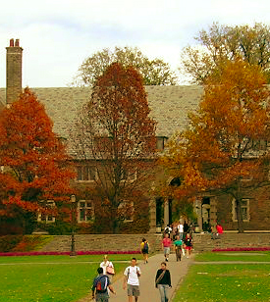
Relevance
Gender-blind dorm rooms (male and female rooming together) are now becoming the norm at many colleges.
You may have to specify that you want a same-sex roommate, depending on where you go to college.

Slide 36

Eugenics
Plato advocates for eugenics in 459d-e, providing for those of “good stock” to breed more numerously and “hiding the deformed away in an unspeakable and unseen place” (460d).

Slide 37
Argument against Private Property
Removing ownership and inheritance:
  Gives extraordinary power to the state
  Prohibits generational wealth transfer
  Will keep families from becoming powerful over generations
“When one person is in pain, the community is in pain.”

Slide 38
Property and Inheritance Today
Estate taxes are among the highest taxes percentage-wise of all taxation in America.
Private property is heavily regulated and taxed.
These measures limit generational wealth transfer and give exponentially more power to the state.

Slide 39
Eugenics
Came into vogue following the popularity of Darwin’s theory of evolution in the late 19th and early 20th centuries.
Buck v. Bell Supreme Court Case (1927) was at the height of the American government’s involvement in eugenics.
Because eugenics was a major part of Adolf Hitler’s ideology, it became repugnant to the rest of the Western world.

Slide 40
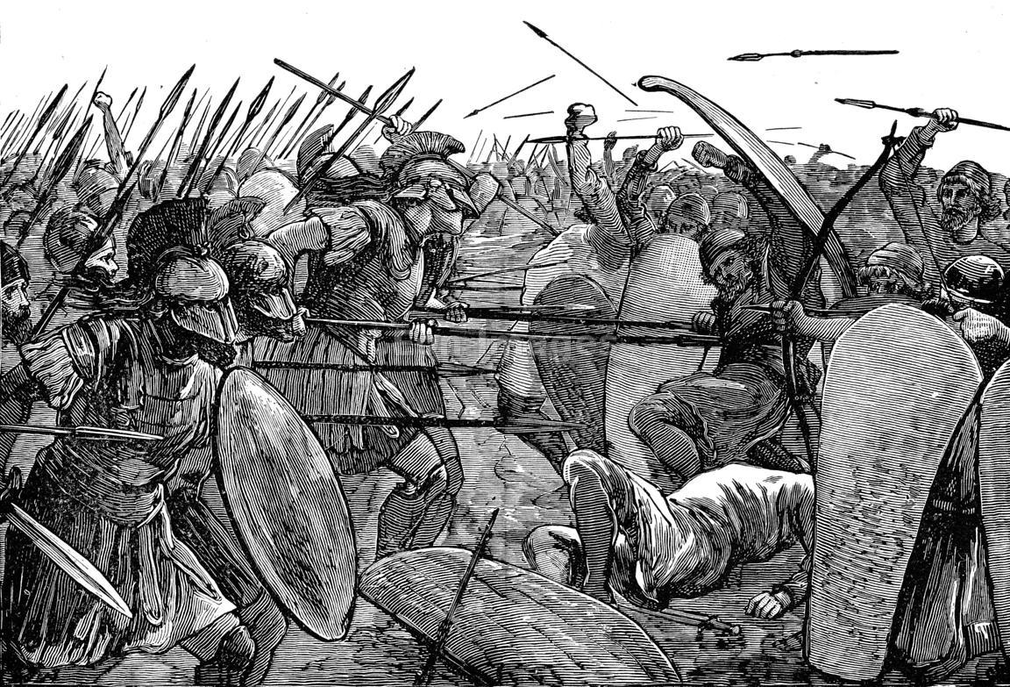
War
Children would be taken to war for assessment and educational purposes (467a).
They can be assessed for the virtue of courage.
This will also give guardian children pause when it comes time for them to commit troops to war.

Slide 41
How Wars Are To Be Fought
Both men and women will fight.
Greeks will be treated differently than “barbarians.” They will not be enslaved and made to suffer other humiliations.

Slide 42
Thesis of Republic
“Unless . . . The philosophers rule as kings or those now called kings and chiefs genuinely and adequately philosophize, and political power and philosophy coincide in the same place . . . There is no rest from ills for the cities . . . Nor I think for human kind, nor will the regime we have now described in speech ever come forth from nature . . . “ (473d-e).

Slide 43
Knowledge
Lastly, Plato gets into the nature of knowledge which he will discuss fully in Books VI and VII
  Knowledge
  Opinion
Has some correspondence to Schaeffer’s upper story/lower story.

Slide 44
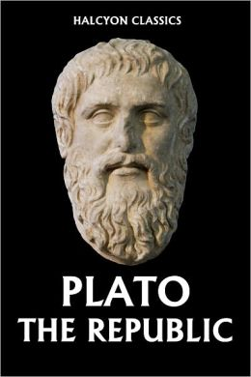
That’s all for now!
Books VI and VII next week

