Slide 1
The Roaring Twenties
Prosperity, New Ideas, Mass Culture

Slide 2
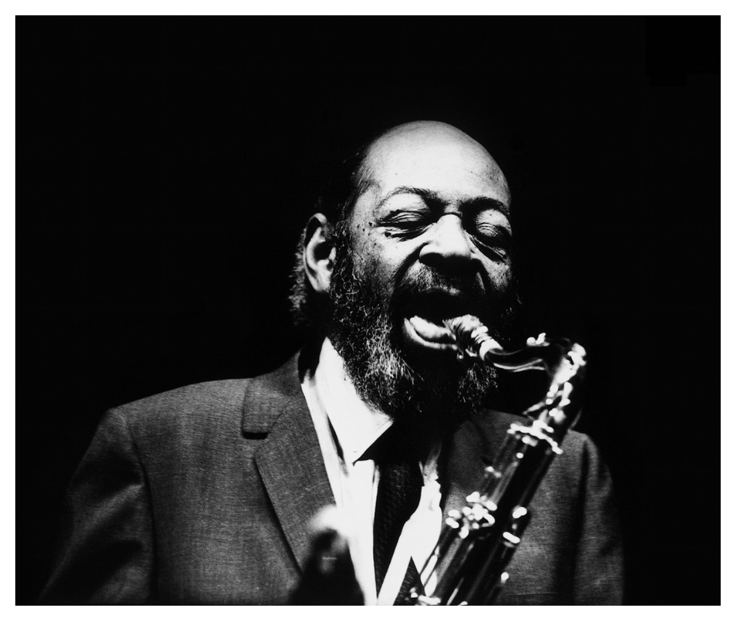
The Jazz Age
The 1920s is also known as the Jazz Age.
Jazz symbolized the entire cultural movement
  An emerging African American culture
  Postwar prosperity
  Mass culture
  The abandonment of old conventions for new ones

Slide 3
The Importance of Jazz
Jazz and its derivatives (blues, &B, Soul, Hip-Hop, Rap– and country, believe it or not) is the only indigenous American form of music.
African, European, and West Indian musical forms were combined. Improvisation is a key element in jazz.
Jazz transcended all cultural forms. It arose from folk culture, made its way into mass or popular culture, and into high culture as well.

Slide 4
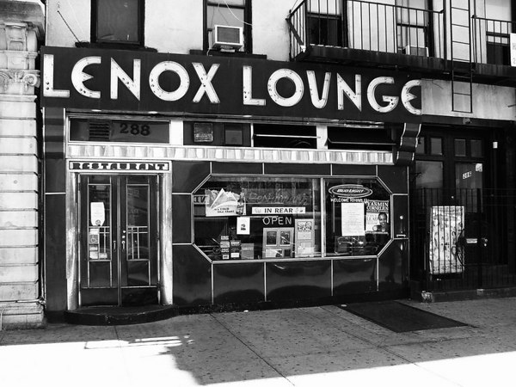
Dominant Musical Style
Jazz and all of its varieties – Dixieland, ragtime, swing, blues, bebop – was the dominant form of popular music until the Fifties, when rock and roll began to supplant Jazz.
Harlem quickly became the epicenter of Jazz, as well as a Black cultural movement known as the Harlem Renaissance

Slide 5
Development of Mass Culture
Postwar prosperity and technological developments brought about a new, mass culture in America.
  Radio
  Movies
  College and Professional Sports
  Automobiles
  Record players

Slide 6
Why Mass Culture?
Before the 1920s, if you wanted music, you would have to make your own music or go to a church, club, or concert hall.
Radio and phonograph records made professionally performed music accessible to almost everyone.
The mass communication of print and radio also helped recording artists to create national followings.

Slide 7
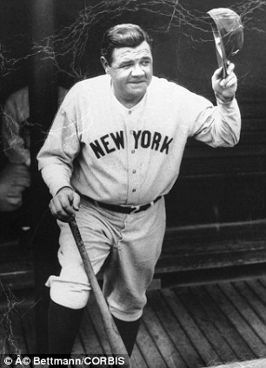
Professional Sports
Baseball became the American pastime in the 20s. The New York Yankees won the American League every year during the 20s and the World Series three times. Babe Ruth set the seasonal home run record in 1927 with 60 home runs. During his career, he hit 714 home runs.

Slide 8
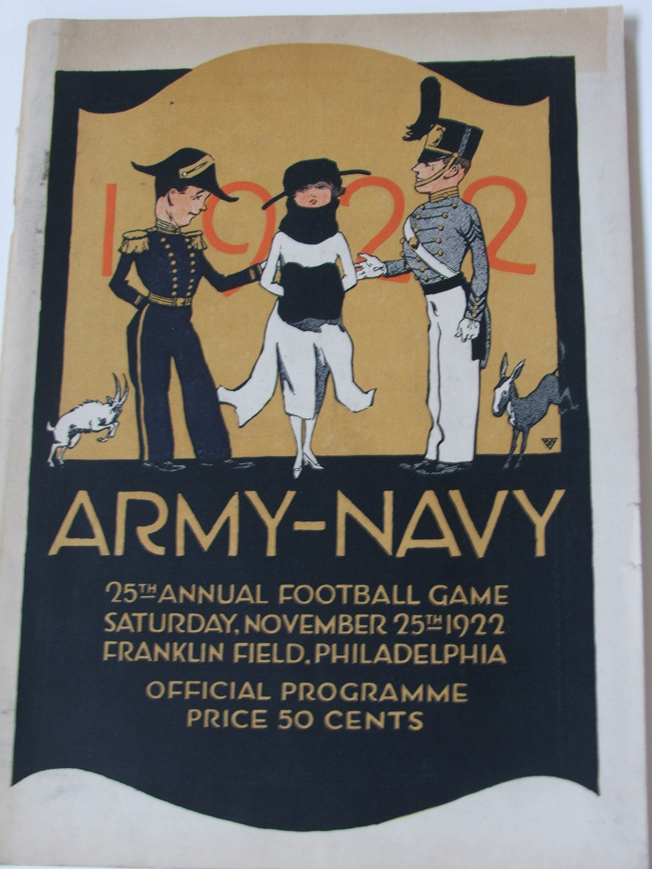
College Football
Although professional football would not establish itself as a leading form of entertainment until the 1960s, college football gained a nationwide following in the 20s. Notre Dame and Army were the two perennial powers at this time.

Slide 9
Changes in Literature
Artistically, the 1920s was known as “the lost generation” (African-American writing was not so – it tended to be upbeat about new possibilities). The phrase “lost generation expresses the disillusionment of those who went to the war to make the world “safe for democracy” and found it anything but a heroic quest.

Slide 10
Writers
Some of the writers of the “lost generation” were:
  F. Scott Fitzgerald
  Ernest Hemingway
  William Faulkner
  T. S. Eliot (although his writing would change after his conversion)

Slide 11
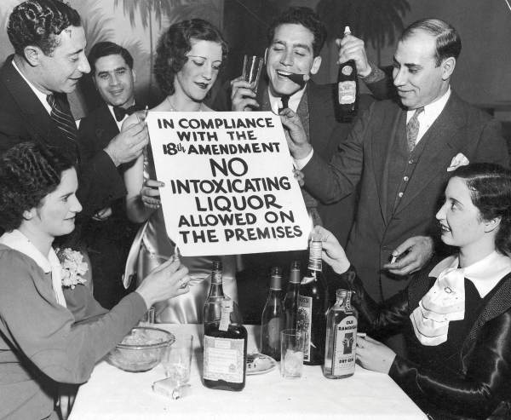
Prohibition
In spite of Prohibition, it seems like the Twenties was one of the most alcohol soaked decades of American History! Prohibition didn’t make alcohol impossible to get, only more difficult.

Slide 12
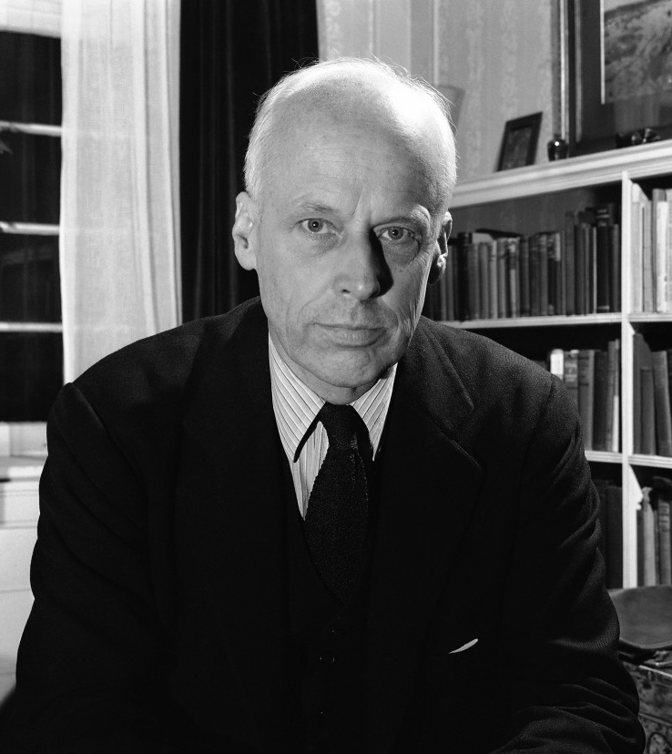
Political Trends
Communism and Socialism: There were thought to be 150,000 communists and 150,000 socialists in the US during the 1920s, which led the the first Red Scare. As Russian

Slide 13
Political Trends
The Ku Klux Klan was also revived in the 1920s. It limited membership to white, native born Protestants.
The Klan originated in the South. In the 1920s, the Klan established itself in the North and the Midwest, where then would gain the majority of their membership.

Slide 14
Ku Klux Klan causes
Some of the causes the Klan stood for:
  Racial purity
  Anti Catholic and Jew
  Against the decline of morals
  Against bootleggers and speakeasys
  Against immoral books and movies
The 1924 Immigration Act, which fixed limits of 2 percent of a nationality living in the US for annual immigration, reduced some of the fear of which the Klan and their violence and racism fed off.

Slide 15
Fundamentalist/Modernist Controversy
The Fundamentalist/Modernist Controversy was a development in American Protestantism which was to have great consequences for the future of Protestant churches.
This was a trans-denominational controversy. Although this did not take place in the Catholic Church, Catholic churches today are affected by it, as are Protestant churches.

Slide 16
Fundamentalist/Modernist
Fundamentalist
Modernist
Verbal inspiration of the Bible by the Holy Spirit
Bible is without error
Bible is to be trusted as authoritative in all that teaches
Bible is completely man-made
Bible has errors
Bible is a product of the evolutionary development of humanity and can be overruled by “human advances”

Slide 17
Fundamentalist/Modernist
Fundamentalist
Modernist
The doctrines of the Apostles and Nicene Creeds are true.
Believed that churches must be kept pure from the false teachings of modernists
Miracles and the Resurrection and Ascension of Christ are “Inspiring stories” but not true.
Believed that Christian charity required that churches accommodate their teachings.

Slide 18
What Happened?
Modernists and their doctrines gained control of many of the historic Protestant denominations, even though the people in the pew didn’t agree with them.
  Presbyterian
  Episcopalian
  Methodist
Additionally, the Catholic Church has been deeply damaged by modernism.

