Slide 1
The Fifties
Baby Boom
Consumer Society
Women at Work

Slide 2
The 1950s
Many look back to the 1950s as a simpler time and think they would like for things to be as they were then.
Yet, the 1950s were also a decade of massive changes for America, and a reshaping of American society.

Slide 3
Economic Boom
From 1945-1960, America had an unprecedented economic boom.
  Gross National Product almost doubled during these years
  Homeownership increased by 50 percent
  “Middle class” doubled
  New industries developed as an offshoot of war production
  Defense spending skyrocketed as a result of the Cold War

Slide 4
A Culture of Consumption
America now had the highest standard of living that any nation had every enjoyed in the world.
After sacrificing and not making major purchases during the war, Americans now had the means and ability to spend.

Slide 5
Planned Obsolescence
Home appliances and items were now mass-produced and purchased by many consumers:
  Washing machines
  Automobiles
  Refrigerators
  Televisions
For the first time, goods were made with “planned obsolescence” in mind. Consumer dissatisfaction would be introduced so that consumers would buy newer models.

Slide 6
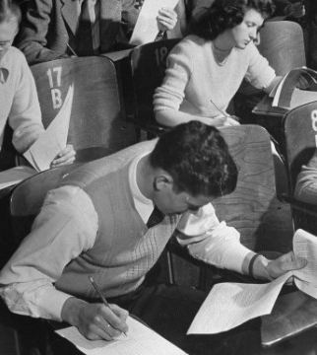
GI Bill
The 1944 Serviceman’s Readjustment Act (GI Bill) provided for returning servicemen to receive money for college and vocational training.
Over 2 million servicemen went to college on the GI Bill

Slide 7

GI Bill
The GI Bill also established the Veteran’s Administration, enabling veterans to buy homes, farms, and businesses.
By equipping servicemen for civilian life, the government participated in expanding the economy.

Slide 8
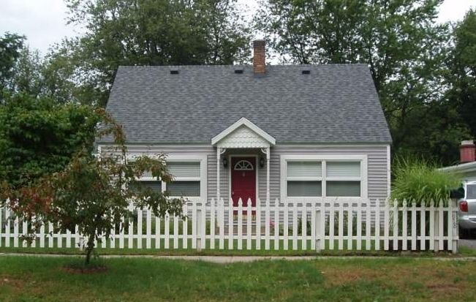
Suburbs
With the widespread use of the automobile, suburban living became the American Dream. A house on a cul-de-sac, a yard with a white picket fence, and green space became the American ideal.

Slide 9
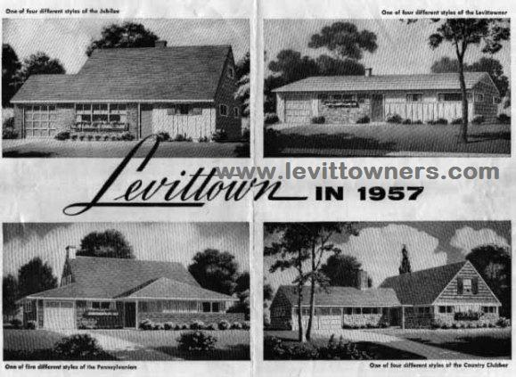
Suburbs
Suburbs (also called Levittowns after the first planned community) provided home ownership for families well below rental costs.
Houses came standard with white picket fence, green grass, and appliances.

Slide 10
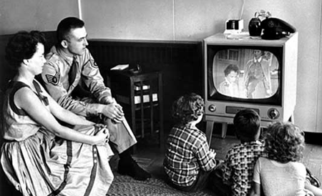
Television Takes Over
In the Fifties, television becomes the dominant media over radio and movies.
By 1960, 90 % of Americans had TVs
Some of the most-watched programs were:
  Father Knows Best
  Leave It To Beaver
  I Love Lucy
  The Honeymooners

Slide 11
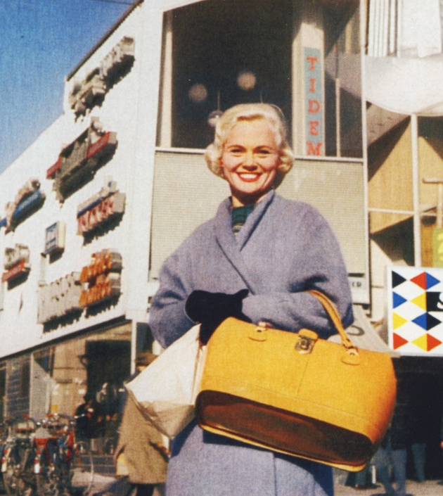
Shopping
For the first time, shopping becomes a leisure activity.
The first shopping malls were built during this period.
Number of shopping malls:
  1945: 8
  1960: 4,000 +

Slide 12
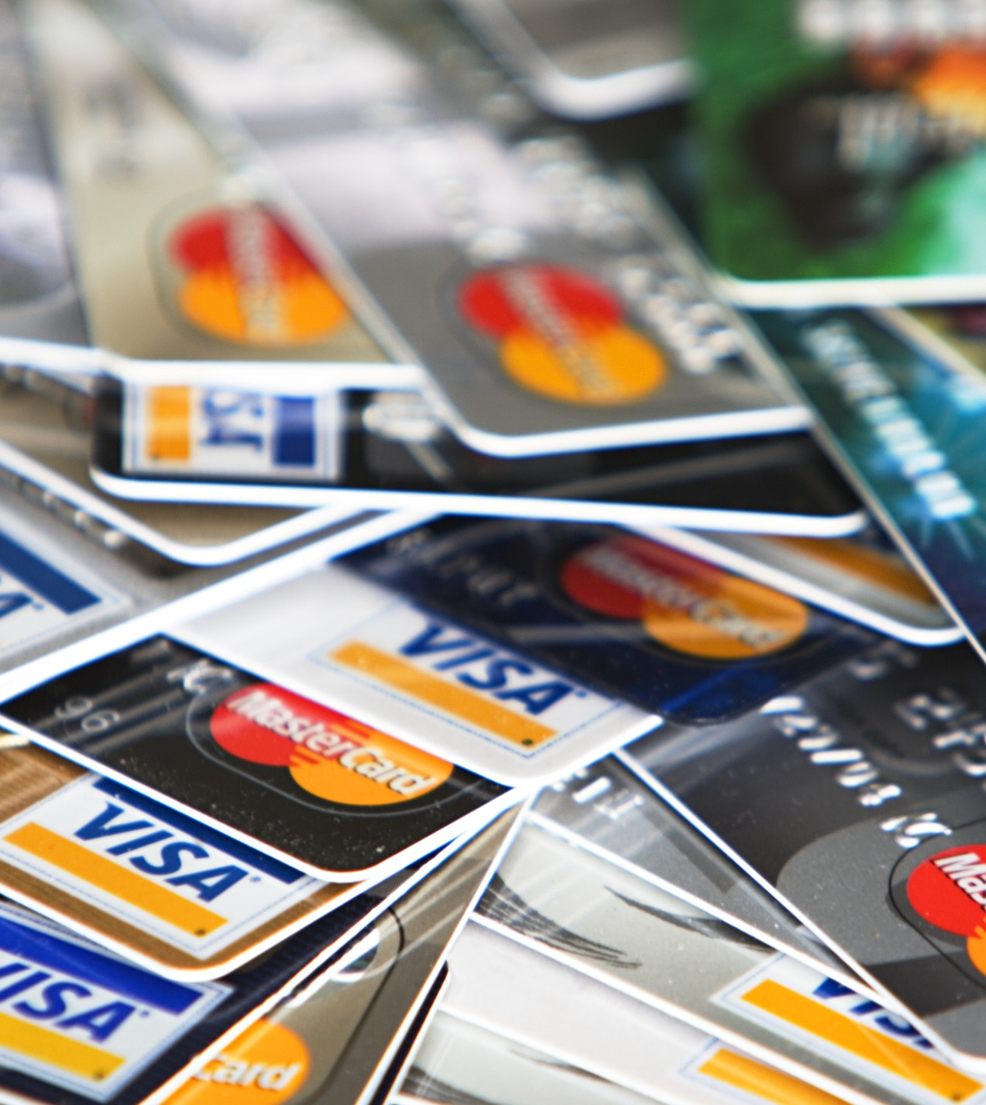
Credit Cards
To facilitate shopping, credit cards were introduced.
By 1965, over a million people had one.
People began to use credit card debt for consumer purchases

Slide 13
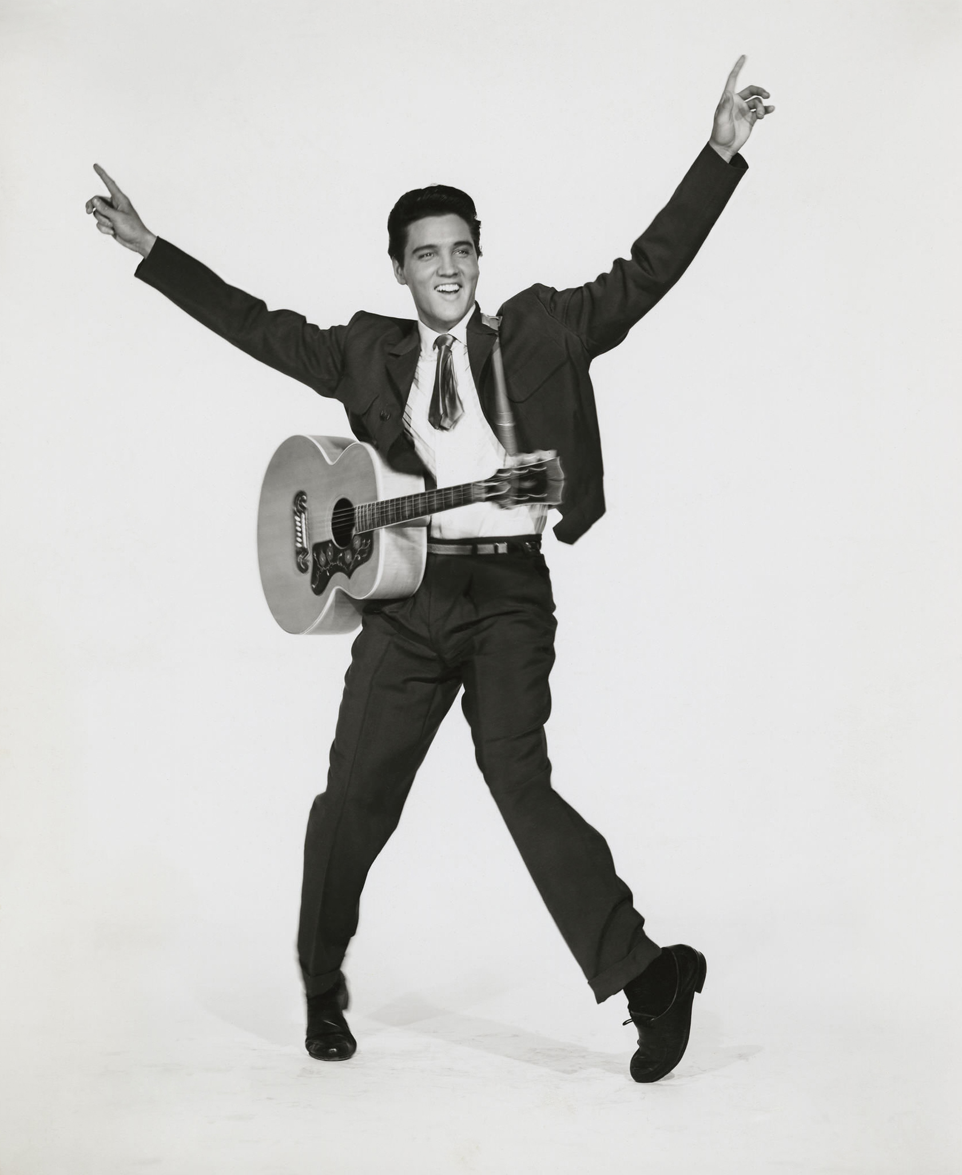
Rock n’ Roll
Along with television, rock n’ roll came into its own. As an offshoot of jazz, blues, and country, its beat, emphasis on guitar, and its rejection of tradition made it popular with young people and despised by older people.

Slide 14
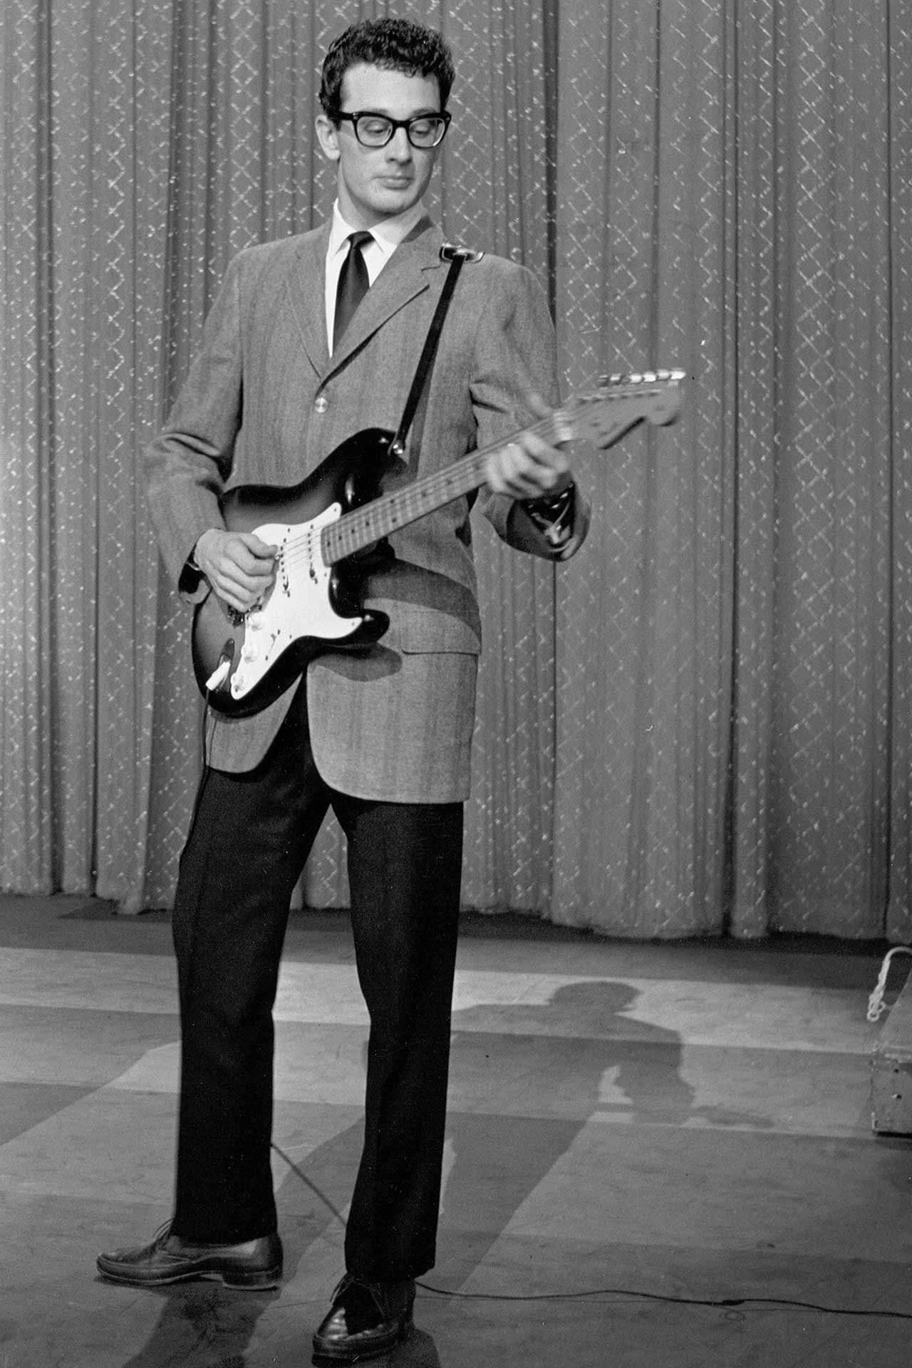
Rock n’ Roll
Some of the pioneer rock n’ rollers were:
  Buddy Holly
  Elvis Pressley
  Chuck Berry
  Jerry Lee Lewis
  Fats Domino
  The Isley Brothers

Slide 15
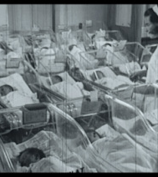
The Baby Boom
1946-1964 is known as the Baby Boom. Returning soldiers became new fathers, which created a massive rise in the birth rate.
Between 1946-1964, America’s population increased almost 30 percent.

Slide 16

Women in the Workplace
During the war, many women who may have been stay-at-home moms went into the workplace out of personal and patriotic necessity.
Women continued in the workplace after the war, and many more women went into the workplace.
By 1970, 41 percent of married women were in the workplace. In 1998, it was 68 percent.

Slide 17
The Space Race
As an offshoot of the Cold War, the Space Race came into being in 1957.
On October 4, 1957, Soviet scientists shocked the world by sending a 184 pound unmanned space craft called Sputnik I into orbit around the world.
A month later, they send a larger satellite, Sputnik 2, a 1,184 pound space craft with a dog in it.

Slide 18

The Space Race
Sputnik gave many Americans the belief that the Soviet Union had passed America in technology.
The military implications of this were staggering. If the Soviets could launch a rocket into space, they could launch ICBMs at the US.

Slide 19
The Space Race
The first being to orbit the Earth was a female part-Samoyed terrier named Laika. She weighed about 12 lbs. The cabin on Sputnik 2 allowed enough room for her to lie down or stand and was padded. Oxygen was provided; food and water were dispensed in a gelatinized form. Laika was fitted with a harness, a bag to collect waste, and electrodes to monitor vital signs. The early telemetry indicated Laika was agitated but eating her food. There was no capability of returning a payload safely to Earth at this time, so it was planned that Laika would run out of oxygen after about 10 days of orbiting the Earth. Because of the thermal problems she probably only survived a day or two.

Slide 20

The Space Race
Both Democrats and Republicans attempted to blame each other for this state of affairs.
“Rocket Fever” soon swept the nation. President Eisenhower soon established NASA and ensured it was funded with millions of dollars.

Slide 21

The Space Race
America soon launched its own spacecraft, Vanguard I, which, humiliatingly, blew up a few feet off the ground after launch.
In 1958, America put a spaceship into orbit about the size of a grapefruit, weighing 2.5 lbs.

Slide 22
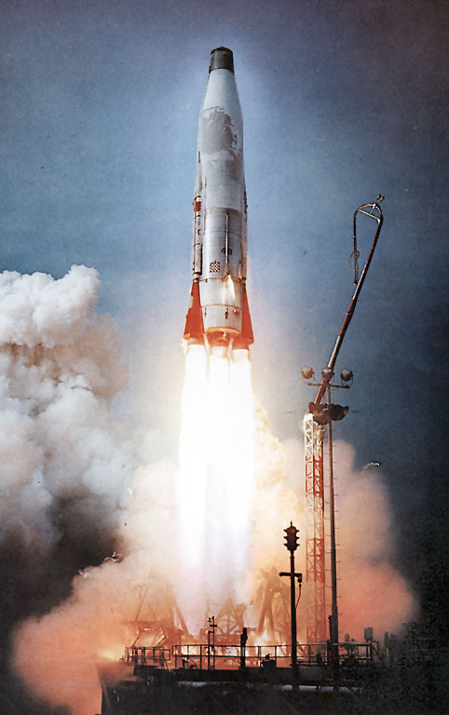
The Space Race
The Space Race led the US to critically examine its educational system.
STEM (Science, Technology, Engineering, and Mathematics) received huge boosts in funding and prestige.

Slide 23
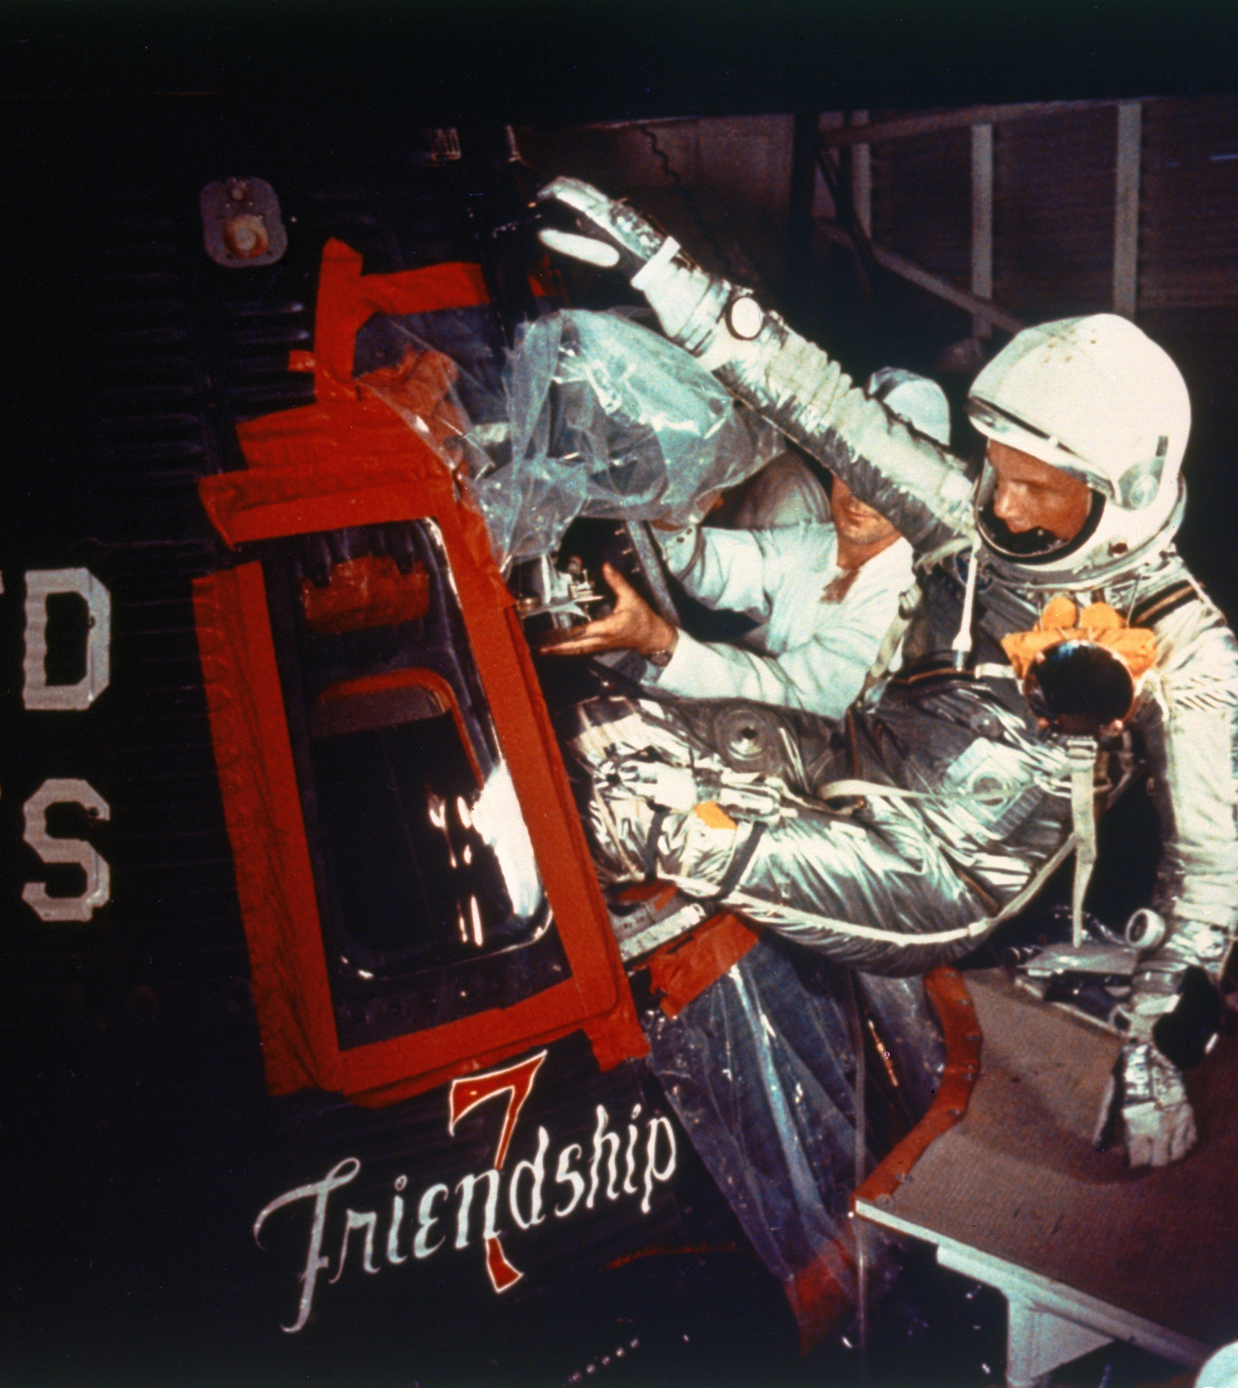
The Space Race
By the end of the 1950s, the US had successfully tested its first ICBMs.
Several satellites had been launched.
The way had been paved for manned spacecraft.
On February 20, 1962, John Glenn was launched to become the first American to orbit the earth.

