Slide 1
The Reagan Revolution
To the Eighties and Beyond!

Slide 2
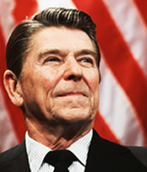
Ronald Wilson Reagan (1911-2004)
Former radio broadcaster and actor
Gave the keynote speech for the 1964 Republican National Convention.
Former Governor of California (1966-74)
Served as President of the United States (1980-88)

Slide 3
America’s New Conservative Movement
Arose after the defeat of Barry Goldwater in the 1964 Presidential Election.
Stood for:
  Limited Government
  Anti-Communism
  Decreased government spending
  Strong national defense
  Opposed Carter initiatives such as the SALT II Treaty and the Panama Canal Treaty
  Opposed abortion on demand and the Roe v. Wade Supreme Court Decision of 1973.

Slide 4
The Democratic Run-Up to 1980
President Carter was hindered by:
  13+ percent inflation
  Iran hostage crisis
  Grain embargo on USSR (hurt farmers by limiting overseas markets and glutting US markets)
  Seeming inability to solve intractable problems.
In the Democratic primaries, Senator Edward “Ted” Kennedy opposed Carter throughout the primary season, despite the fact that he had virtually no chance of winning the nomination.
  Kennedy was more liberal than Carter, and along with those who supported him, wanted to push Carter in a more liberal direction.

Slide 5
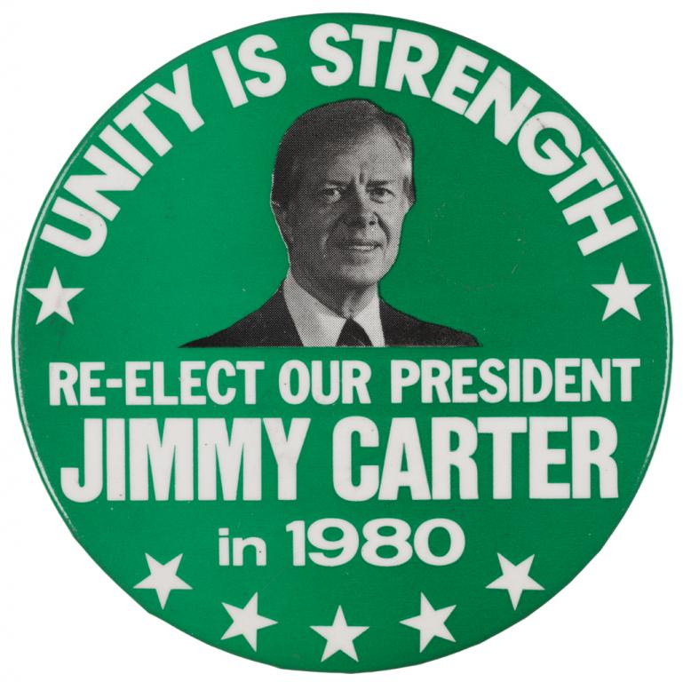
The Democratic Run-Up to 1980
Not only was Carter opposed by Kennedy in the primaries, but in the General Election, John Anderson of Illinois, another candidate more liberal than Carter, ran as a third party candidate. Although he received only 6 percent of the vote, President Carter was the candidate who was most affected.

Slide 6
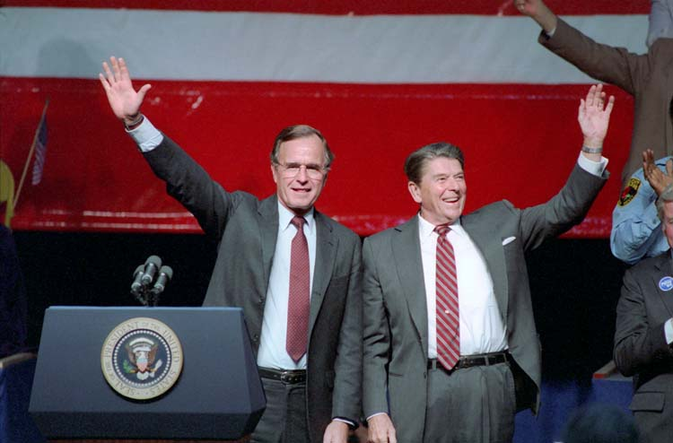
The Republican Run-Up
In contrast to the Democrats, the Republicans were unified going into the 1980 election. To unite the party, Mr. Reagan asked George H. W. Bush, a more moderate Republican, to be his Vice-Presidential candidate

Slide 7
What made Reagan different?
Had tremendous charisma, especially compared to Nixon, Ford, and Carter.
Was known as “The Great Communicator”
Tremendous optimism and belief in the greatness of America and its people.
Was able to redraw the lines of traditional American voting
  The formerly “Solid South” was now Republican
  Pro-military positions won Reagan votes in the South and the Midwest
  Tax-cutting was popular with the working and middle class
  Religious conservatives, who were organizing as a political constituency after Roe v. Wade, appreciated Reagan’s staunch pro-life support.

Slide 8
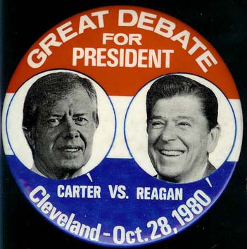
“Are you better off . . . ?”
1989, 2nd Presidential debate:
Debate button
  "Ask yourself, 'Are you better off now than you were four years ago? Is it easier for you to go and buy things in the stores than it was four years ago? Is there more or less unemployment in the country than there was four years ago? Is America as respected throughout the world as it was?”

Slide 9
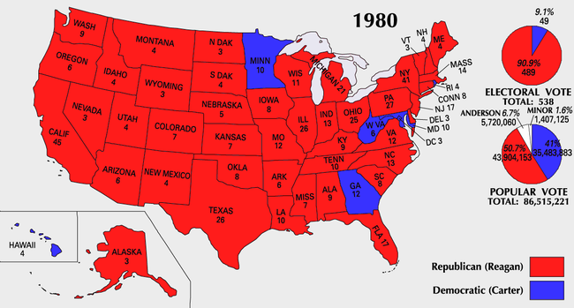
1980 Electoral Map

Slide 10
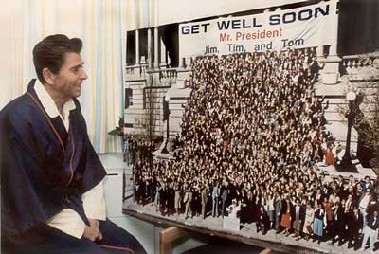
Reagan Humor in Dark Times
March 30, 1981: John Hinckley Jr. shot Reagan outside a hotel where the newly elected president had just spoken. After the assassination attempt with a bullet an inch from his heart, as Reagan was moved to the operating table, he said to the doctors, "Please tell me you're all Republicans." Dr. Joseph Giordano, a Democrat, replied, "We're all Republicans today."

Slide 11
Reagan: The Gift of Leadership
President Reagan had the gift of being able to inspire people to do greater things than they believed possible.
His confident, optimistic leadership was a stark contrast to Johnson, Nixon, Ford, and Carter.
He restored public confidence in the Presidency after the disastrous records of the Presidents of the 1970s.
Reagan placed his faith in the ability of the individual rather than in government. He sought to liberate Americans from oppressive taxation, government regulation, and the fear of worldwide Communism.

Slide 12
“Revolution in governance”
Two points:
  American must be free
  America must be strong
Strategies
  Promote opportunity
  Unleash government restrictions hindering economic growth
  Strengthen America’s moral fiber
Hindrances
  Big Government
  High Taxes
  Budget Deficit

Slide 13
“Reaganomics”
Lower inflation by:
  Increasing production of goods
  Increasing supply of goods
Higher productivity and lower prices stimulate the economy by:
  Creating more job opportunities
  Lowering prices
Increase confidence in the American economy by:
  Lowering taxes
  Giving Americans incentives to earn, save, and invest
  Reducing government regulations
  Giving corporate tax breaks

Slide 14
Economic Recovery
Reagan’s outlook on the economy in 1980:
“A recession is when your neighbor loses his job. A depression is when you lose yours. And recovery is when Jimmy Carter loses his.”
In 1980, the economy continued to worsen. President Reagan challenged Americans to “stay the course.” By 1983, the Reagan tax cuts and pro-business policies helped to jump start the longest continual economic expansion that America has ever experienced.

Slide 15
Economic Recovery
In the 1980s, America experienced
  Lower unemployment
  Lower taxes
  Lower prices
  Lower interest rates
  Lower oil prices
  Unemployment below 5 percent
  20 percent of all houses in America were built during the 1980s
  Per capita income increased by 17 percent during the 1980s

Slide 16
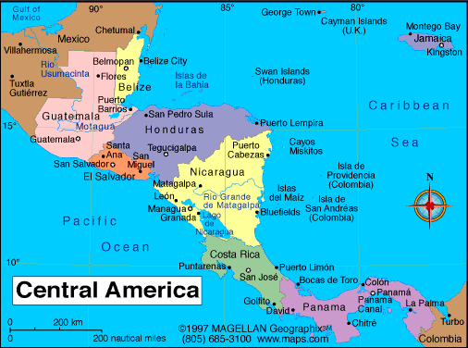
Foreign Policy
Military action in Latin America:
  America sent weapons weapons, military advisors, and economic aid to anti-Communist groups in El Salvador and Latin America, preventing a Communist takeover in El Salvador.
  Nicaragua was much more controversial. The country was governed by a group called the Sandinistas, a Marxist group with Soviet backing through Cuba. President Reagan, against the warnings of Democrats and even some within his own party, sent arms, advisors, and economic aid to a group called the Contras.

Slide 17
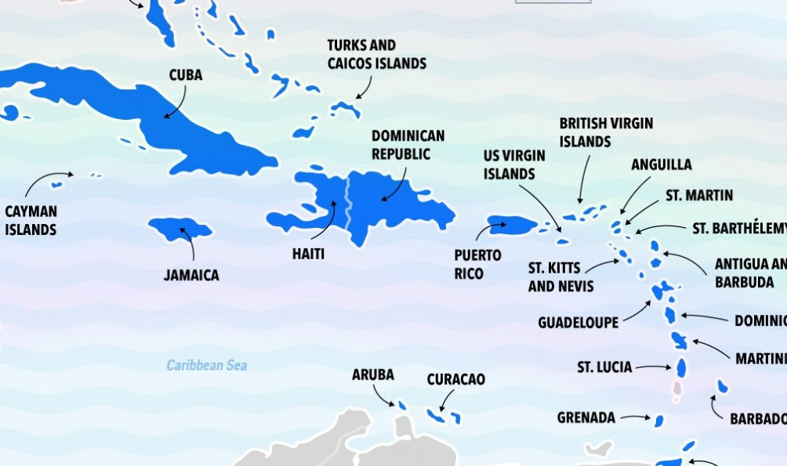
Regime Change in Grenada: October 1983

Slide 18
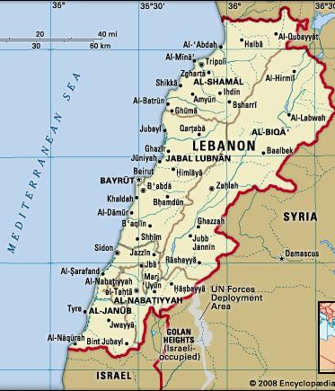
Terrorism
Lebanon had been in a state of war since the 70s.
Reagan ordered US troops to join a multi-national peacekeeping force in 1983.
US forces were perceived as Israeli allies and targets for terrorists.
October 26, 1983, a suicide bomber drove a truck into a US Marine barracks, killing 241 marines.
US troops soon returned offshore to leave Lebanon to sort out its own fate.

Slide 19
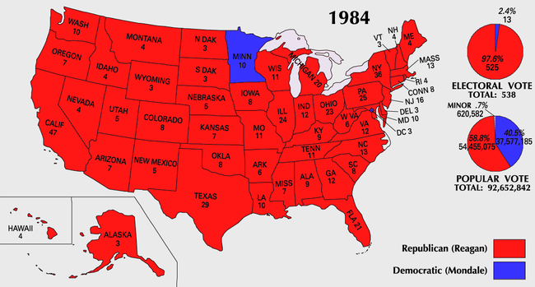
1984 Election – Reagan wins 49 states

Slide 20
Foreign Policy – The Soviet Union
1985: Mikhail Gorbachev comes to power in the USSR. The economy and the military are on the verge of collapse.
Gorbachev attempts to restructure the economy on free-market principles (perestroika)
He also promotes openness to Western ideals (glasnost)
These tended to be half-hearted measures, powerless to stop the Soviet Union from imploding.
  The ethnic republics began to rebel against Soviet rule.
    In 1989, each of the Soviet-bloc Eastern European countries got rid of their Russian-backed, Communist government.
    Germany reunited in 1990.
    The Soviet Union broke up at the end of 1991.

Slide 21
Foreign Policy: Iran Contra Scandal
The House and Senate won Democratic majorities in the 1984 election, and would not approve aid to the Contras in Nicaragua.
Iran was in a costly, eight year war with Iraq (this is the same Iran run by the Ayotollah Khomeni who held American hostages for 454 days).
It was revealed that John Poindexter, National Security Council Chief, his aid Oliver North, and CIA Director William Casey had set up arms sales to Iran, for the purpose of funneling the proceeds to the Contras in Nicaragua.
On March 4, 1987, President Reagan took full responsibility for these actions in a televised address.
North and Poindexter were later indicted and convicted on criminal charges. North’s conviction was overturned on a technicality.

Slide 22
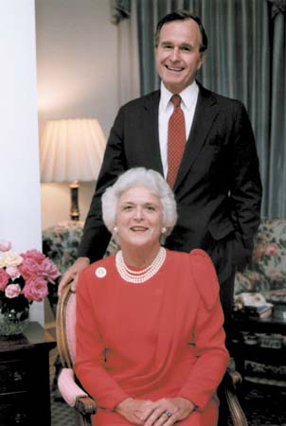
George H. W. Bush wins the Presidency
In 1988, Vice President George Herbert Walker Bush wins the Presidency. This victory was largely a stamp of approval on the Reagan Presidency. Bush would go on to have great successes in his term, but a downturn in the economy doomed him to be a one-term President.

Slide 23
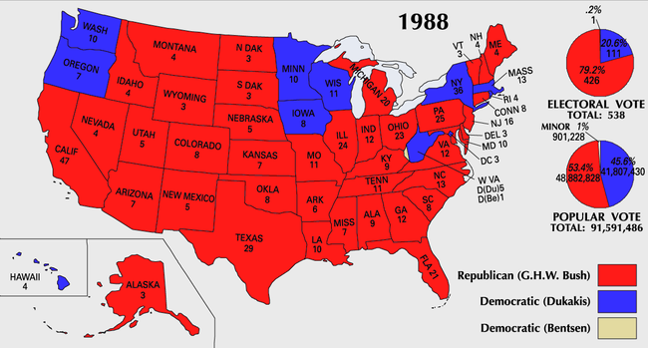
1988 Presidential Election

