Slide 1
The Seventies
Weak Presidents
Weak Economy
Bad Clothes

Slide 2
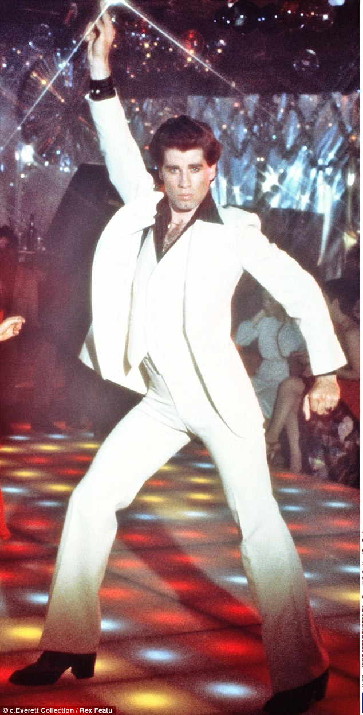
The Seventies Look
John Travolta in Saturday Night Fever. Notice the flyaway collar, tight pants, and shirt unbuttoned halfway down the chest.

Slide 3
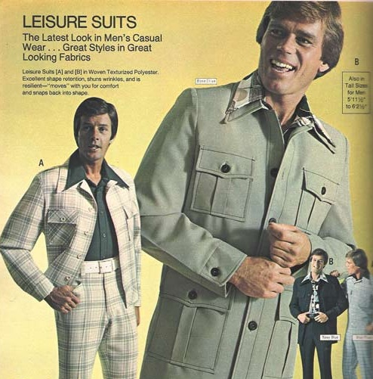
The Leisure Suit
The worst fashion idea ever conceived!

Slide 4
Weak Presidents
The Watergate Scandal and Cover-up significantly weakened the office of the Presidency.
This, along with a falling economy, made both Gerald Ford (1973-76) and Jimmy Carter weak Presidents.

Slide 5
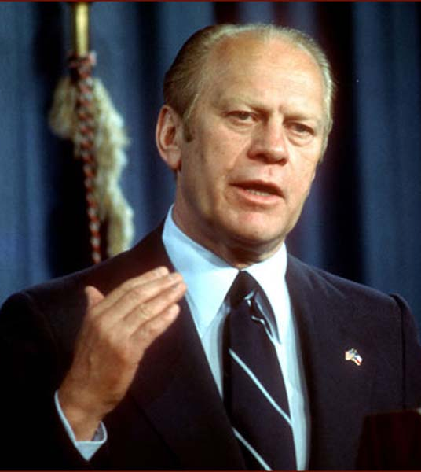
President Gerald Ford
Prior to becoming President, Gerald Ford was a Congressman from Michigan and the House Minority Leader. Nixon selected him for the office of Vice President after the resignation of Spiro Agnew.

Slide 6
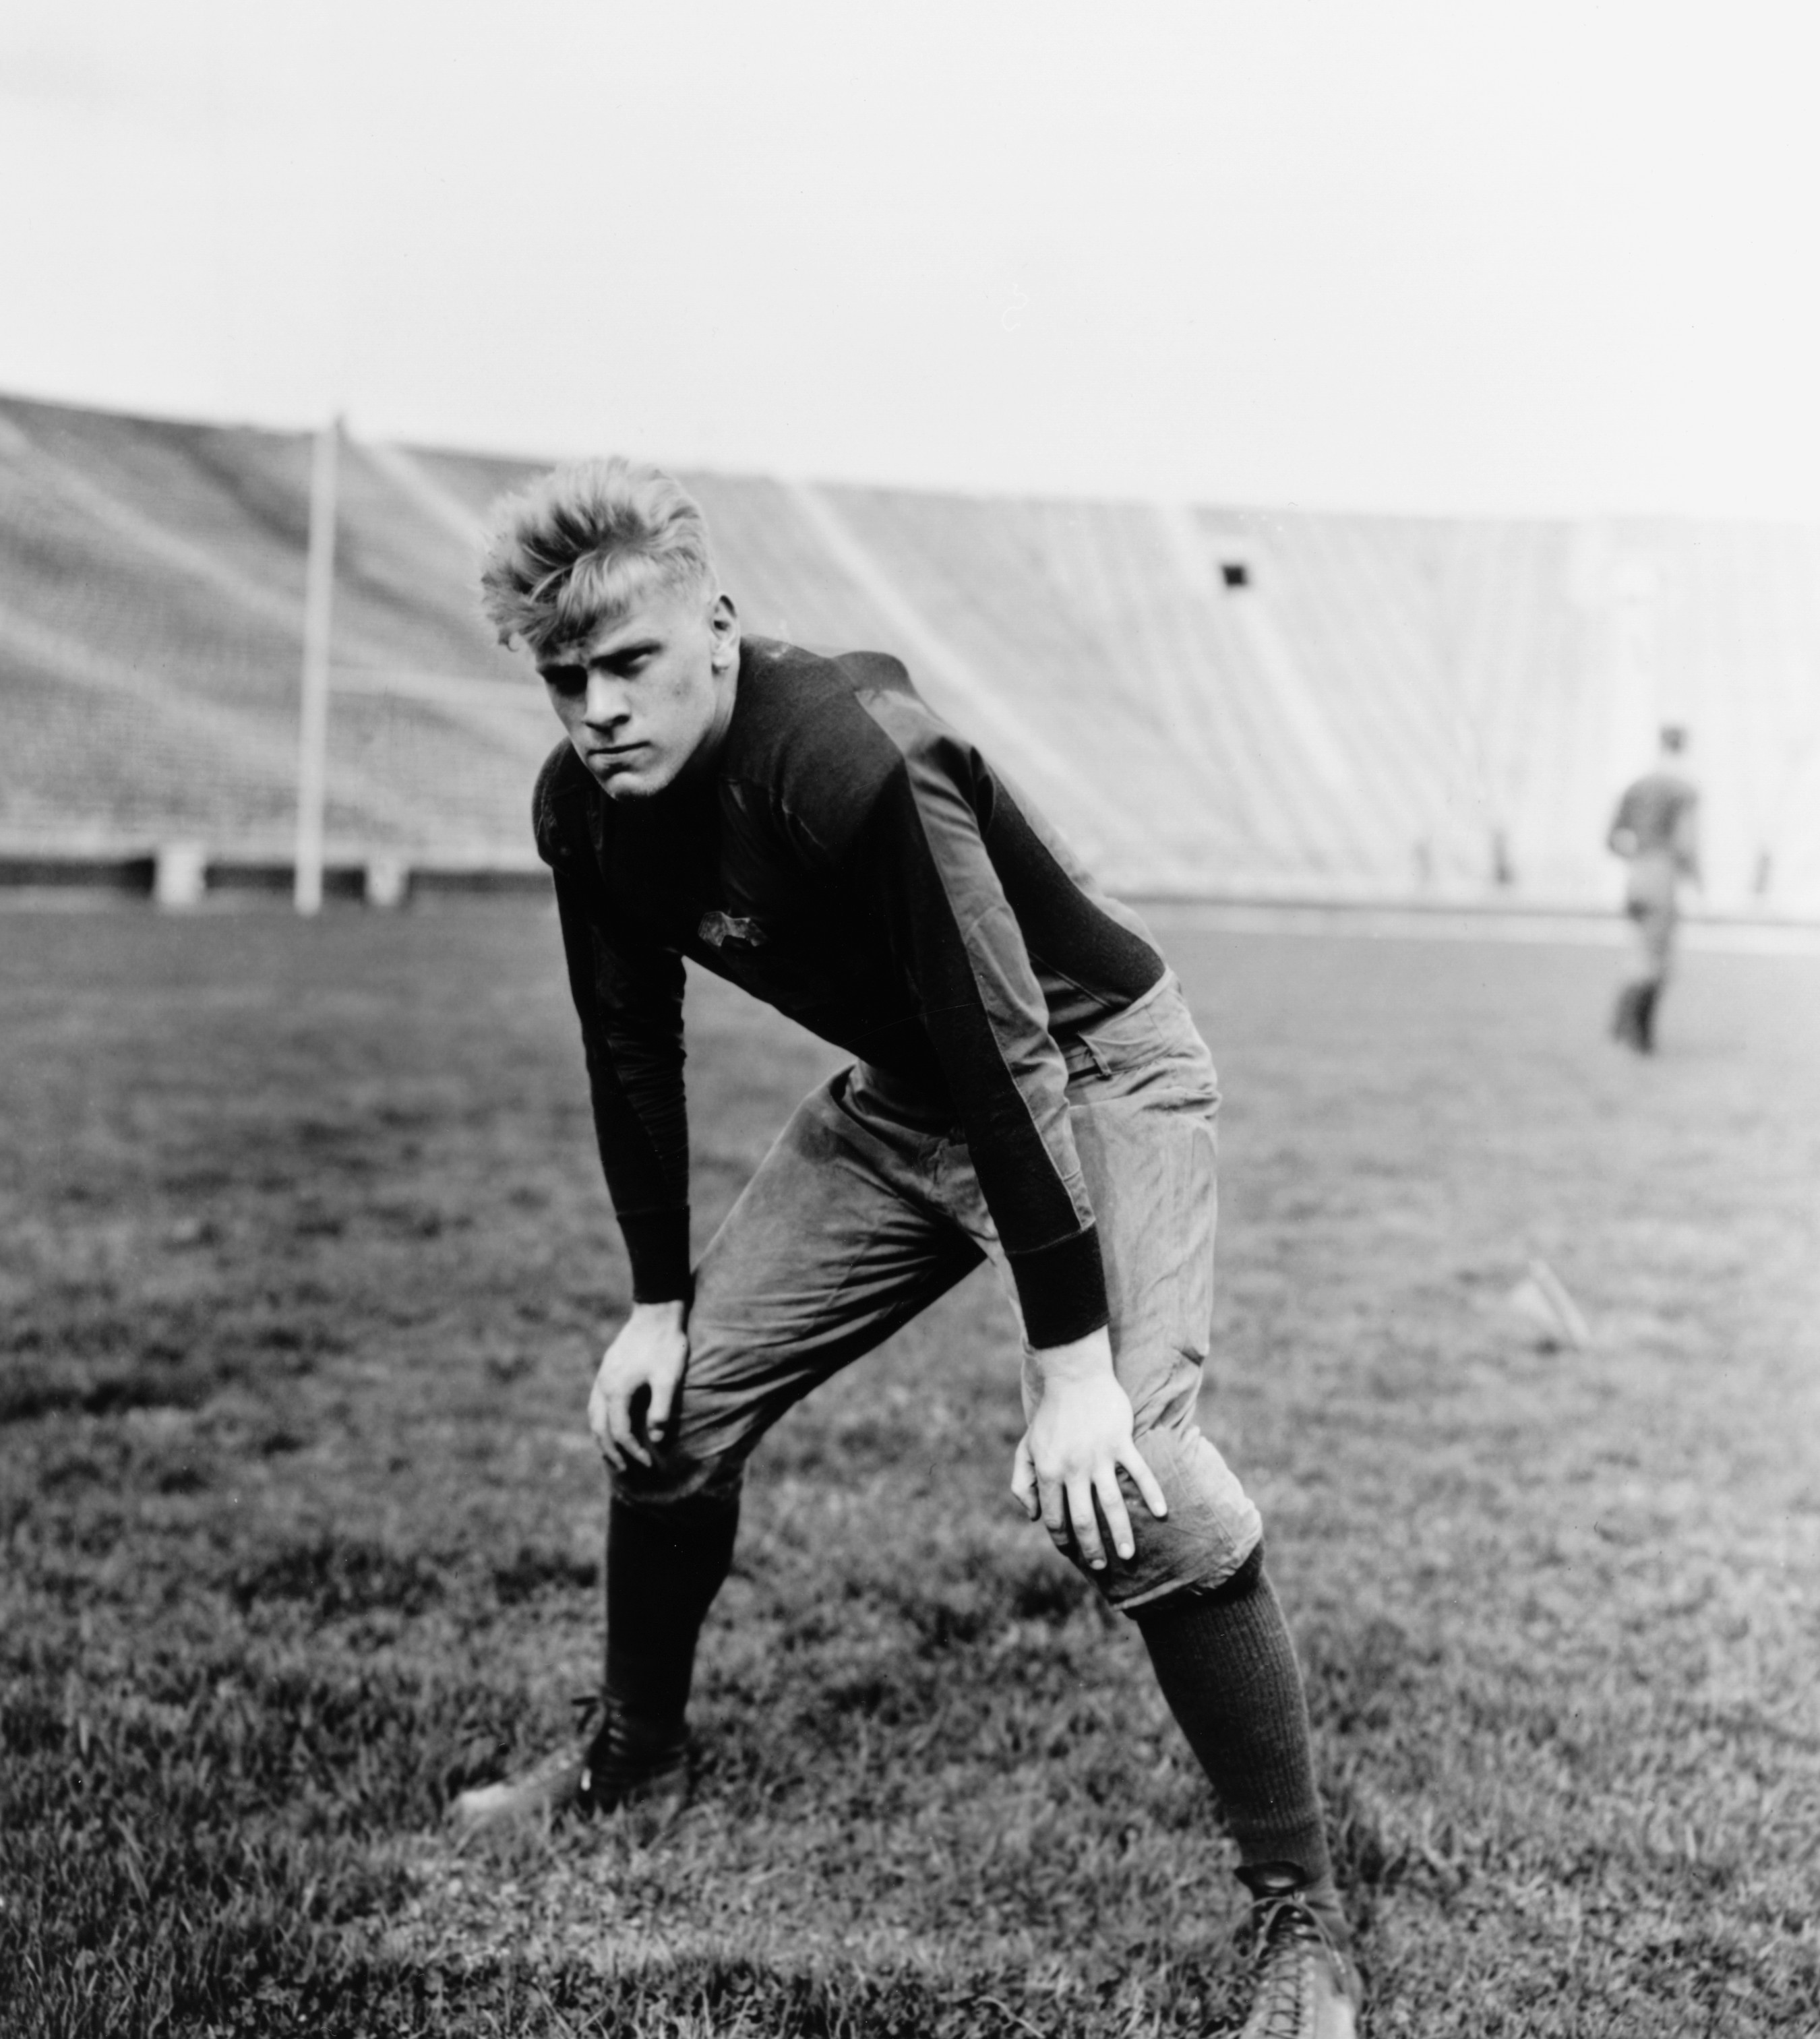
President Gerald Ford
President Ford was seen as a decent, honest man, the right man for the nation to heal after Watergate.
Lyndon Johnson said, “He’s a nice fellow, but he spent too much time playing football without a helmet.”

Slide 7
President Gerald Ford
President Ford was the only President who was not ever elected to a national office.
He began with the nation’s sympathy, but soon lost it when he granted President Nixon a “full, free, and absolute pardon” for any crimes he may have committed while President.

Slide 8
Challenges Ford Faced
Neither he nor his Vice President, Nelson Rockefeller, were elected.
Both the House of Representatives and the Senate had Democratic majorities.
Congress was determined to control the executive branch after the transgressions of the Nixon administration.
Because of this, President Ford was not able to get meaningful legislation passed.

Slide 9

Other Challenges
President Ford presided over the final withdrawal of troops from Vietnam in 1975.
The economy continued its downward spiral, and wouldn’t recover until the 1980s.

Slide 10
The Energy Crisis
One of the challenges that President Ford faced was the Energy Crisis.
The Arab Oil Embargo, begun in the Nixon administration, continued in the new administration.
The embargo plus rationing created shortages in gasoline, heating oil, and natural gas.
Americans now began to realize that energy sources were not inexhaustible nor inexpensive.

Slide 11
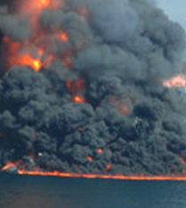
Environmentalism
Partially as a result of the energy crisis, the Environmental Movement began in the 1970s.
Industrial emissions and auto emissions had greatly damaged air quality in the nation’s largest cities.
The nations waterways were polluted as well. The Cuyahoga River in Ohio was so polluted and filled with petroleum waste it caught on fire in 1969

Slide 12
Creation of the EPA
In 1970, Congress created the Environmental Protection Agency (EPA) to oversee and coordinate environmental regulations.
They passed the Clean Air Act (1970, rev. 1977), and the Clean Water Act (1977).
While these changes were certainly needed, they also caused energy to be more expensive.

Slide 13
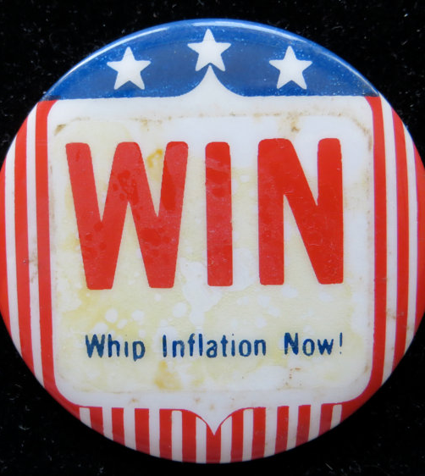
Stagflation
The economy of the 1970s suffered from stagflation – high unemployment plus high inflation. This was caused by:
  The energy crisis and the resulting shortages and price hikes
  Inflating the money supply to pay for the Vietnam War and the Great Society without raising taxes
  Taking the country completely off the gold standard

Slide 14
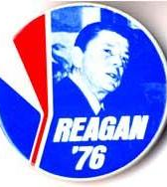
1976 Election
President Ford almost didn’t get renominated by his own party. Inflation, high unemployment, the Nixon pardon, and the public perception of Ford as inept hampered his chances. Ronald Reagan, the former governor of California, put up a strong challenge to Ford in the primaries.

Slide 15
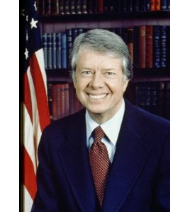
Jimmy Carter
The Democrats ran an unlikely candidate.
James Earl “Jimmy” Carter was a Naval Academy graduate and was a nuclear engineer in the Navy. After his naval career, he returned to his hometown of Plains, GA and life as a peanut farmer. He then rose to the governorship of Georgia.

Slide 16
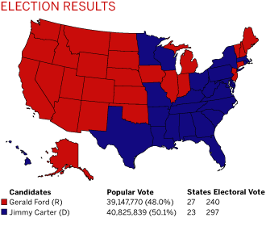
1976 Election Results

Slide 17
Carter as President
President Carter was perhaps one of the most capable men that the US has ever had in the Presidency. He was seen as open, honest, and compassionate.
However, from the beginning, his style worked against him.
  He was seen as dour and humorless
  He attempted to manage every detail of the government
  Being an outsider handicapped him, even though he had large majorities in both houses of Congress.
  These qualities made him largely ineffective as a leader.

Slide 18
Carter’s Undistinguished Record
Amnesty (a general pardon) for Vietnam War draft dodgers
Giving away the Panama Canal (the Panama Canal treaty returned the canal to Panama in 2000)
Reinstituted draft registration
1980 Olympics boycott (over the 1979 Soviet invasion of Afghanistan).
Iran hostage crisis (see https://www.youtube.com/watch?v=FUMqx25X2hs)
The economy continued to worsen, with almost 8 percent unemployment and 13 percent inflation.

Slide 19
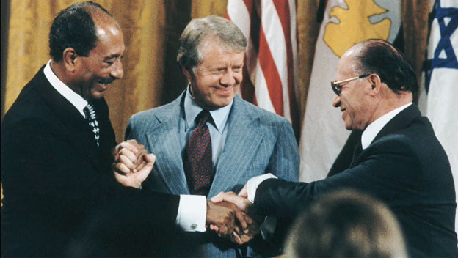
Carter’s Greatest Accomplishment
Camp David Accords: Jimmy Carter was able to get Menachem Begin, Prime Minister of Israel, and Anwar Sadat, President of Egypt, to hold face-to-face talks at Camp David.
Egypt and Israel agree to diplomatic recognition of each other, and sign a peace treaty ending 31 years of hostility.

Slide 20
Next . . .
The Reagan Revolution
The Downfall of Communism
The Age of Terror

