Slide 1
The Sixties
The Counterculture and Radicalism
“Sex, Drugs, and Rock n’ Roll”

Slide 2

Summary of the 60s
“The Sixties were bad!” Mr. Clay

Slide 3
What was bad about the 60s?
Assassinations of public figures
An unpopular war
A culture of violence
A great expansion of the power of the federal government
The counterculture (mostly)
The drifting of much of the church from historic Christianity
The sexual revolution

Slide 4
Assassinations
President John F. Kennedy; November 22, 1963
Civil Rights Advocate Malcom X; February 21, 1965
The Rev. Dr. Martin Luther King, Jr.; April 4, 1968
Senator and Presidential Candidate Robert F. Kennedy; June 5, 1968

Slide 5
An Unpopular War
The Vietnam War (1955-1975) was probably the most divisive war fought in US History. American deaths totaled 58, 220. We will spend a class period on this conflict, but this a polarizing force in America in the 1960s.
Vietnam was also the first “nationally televised war.” Gruesome images of the horrors of war were a staple of the nightly news, and led to pressure on the US government to get out of the war.

Slide 6
The New Left
The New Left was a political movement of the 1960s . It originated with politically active college-aged students who sought to reform the American political system.
Characteristics of the New Left were:
  A vision of participatory democracy
  Free speech on college campuses
  Direct Action to raise public consciousness of issues.

Slide 7

The New Left
Goals of New Left:
  End poverty through redistribution of wealth
  Civil rights
  Nuclear disarmament
  Feminism
  Most importantly, ending the Vietnam War

Slide 8
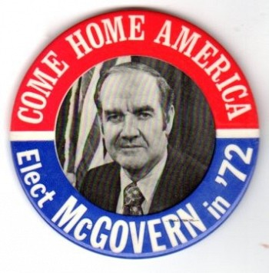
New Left
The New Left reached their peak influence in 1972, when the Democratic Party nominated George McGovern, an anti-war Senator from South Dakota, as a protest candidate to “the establishment.”

Slide 9
A culture of violence
Protests against the Vietnam War often turned violent.
Civil rights actions often turned violent.
Violent crime skyrocketed in 60s.
Riots took place in Newark, NJ, Detroit, and Los Angeles in 1967, as inner cities became anarchic.
US atrocities during the Vietnam War, the most famous being the My Lai massacre, were heavily publicized.

Slide 10
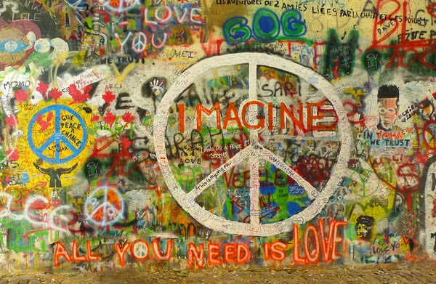
The Counterculture
The counterculture flourished mainly from 1964-1972, although it has never really gone away.
This was a movement mostly involving people in the 18-30 age range.

Slide 11
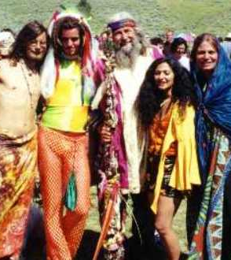
Hippies and Counterculture
Distrust of authority – “don’t trust anyone over 30.”
Rejection of authority and values of parents.
Rejection of materialism
Experimentation in sexuality
Embracing rock n’ roll
Drug usage

Slide 12

Haight Asbury, San Francisco
Haight-Asbury in San Francisco became the epicenter of the 60s counterculture. Live rock n’roll was plentiful, people sold and used drugs openly, and there were plenty of college students from the colleges in San Francisco.

Slide 13

Summer of Love
The Haight-Asbury experience culminated in the 1967 “Summer of Love,” when over 100,000 people descended on this neighborhood to partake of sex, drugs, and rock n’ roll.

Slide 14
“Free Love”
One of the values of the hippies was “free love”
Self-fulfillment was seen as a higher good than a lifelong commitment to a husband or wife.
This was the beginning of the sexual revolution that is still with us today.
“Do your own thing” was an innocuous-sounding motto that has become the battle-cry of sexual libertines since then

Slide 15
Why this is important now
The counterculture was an enormous influence on middle class youth of the 60s, 70s, and 80s.
Many of today’s opinion leaders can trace their intellectual journeys back to the counterculture (i.e., Steve Jobs – even though he’s dead, the Clintons, chairmen of Fortune 500 companies that advocate for progressive causes).

Slide 16
Why this is important now
The values of the counterculture continue to be transmitted through literature and classic rock n’ roll to new generations. While the fashions of the hippies have come and gone, the values have become mainstream.

Slide 17
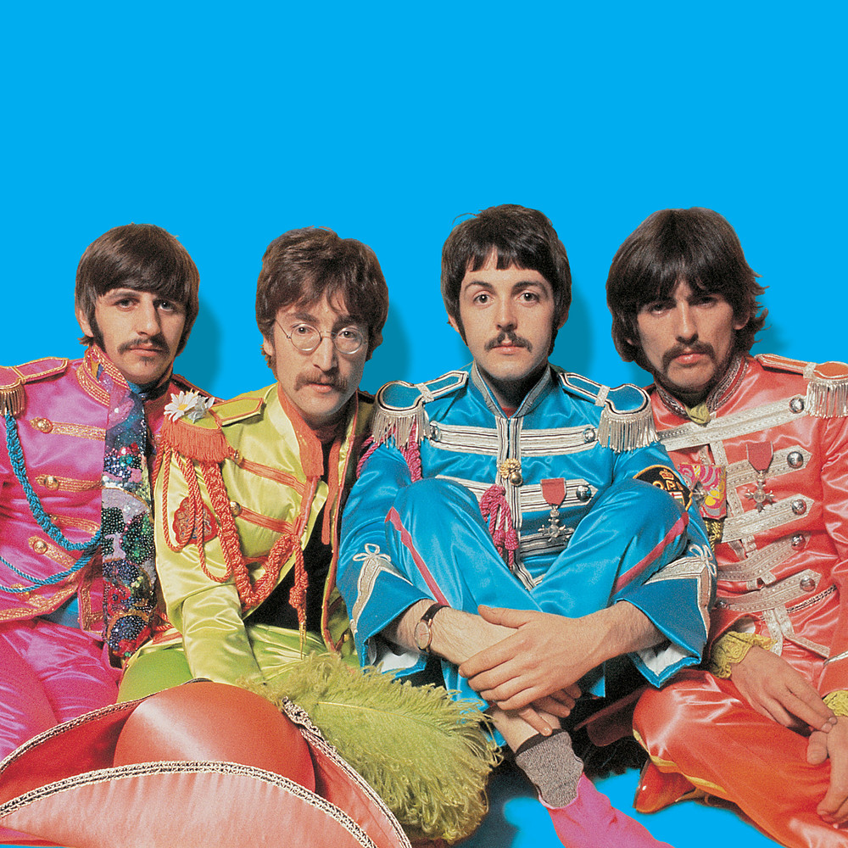
Music
Music is one of the most important cultural contributions of the 60s. Mention the 60s to almost anyone, and they will think of the Beatles, the Rolling Stones, Jimi Hendrix, Janis Joplin, The Who . . .

Slide 18
Election of 1968
President Lyndon Johnson, after losing the New Hampshire Primary, decided not to run for another term
The Democrats were saddled with the failures of the Vietnam War.
They nominated Hubert Humphrey, Johnson’s Vice-President and a former Senator from Minnesota

Slide 19
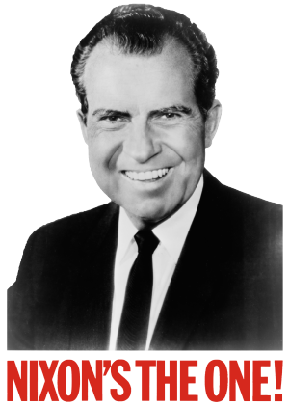
Election of 1968
Meanwhile, the Republicans nominated Richard M. Nixon, a one time Senator from California who became famous for anti-Communism and was Eisenhower’s Vice-President.

Slide 20
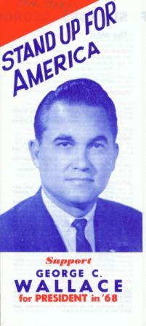
Wallace splits Democratic Vote
Desiring to throw the Election into the House of Representatives, George Wallace, the pro-segregation Governor of Alabama, ran as a third-party candidate. He carried the Deep South, and split the Democratic vote, opening the way for a Nixon victory.

Slide 21
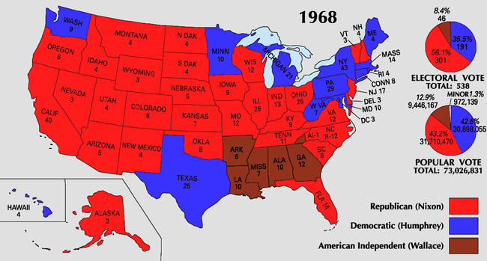
1968 Electoral Map

Slide 22
The “Silent Majority”
In the face of all of the cultural changes of the 1960s, how did Nixon win?
His “Silent Majority” speech of November 3, 1968 identified the constituency who would vote him into office:
"And so tonight—to you, the great silent majority of my fellow Americans—I ask for your support.”

Slide 23
Who was the Silent Majority?
People who didn’t participate in protests, marches, or even publically express political opinions.
Blue-collar people
Young people of the South and Midwest
Middle class
People who believed “freedom was everybody’s business.”

Slide 24
Problems Nixon Faced
Vietnam: Nixon’s “secret plan” for ending the war caused the war to go on another five years. Each year, the war became more and more unpopular, as more men came home either in body bags or permanently disabled. During his second term, he was able to end American involvement in Vietnam.

Slide 25
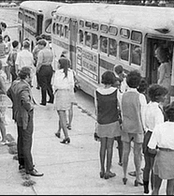
Problems Nixon Faced
Presiding over forced busing as a means of school desegregation. In April, 1971, the Supreme Court ruled that Federal Courts had the authority to order busing to redress racial imbalance. This was enormously unpopular with suburban whites, which were much of Nixon’s constituency.

Slide 26
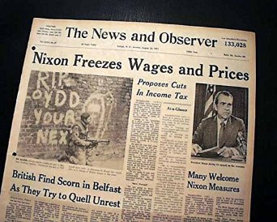
Problems Nixon Faced
Economy: During the Nixon administration, inflation rose from 4.7 % to 10%. The Nixon administration imposed wage and price controls to attempt to stem inflation. These policies were an utter failure, sending the economy into a decade-long recession.

Slide 27
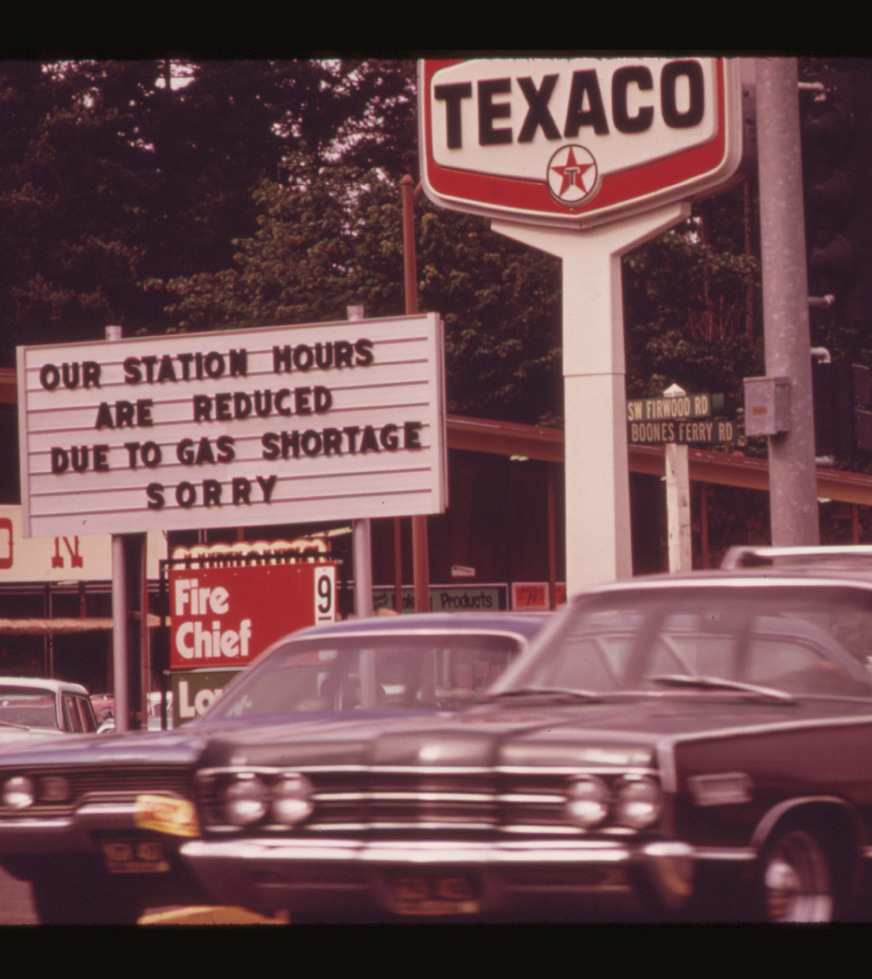
Problems Nixon Faced
Oil Embargo: In 1973, the Organization of Arab Petroleum Exporting Countries placed an embargo on oil exports to the United States, in response to American support for Israel during the Yom Kippur War of 1973.

Slide 28
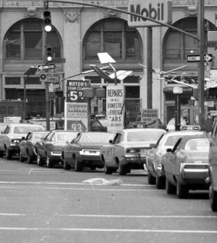
Problems Nixon Faced
The Arab Oil Embargo led to:
  Quadrupling the prices of gasoline and petroleum products.
  Gasoline shortages
  Price controls
  Rationing
  Long lines at gas stations when they were open

Slide 29
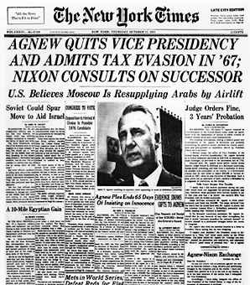
Problems Nixon Faced
Corruption: Vice-President Spiro Agnew was indicted for tax evasion and accepting bribes during his time as Governor of Maryland, and resigned on October 10, 1973.

Slide 30
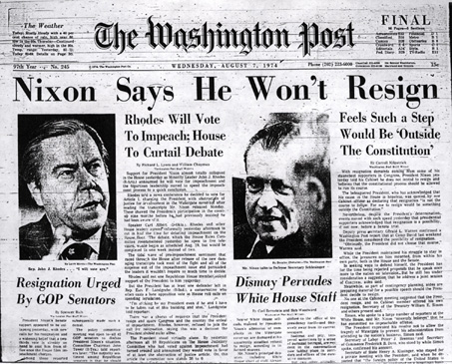
Problems Nixon Faced
Watergate: The Watergate break-in and the resulting cover-up would result in the downfall of the Nixon administration. It came out that the President had extensive knowledge of the break in and was highly involved in the cover-up

