Slide 1
Trojan War
How Greece and Troy ended up fighting a ten year war

Slide 2
Iliad and Trojan War
The Trojan War was a ten year conflict that is believed to have taken place in the 1100s BC.
The combatants were the leaders and princes of Greece versus Troy.
The Iliad does not contain the entire story of the Trojan War. The Iliad takes place over 40 day period in the ninth year of the war.

Slide 3
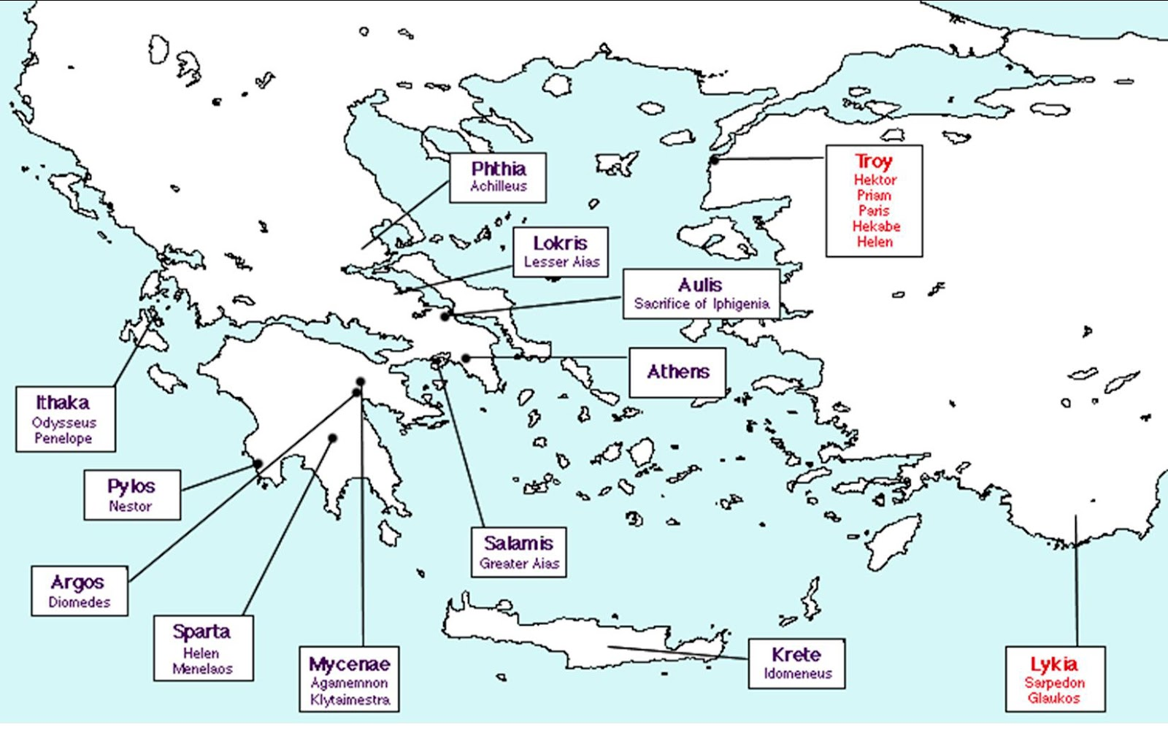
Key People and Places

Slide 4
Important Greeks (Achaians)
Heroes
Gods
Agamemnon
Achilles
Menelaus
Odysseus
Patroclus (Patroklos)
Diomedes
Ajax (Aios)
Hera
Athena
Poseidon
Thetis
Hephaestos

Slide 5
Important Trojans
Heroes and People
Gods
Priam
Paris
Hector (Hektor)
Andromache
Sarpedon
Cassandra
Aphrodite
Ares
Zeus (in early part of story)

Slide 6
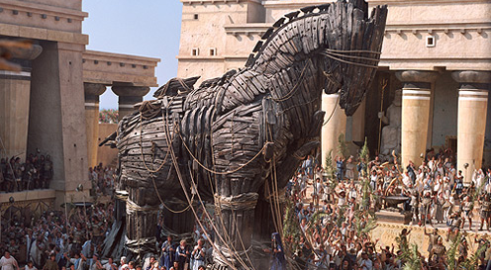
The Trojans

Slide 7
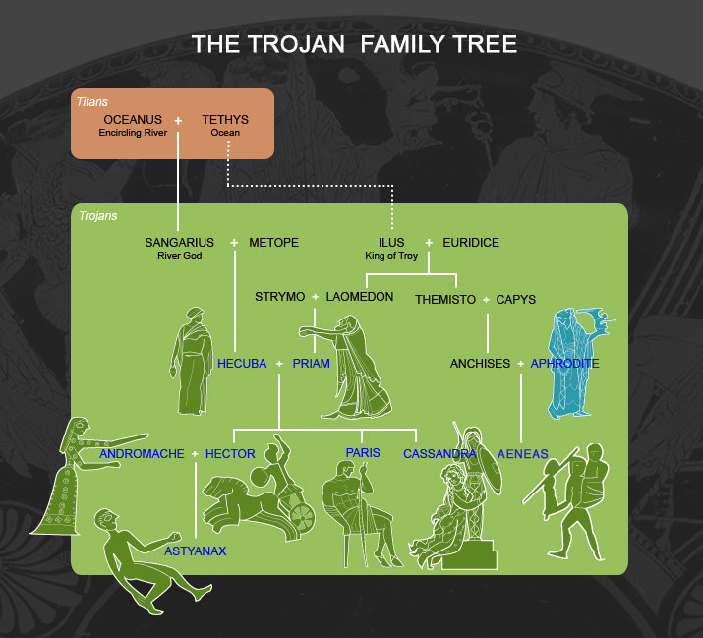
Family Tree of The Trojans

Slide 8
Priam
Priam is the patriarch of the Trojan Royal family. He is married to Hecuba and he has fifty sons.
Among his children are Hector, Paris, and Cassandra.
Priam feels guilty about abandoning Paris as a child, so when Paris reappears, he restores him as a Prince of Troy.

Slide 9

Priam
When Paris returns from Sparta with Helen, Priam indulges his son, although he knows that this may cause him to lose his life and his city.

Slide 10
Hector
The Trojan Prince Hector is the oldest son of Priam and Hecuba and the leader of the Trojans.
He believes that it is likely that the Trojans will lose the war, but that he is honor-bound to defend his brother, Paris, his city, his family, and Troy.
The only Greek who can match Hector on the battlefield is the semi-divine Achilles

Slide 11

Cassandra
Apollo fell in love with Cassandra and gave her the gift of prophesy.
Cassandra did not return his love. Apollo was outraged at his rejection but could not take the gift back.

Slide 12
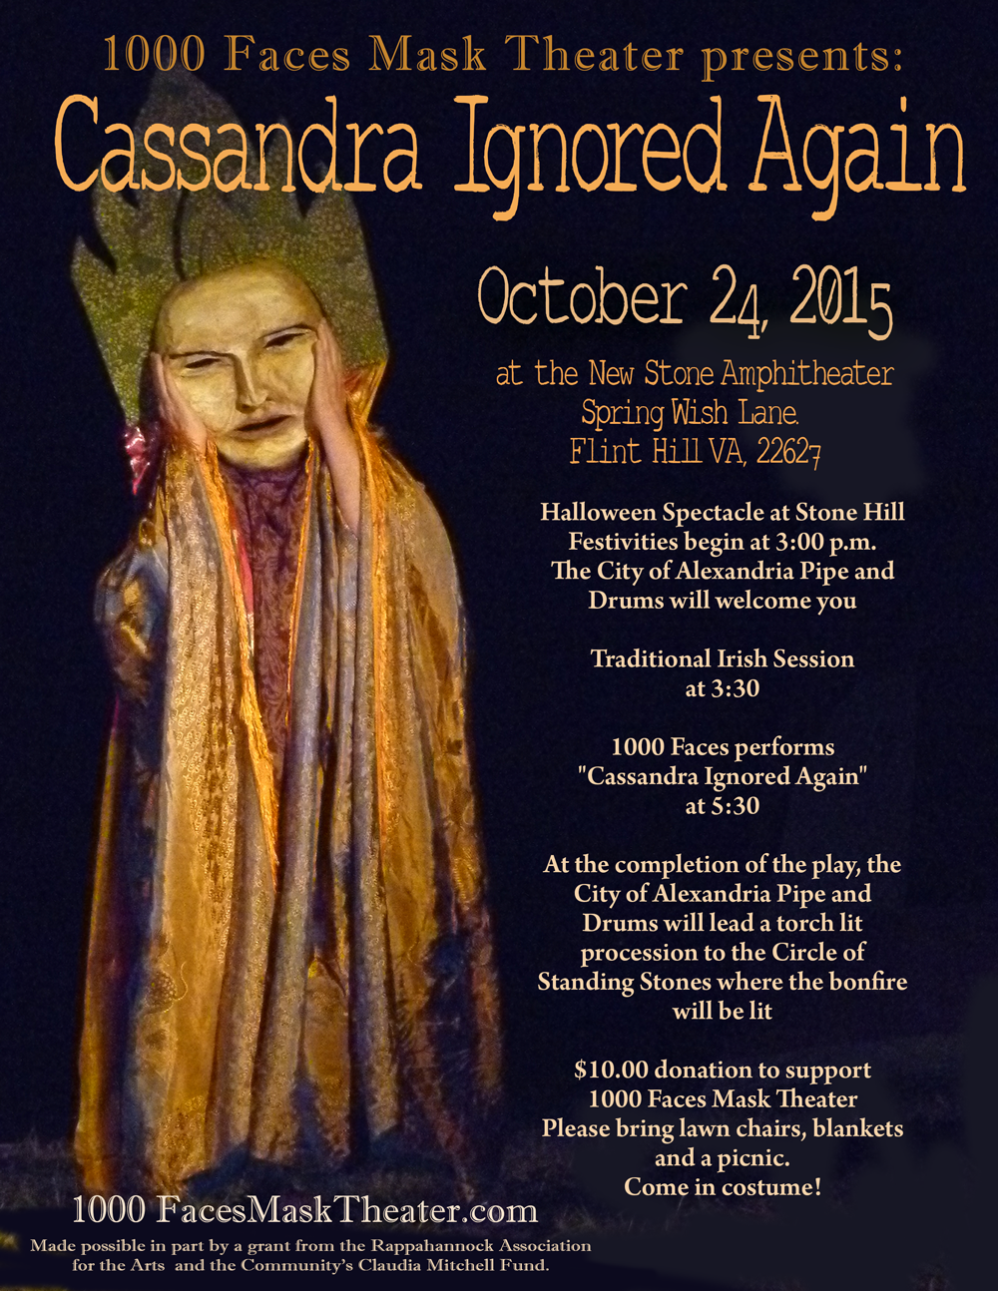
Cassandra
Apollo then curses Cassandra with the fate that although she will prophesy correctly, nobody will believer her.
She accurate predicts the Trojan Horse. When Agamemnon takes her home as his war bride, she also predicts their deaths.

Slide 13
Paris
Before his birth, the prophets of Troy foretold that Paris would cause the destruction of the city. So, his parents left the infant Paris on a mountainside so that the gods could determine his fate. Paris was found by a shepherd and raised as his son.
Paris settled the divine argument over the Apple of Discord, in what is known as the Judgment of Paris.

Slide 14
Paris
Eventually, Paris returns to Troy where he is miraculously recognized by Queen Hecuba as her long lost son.
The king and queen restore Paris to his royal birthright.
In his first official duty as a Trojan Prince, Paris travels to Sparta to negotiate a peace treaty with Menelaus. In Sparta, he meets Helen, the wife of Menelaus, and falls in love with her.

Slide 15
Apple of Discord
Three goddesses come forward to claim the prize.
  Hera
  Athena
  Aphrodite
They cannot decide among themselves who is the fairest, so they ask Zeus to judge.

Slide 16

Apple of Discord
Zeus, who is the husband of Hera and father of Athena and Aphrodite, sees a conflict of interest and refuses to intervene.
He tosses the apple over his shoulder, which bounces to earth and falls at the feet of a shepherd named Paris.

Slide 17
Apple of Discord
The goddess Discord was unhappy at being the only immortal not invited to the wedding of Peleus and Thetis, who later were the parents of Achilles.
As revenge, she picks a golden apple from the Garden of the Hesperides and attaches a tag that reads “For the Fairest.” She then waits to watch the results.

Slide 18
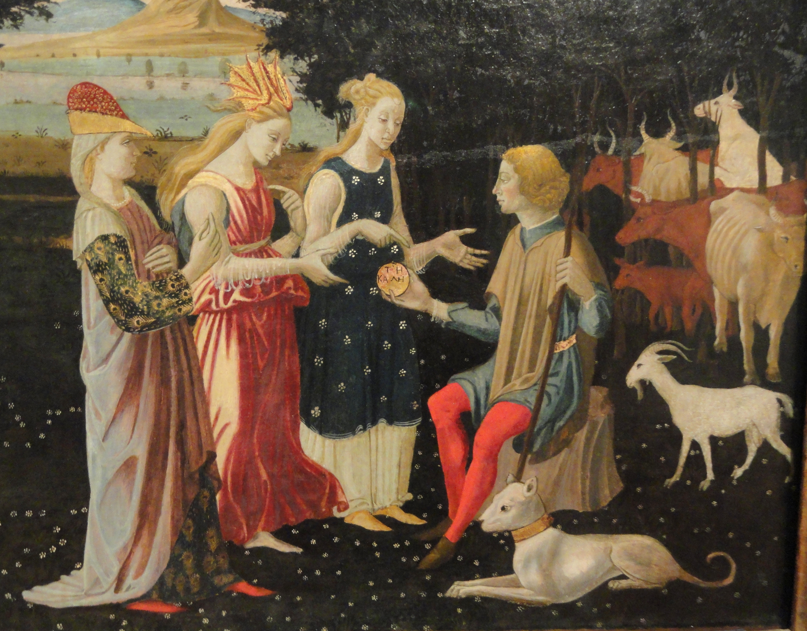
Judgment of Paris
As the adopted son of a shepherd, Paris is tending his flocks one day when a golden apples falls at his feet.
Three goddesses then appear: Hera, Athena, and Aphrodite. Each promises a unique gift.

Slide 19
Judgment of Paris
Which one do you think he chose?
HERA = King of all Europe and Asia
ATHENA = Victory in War
APHRODITE = The most beautiful woman in the world

Slide 20
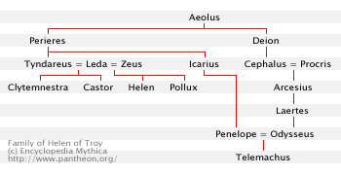
Family Tree of Helen of Troy

Slide 21
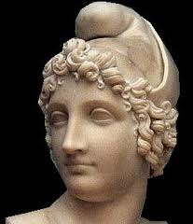
Helen of Troy/Sparta
Helen is married to Menelaus, King of Sparta.
Paris was sent on a diplomatic mission to Menelaus to negotiate a peace treaty.
Paris and Helen fall in love, and Helen goes to Troy with Paris.

Slide 22
Helen of Troy/Sparta
Helen is the daughter of Tyndareus and Leda. She is also the cousin of Penelope, who married Odysseus.
She was the most beautiful woman in the world. Aphrodite did not tell Paris that the most beautiful woman in the world was married.

Slide 23
Oath of Tyndareus
Tyndareus, Helen’s father, had many suitors who pursued Helen.
Every eligible young man in Greed wanted to marry her.
As time went on, Tyndareus could not select a suitor. Then the suitors began to fight among themselves.

Slide 24
Oath of Tyndareus
Odysseus made a suggestion to Tyndareus: Let every suitor swear that he would defend the marriage of Helen and her future husband from any man who tried to separate them as long as any of them should live.
Each of the suitors agreed. Tyndareus then chose Menelaus by lot.
The Oath of Tyndareus was sworn, and all the men who had been Helen’s suitors were honor-bound to recover Helen for Menelaus when she went to Troy with Paris.

Slide 25
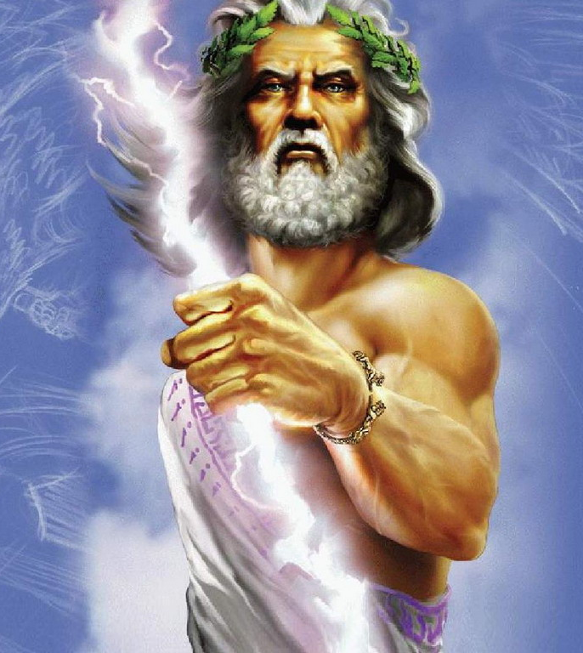
The Immortals
The gods and goddesses play active parts in the Iliad. Sometimes they even come down from Olympus and fight.

Slide 26
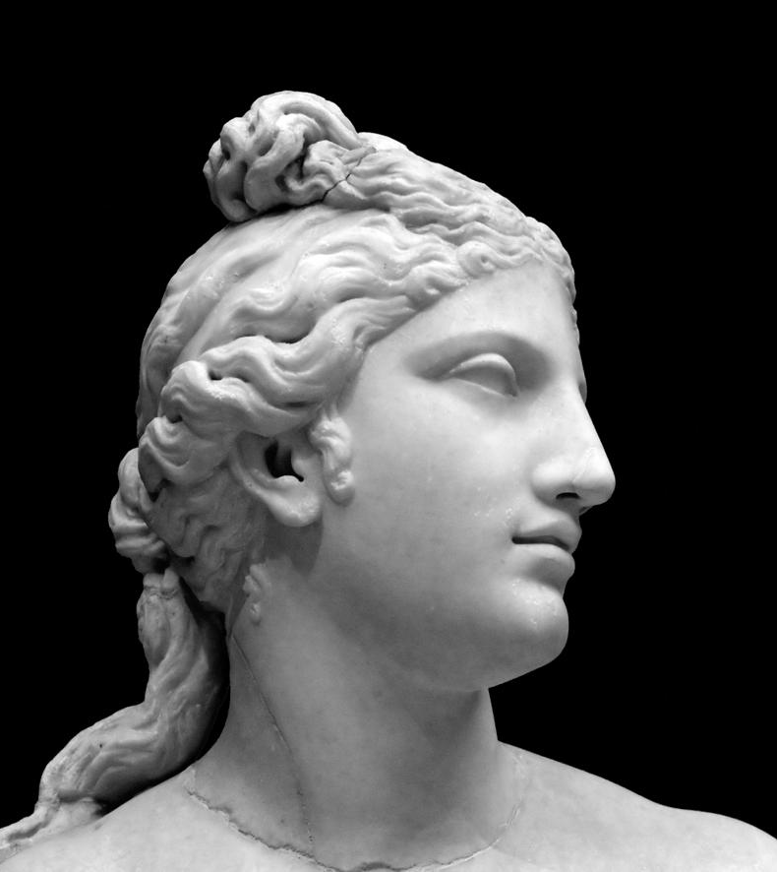
Aphrodite
Aphrodite is the mother of the Trojan prince Aeneas, who is the hero of the Aeneid. She fights for the Trojans during the war.
Aphrodite wins the Apple of Discord. She promises Paris the most beautiful woman in the world.

Slide 27
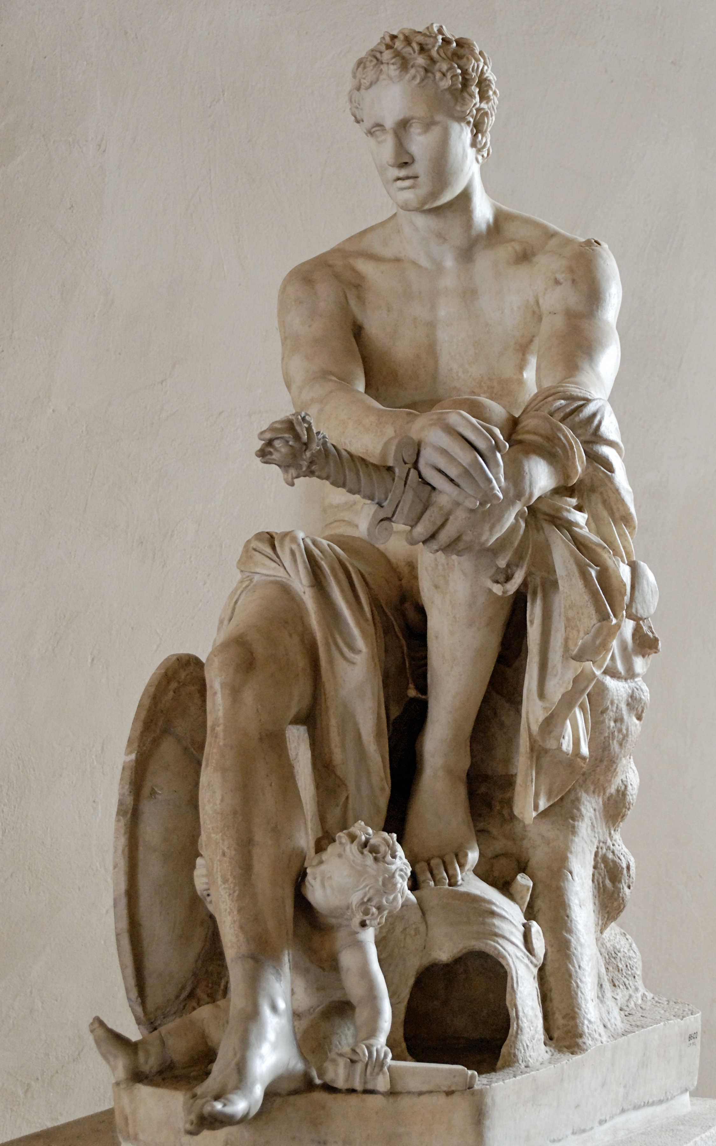
Ares
Ares is an unpredictable god who enjoys war for the sake of war. He fights for the Trojans because he is in love with Aphrodite and appreciates that Paris could cause such a widespread war.

Slide 28
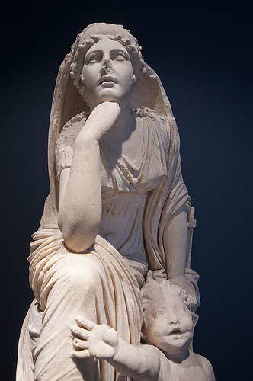
Thetis
Thetis was an immortal sea nymph. Zeus was in love with her, but he received a prophesy that any child he had with her would cause his death. To prevent this, he arranged for her marriage to Peleus.
This was the wedding that all of the immortals were invited to except Discord.

Slide 29
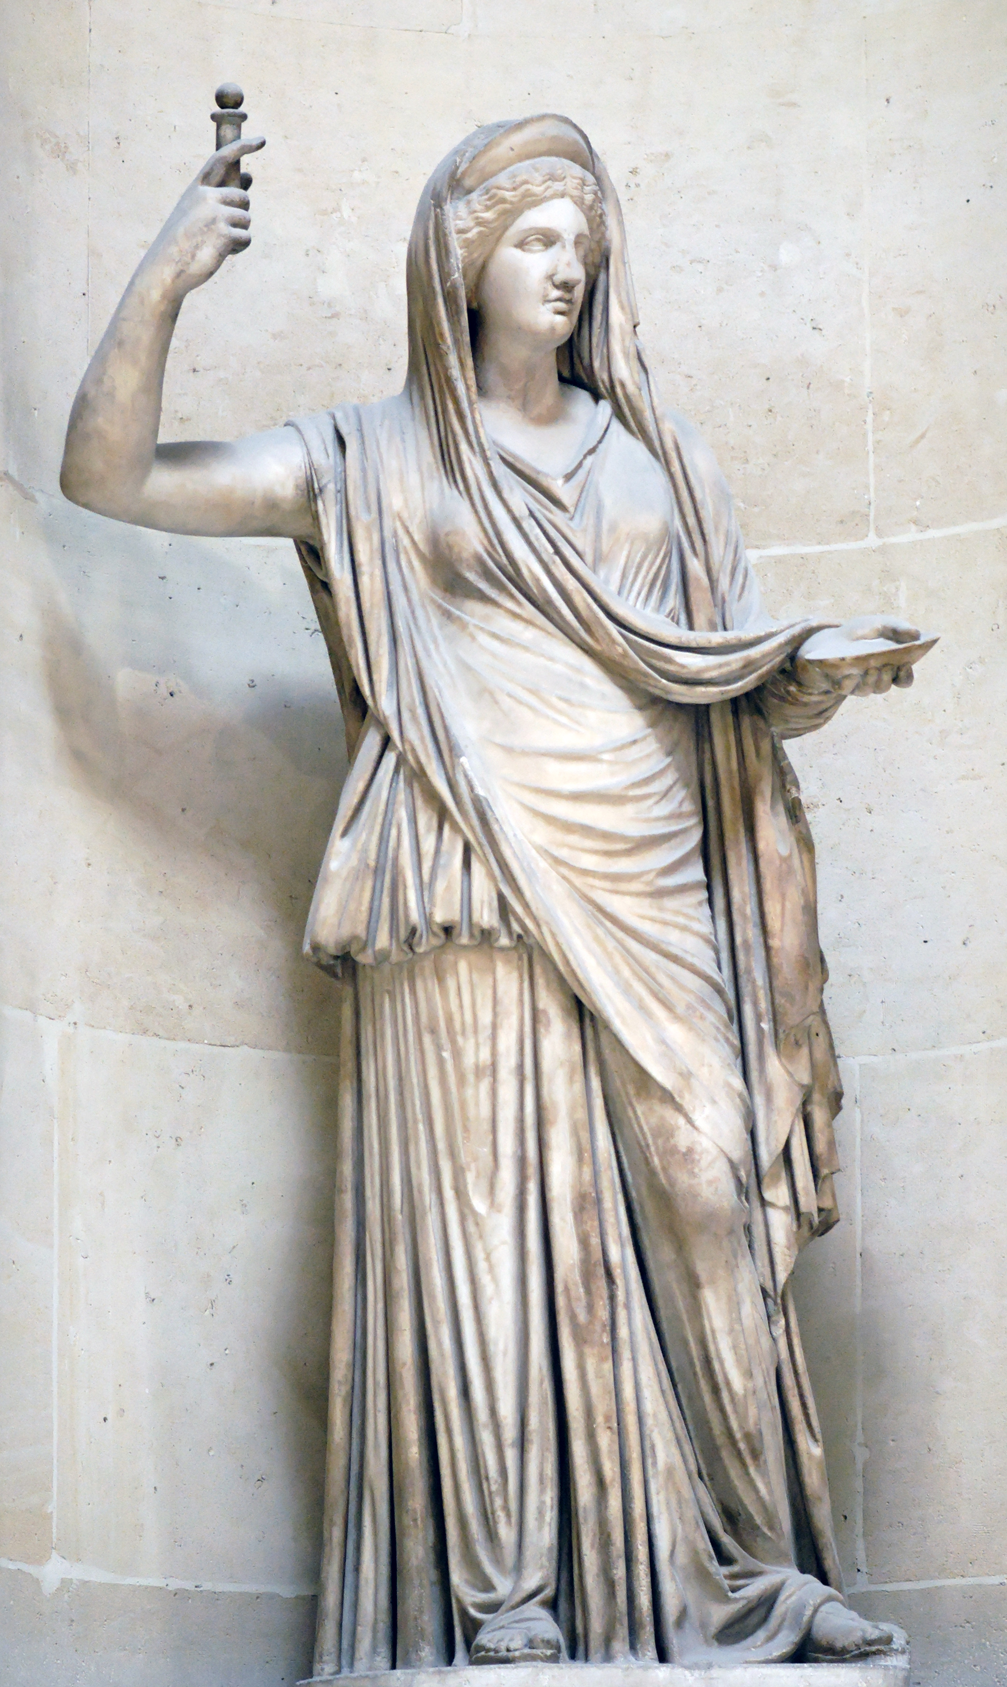
Hera
Even before the Judgment of Paris, Hera hated the Trojans. Her hatred originated when Zeus chose the Trojan boy Ganymede as his cupbearer over her son Hephaestos.
Helen fights for the Greeks during the Trojan War.

Slide 30
Poseidon
Poseidon takes human form and fights alongside the Greeks during the Trojan War.
He fights against the Trojans because when Troy was founded, the first king, Laomedon, promised to reward the god for building the city walls. After the walls were built, Laomedon refused to pay up.

Slide 31
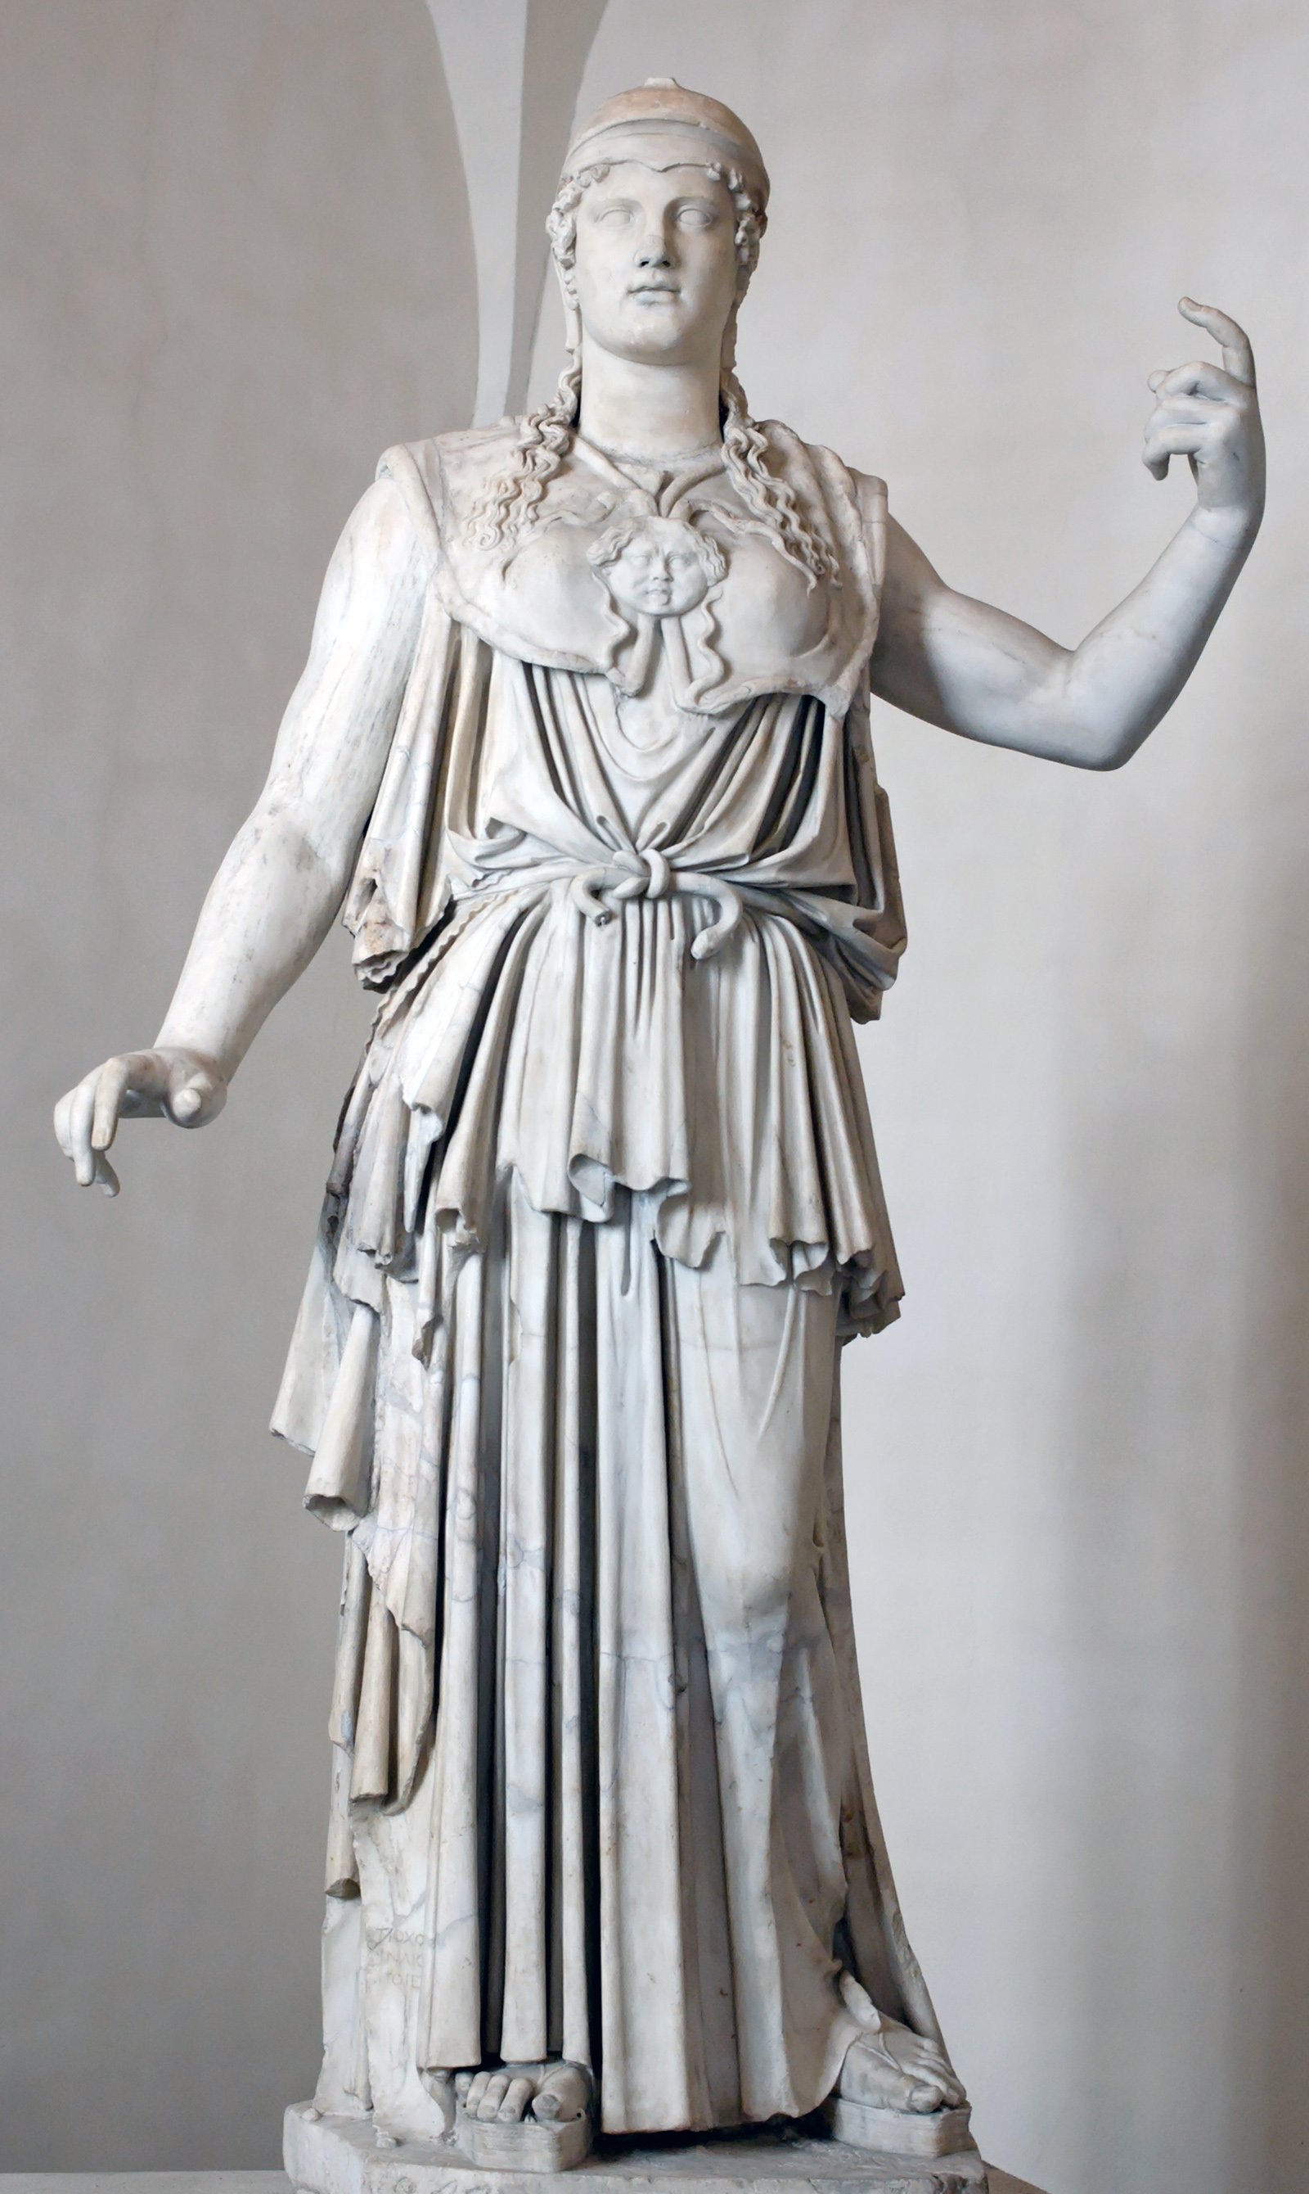
Athena
Athena fights on the side of the Greeks during the Trojan War for two reasons:
  She did not win the Golden Apple at the Judgment of Paris
  She is the patron goddess of Odysseus. As the goddess of wisdom, she appreciates his craftiness.

Slide 32
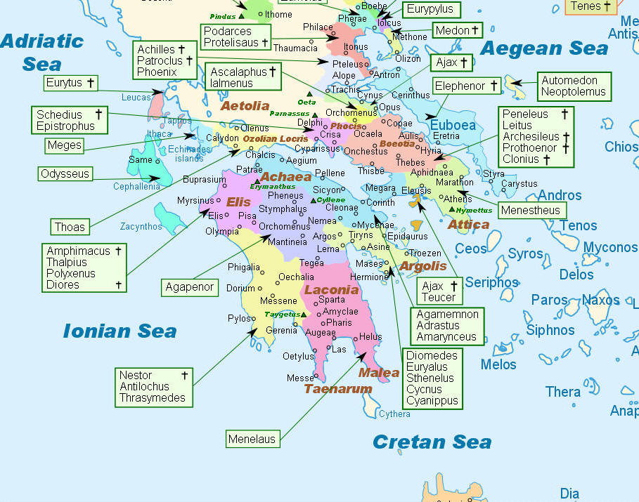
The Greeks

Slide 33
Menelaus
Menelaus is the King of Sparta and the lawful husband of Helen.
Menelaus was chosen for Helen by her mortal father, Tyndareus, after all of the suitors had sworn the Oath of Tyndareus, binding them to fight for the marriage of Menelaus and Helen.
Menelaus is the brother of Agamemnon.

Slide 34
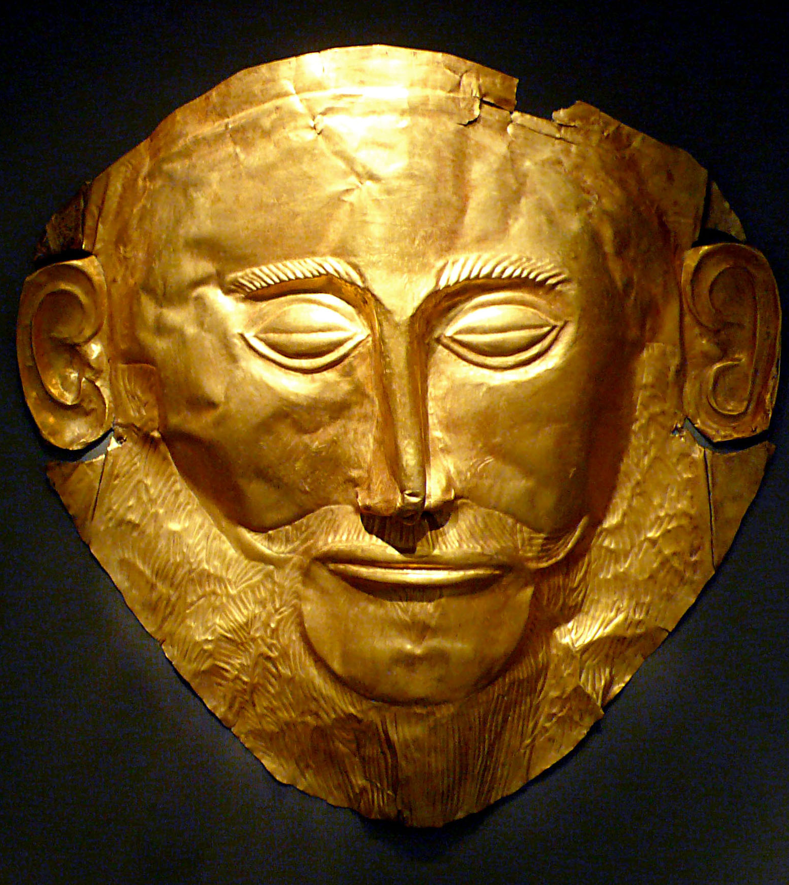
Agamemnon
Agamemnon is the brother of Menelaos and the leader of the Greeks during the Trojan War.
In order to gain favorable winds to sail to Troy, he sacrifices his daughter, Iphigenia, to Artemis.

Slide 35
Agamemnon
Agamemnon is both excessively proud of his leadership role and incompetent for the task.
The Iliad begins with Agamemnon angering Achilles, causing Achilles to withdraw from the fighting.
After the war, Agamemnon takes Priam’s daughter Cassandra home as his war bride. His wife, Clytemnestra, is not pleased.

Slide 36
Agamemnon’s Home Life
Agamemnon’s wife Clytemnestra was upset that her daughter had been sacrificed in an attempt to win the war.
For the ten years that Agamemnon was at war, she plotted her revenge against him.
The night that Agamemnon returned from the war with Cassandra, she killed them both in the bath, fulfilling Cassandra’s prophesy.

Slide 37
Clytemnestra and Orestes
While Agamemnon is away at war, Clytemnestra takes a lover, Aegisthus.
Her son, Orestes, knew that the honor code of ancient Greece demanded that he avenge the murder of his father. Orestes, however, did not want to kill his mother.
After seven years, the guilt of allowing his father to die un-avenged overcame Orestes, and he killed Clytemnestra and Aegisthus.

Slide 38
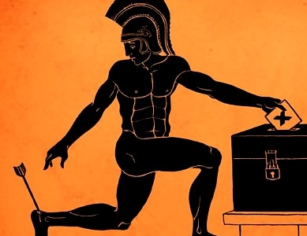
Achilles
Achilles is the only son of Peleus and Thetis. After he was born, Thetis held him by the heels and dipped him in the River Styx. This “baptism” provided protection for Achilles everywhere except for his heels, which Thetis was holding.

Slide 39

Achilles
The theme of the Iliad is the rage of Achilles. Homer focuses on this throughout the poem. As the rage of Achilles changes targets, different things happen.
Achilles is godlike in his prowess on the battlefield. Only Hector can come close to matching him in battle.

Slide 40
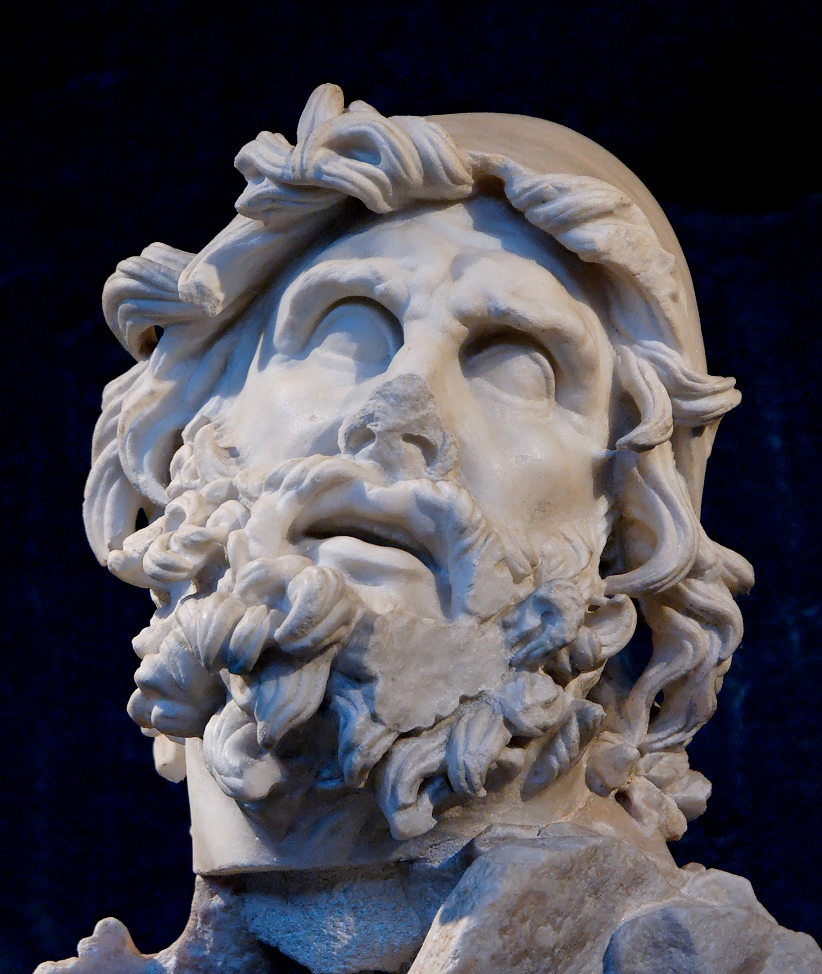
Odysseus
Odysseus is one of the most able fighters among the Greeks. He is also the best strategist. He devised the Oath of Tyndareus, and later, the Trojan Horse.
His ten year return home is chronicled in The Odyssey.

