Slide 1
America Goes To War
World War II
1941-45

Slide 2
Japan Becomes A World Power
Much like Germany, Japan began conquering territory in Asia since the early 1930s.
  Korea was occupied from 1910-1945
  Manchuria, a province of China, was conquered in 1931.
  The Second Sino-Japanese War began in 1937, and concluded with the end of World War II.
  Japan had conquered much Chinese territory before attacking Pearl Harbor.

Slide 3
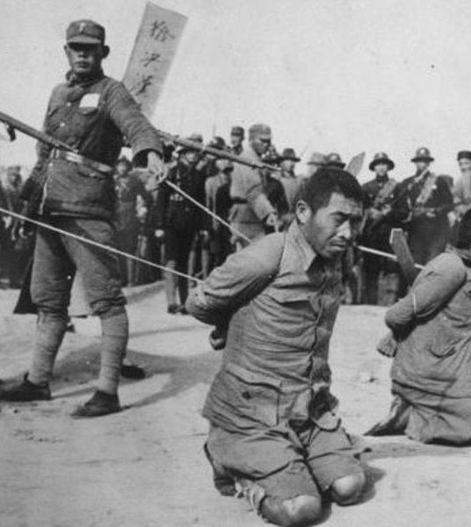
Sino-Japanese War
The Sino-Japanese War is an often overlooked part of WWII.
However, this was a particularly brutal theater:
  Chinese casualties: appx. 5 million dead, 15 mil. Wounded, and at least 3 million civilian deaths.
  Japanese casualties: 1 million dead, 1.7 million wounded
  40 percent of Japanese casualties were in the war with China

Slide 4
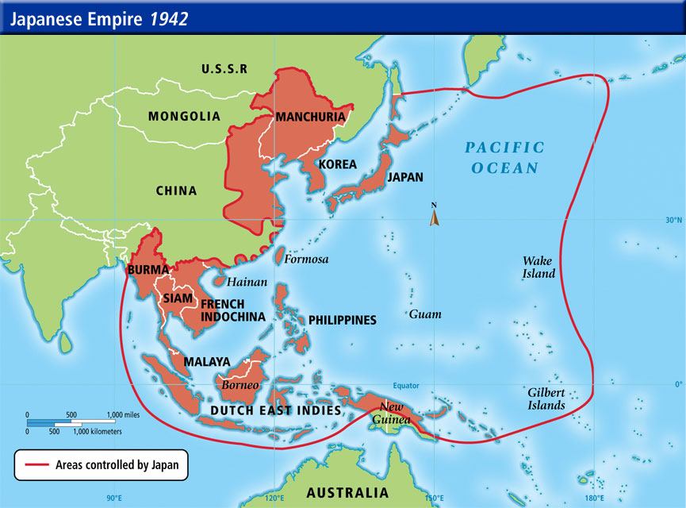
Japanese Empire in 1942

Slide 5
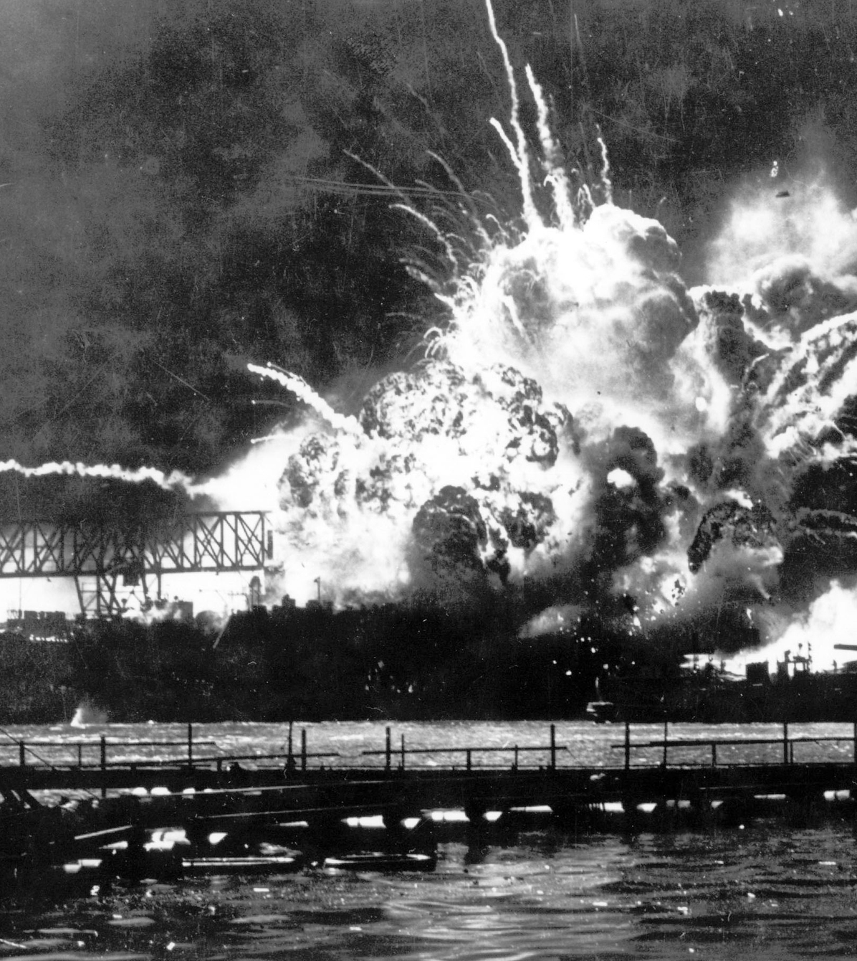
December 7, 1941: “A Day of Infamy!”
US Casualties – c. 2500 killed, 1800 wounded 350 aircraft destroyed or damaged, 19 ships damaged or destroyed
Japan: Attack was made by 353 aircraft in two waves. 64 killed, 1 captured.

Slide 6
Why did Japan attack Pearl Harbor?
Saw this as a preventative measure to keep US from asserting influence in Asia.
The ban imposed by President Roosevelt on the trade functions of Japan especially export of oil, steel and scrap iron. This ban gave a great set back to Japanese economy and their trade and military was adversely affected.
Japanese were on the way to emerge as the strongest naval power but America stood in their way. So Japanese wanted to clean their competitor and earn the title.

Slide 7
Why did Japan attack Pearl Harbor?
America had not overcome the loss and outcome of World War I and they did not want to involve in another war that can take many lives. The Japanese thought that their idea of surprise attack was too powerful that would destroy the American navy and all its hopes.
America also wanted Japan to withdraw from north Indo-China. Source: http://www.enkivillage.com/why-did-japan-attack-pearl-harbor.html

Slide 8
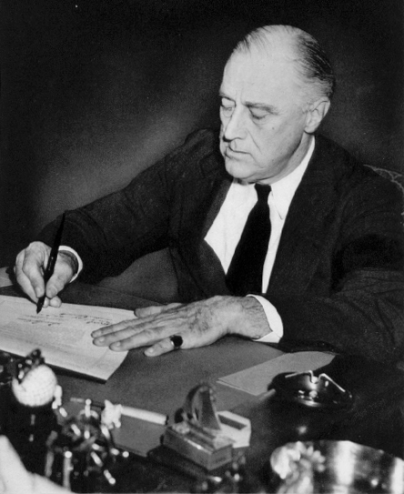
Congress Declares War!
America declares war on Japan on December 8.
Germany and Italy then declare war on America in cooperation with Japan

Slide 9
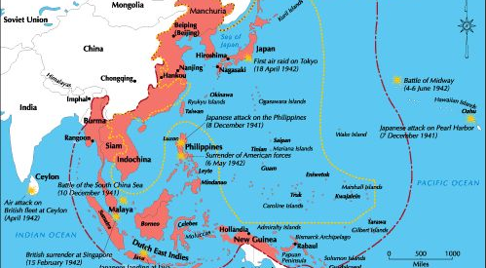
Pacific Theater

Slide 10
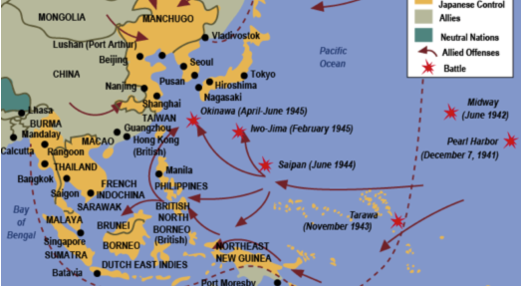
Pacific Theater

Slide 11
The Home Front
The US had to convert the means of production from making consumer goods to producing war material.
Early on, the Allies knew that the war would be won on the “home front,” that is, the side that could most effectively supply their personnel.

Slide 12
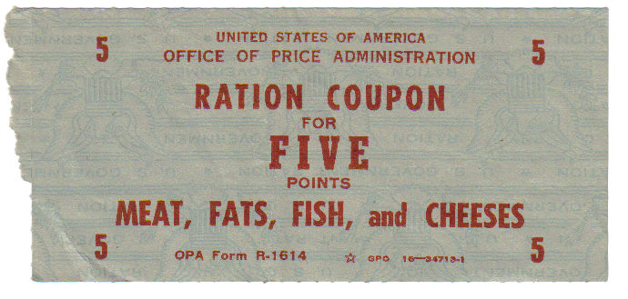
Rationing and Price Controls
Rationing and price controls were put into effect from 1942 until the end of the war.
Some items rationed were:
  Meat
  Rubber
  Metals
  Sugar
  Shoes
  Gasoline

Slide 13
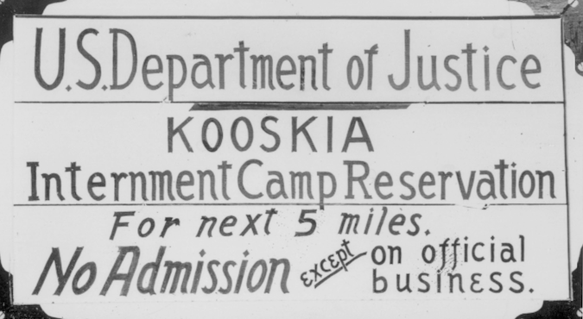
Federal Authority is Expanded
In any war, federal authority is expanded. The World War II period was one of the largest expansions of the authority of the Federal Government.
  Wage and Price Controls
  Assuming means of production
  Putting the Nisei into detention camps
  Rationing

Slide 14
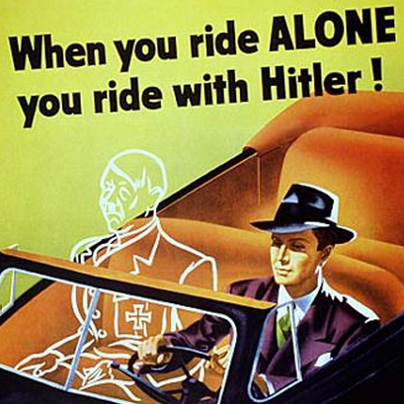
Wartime Propaganda
In addition, the government encouraged other ways to stretch resources:
  Victory Gardens
  Car Sharing Clubs
  Fuel Oil Conservation . . .

Slide 15
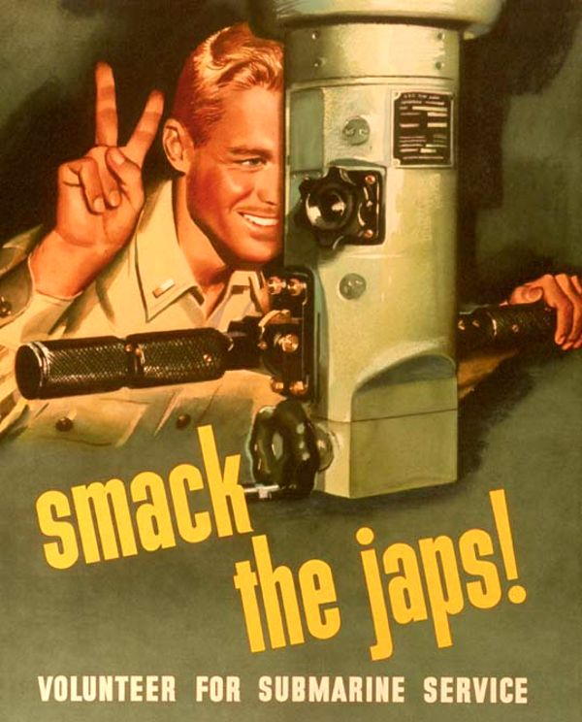
Military Recruitment
The number of US servicemen at the time of Pearl Harbor was about 2 million.
Volunteers and the draft caused the services to grow to 10 million in wartime.

Slide 16
Approaching D-Day
By 1942, the war was being fought on four fronts:
  Western Front (France, Holland, Belgium)
  Eastern Front (USSR)
  African/ Italian Front
  Pacific Theater
It did not seem that any breakthrough was likely on these fronts.

Slide 17
Approaching D-Day
Stalin had been pushing the Allies for a cross-Channel invasion of Europe since 1942.
The Allies determined that they did not have the resources for such an invasion in 1942 and probably would not have in 1943.
A large scale, amphibious invasion had never succeeded in the history of warfare.

Slide 18
What was D-Day?
On June 6, 1944, more than 160,000 Allied troops landed along a 50-mile stretch of heavily-fortified French coastline, to fight Nazi Germany on the beaches of Normandy, France. Gen. Dwight D. Eisenhower called the operation a crusade in which, “we will accept nothing less than full victory.”

Slide 19
What was D-Day?
More than 5,000 Ships and 13,000 aircraft supported the D-Day invasion, and by day’s end, the Allies gained a foot-hold in Continental Europe.
About 130,000 men went ashore on D-Day
The cost in lives on D-Day was high. More than 9,000 Allied Soldiers were killed or wounded, but their sacrifice allowed more than 100,000 Soldiers to begin the slow, hard journey on foot across Europe, to defeat Hitler and his allies.

Slide 20
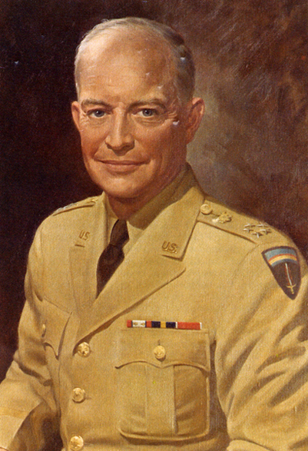
General Dwight D. Eisenhower
General Dwight D. Eisenhower, known as “Ike” to his men, was the architect of D-Day. He was the Supreme Commander of the Allied Forces in Europe.
From 1953-1961, he would be one of the most popular Presidents ever.

Slide 21
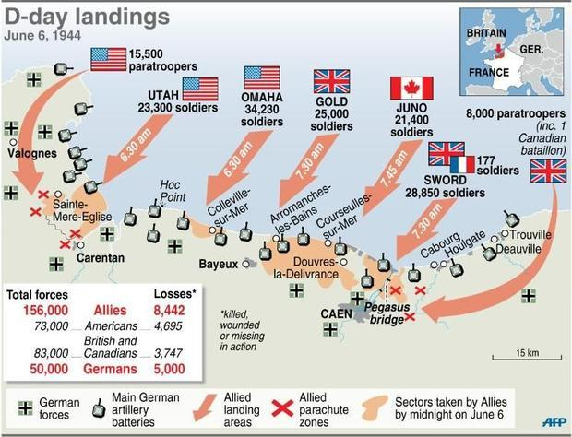
D-Day Landings

Slide 22
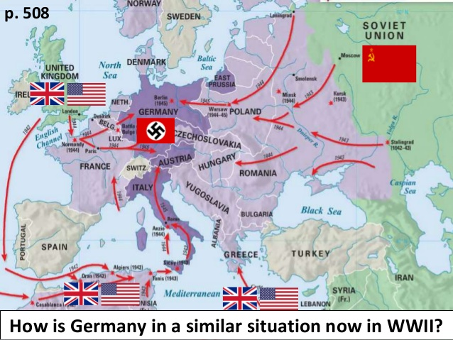
March to Victory

Slide 23
Government Transitions
Both the US and Great Britain experience government transitions as the Allies approach Berlin.
President Roosevelt dies on April 12, 1945 of a cerebral hemorage. Harry S. Truman, his Vice-President, is sworn in as President of the United States.
On July 5, 1945, Winston Churchill’s Conservative Party loses its majority in the House of Commons. Clement Atlee, leader of the Labour Party, becomes the new Prime Minister of Great Britain.

Slide 24
Hitler takes his life
By the end of April,1945 Russian troops arrived at Berlin from the east and the American-led forces arrived from the west
On April 30, 1945, with fighting less than 400 yards from his bunker, Hitler and his girlfriend, Eva Braun, take their own lives.
Germany formally surrenders on May 8, 1945, which is known as V-E Day

Slide 25
Victory over Japan
Allies winning victory after victory in the Pacific.
Japan cannot replace planes and pilots, but they are causing a high casualties toll with kamikaze pilots.
Intelligence reports that an invasion of Japan would cost America 1 million men and would not bring victory for five years.

Slide 26
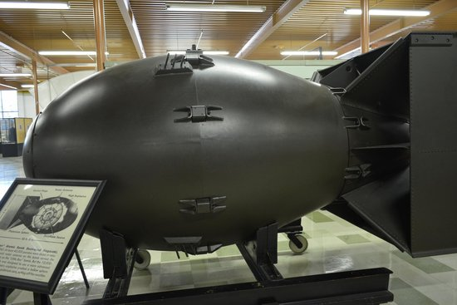
Atomic Bombs
President Truman learns of the existence of the atomic bomb, and makes the decision to use atomic weapons against Japan.
Atomic bombs were dropped on Hiroshima and Nagasaki.
Japan surrenders unconditionally on August 15, 1945.

Slide 27
Next Up
The Holocaust
Communism
The “Domino Theory”
The “Baby Boom”
Korea and Vietnam

