Slide 1
World War I
Curiosities, End of War and Roaring Twenties

Slide 2
Amount of Material
We could study World War I until the end of the school year and not even come close to telling the entire story.
However, there are a few things we are going to look at today before we move on:
  Christmas Truce
  Armistice (on 11/11 at 11 AM)
  Treaty of Versailles and the League of Nations

Slide 3
Christmas Truce
By November 1914, it became apparent that the war was not going to be over quickly and that the soldiers would not be home for Christmas.
At this time in the war, as soldiers settled into the trenches there were brief periods of unofficial “cease fires,” usually so that each army could gather their dead.

Slide 4
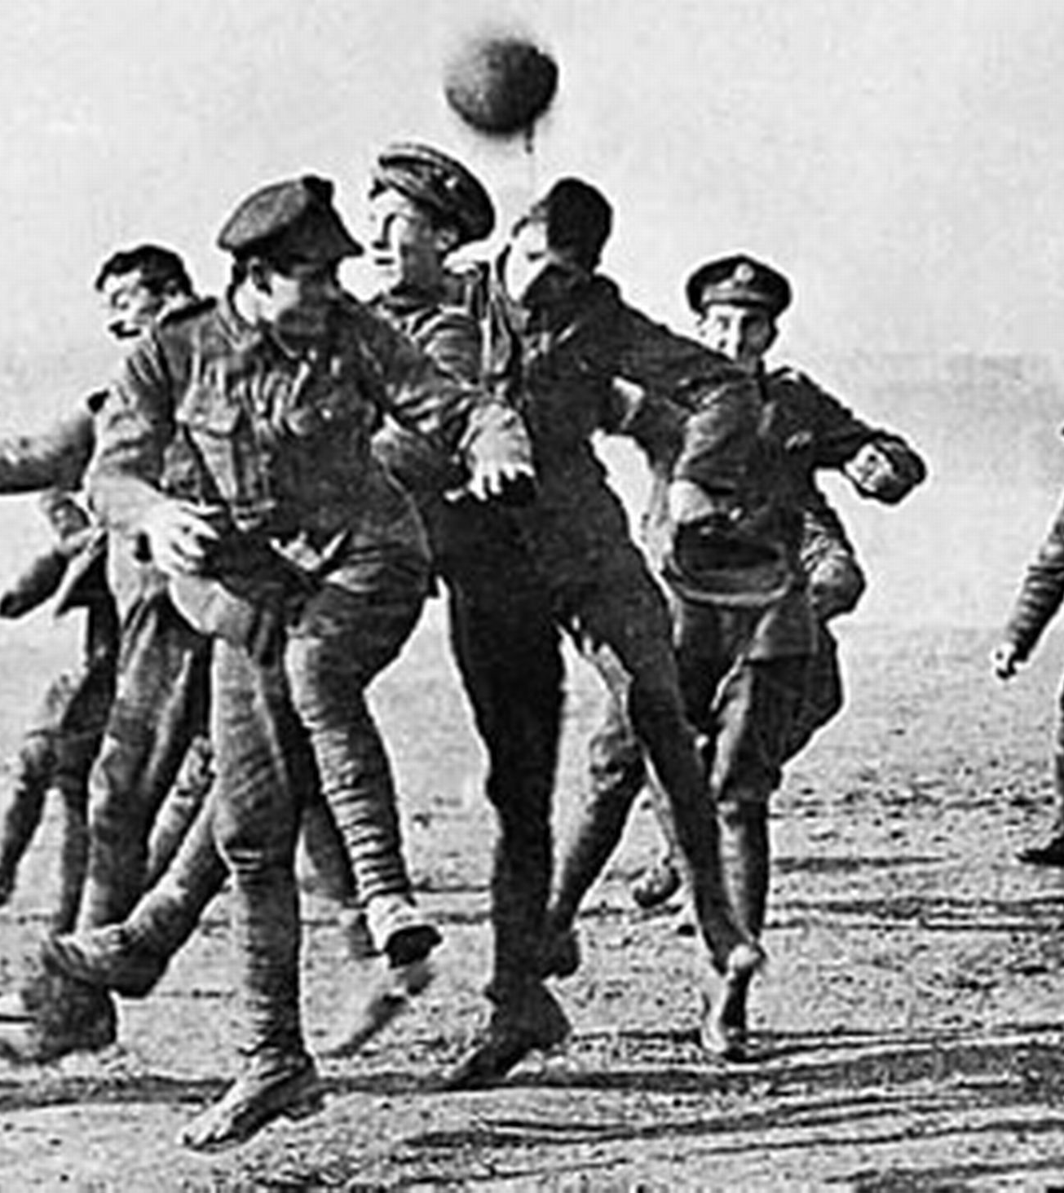
Christmas Truce
The truce was strictly unofficial and was not universal on the line.
However, in certain places on the lines, soldiers on opposing sides joined together in singing “Silent Night,” exchanging gifts from home, and soccer games.

Slide 5
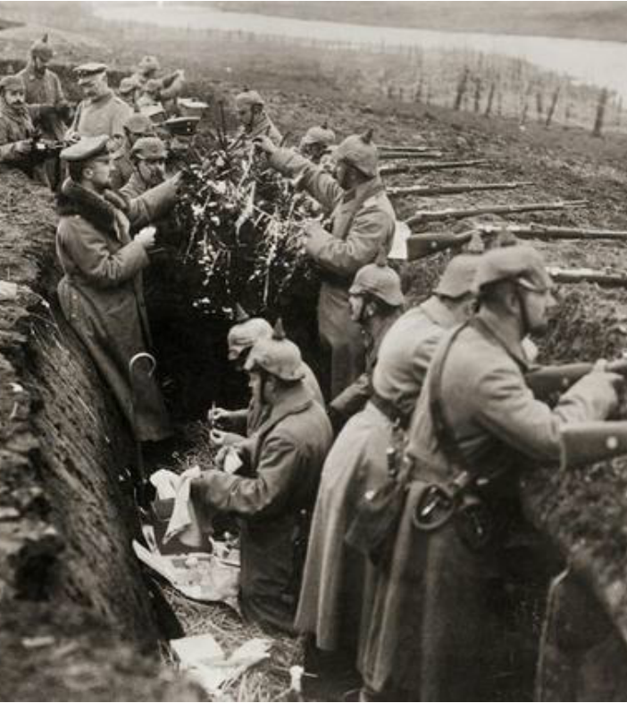
Reaction from High Command
The Christmas Truce(s) provoked a decisive reaction from the High Command.
They feared that the men would question the war, perhaps even mutiny, and that fraternizing with the enemy would lead to defeat.

Slide 6
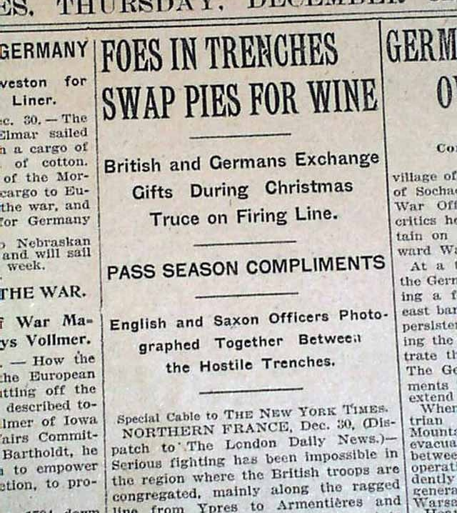
Reaction from High Command
The London Rifle Brigade's War Diary for 2 January 1915 recorded that “informal truces with the enemy were to cease and any officer or [non-commissioned officer] found to having initiated one would be tried by Court Martial.”

Slide 7
Armistice: November 11, 1918
An “Armistice” is an agreement to end fighting as a first step of negotiating for peace.
By the end of 1918, the will of the Triple Alliance to continue the war had been broken. Austria-Hungary and the Ottoman Empire could not contribute to the war effort. Germany was fighting alone, and could not replace the casualties that they lost each month.

Slide 8
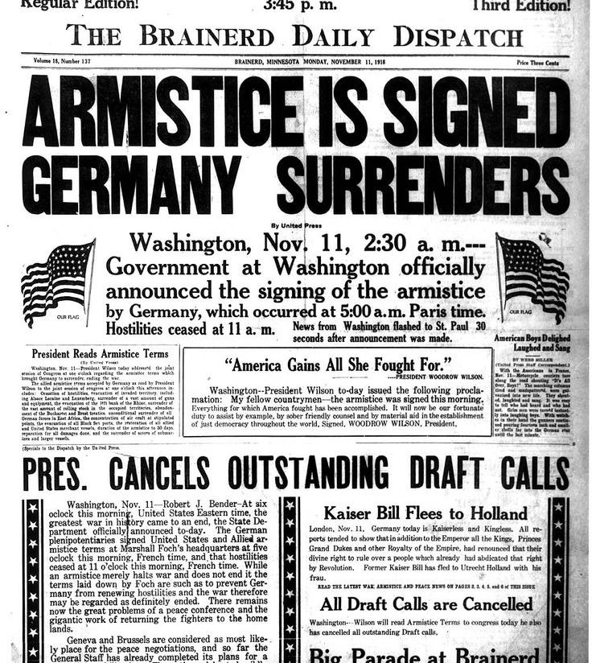
Armistice
The Armistice agreement is signed by representatives of France, Great Britain, and Germany at 5AM on November 11, 1918. It was to take effect at 11 AM on the same day (French time).

Slide 9
A Strange Event
In order to give time to get word to the front of the Armistice, the leaders who signed it negotiated it to start at 11 AM. This means that the troops fired on each other until 11 M ( and for some units after), and then they just stopped.
This is yet another feature of the absurdity of this war.
There were over 10,000 casualties on Armistice Day. The last official death was of Private Henry Gunter of the US.

Slide 10
Terms of Armistice
Germany was ordered to give up 2,500 heavy guns, 2,500 field guns, 25,000 machine guns, 1,700 airplanes and all submarines they possessed (they were originally asked to give up more submarines than they actually had!). They were also asked to give up several warships and disarm all of the ones that they were allowed to keep.
This and the Treaty of Versailles were punitive measures that Germany really had no choice to accept.

Slide 11
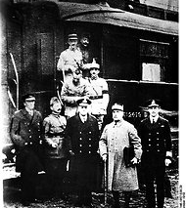
Irony of History
The armistice was signed in Gen. Ferdinand Foch’s personal train car at Compeigne.
On June 22, 1940, Hitler forced France to surrender in the same train car as Germany had in WWI

Slide 12
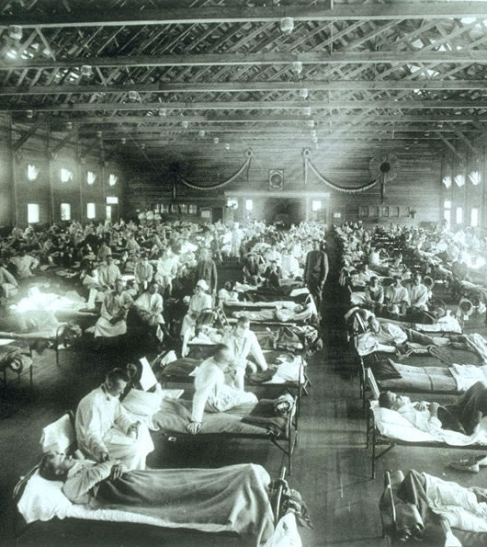
Great Influenza Pandemic
From 1918-1920, the world’s deadliest pandemic raged.
Over 500 million people were made ill by the H1N1 virus.
This resulted in the deaths of over 50 million people, easily surpassing the casualties in WWI

Slide 13
Treaty of Versailles
The Treaty of Versailles was signed on June 28, 1919, exactly five years after the assassination of Archduke Franz Ferdinand.
On of the most controversial points was assigning blame for the war to Germany.
Because of this, Germany and her allies were assigned to pay for “all loss and damage” during the war, surrender territory, and disarm
The assessment was 132 billion marks (in today’s money, $432 billion).

Slide 14
Treaty of Versailles
The Treaty also created an organization called the League of Nation. Its purpose was to provide for “collective security.”
President Woodrow Wilson went on a speaking tour throughout the US promoting American involvement in the League of Nations. The President suffered a series of strokes and never fully recovered.
The Senate never ratified the Treaty of Versailles, seeking to return to “normalcy,” as the next President, Warren G. Harding, expressed

Slide 15
The Twenties
Americans did not believe that our nation should be involved in European wars. Warren G. Harding won the 1920 Presidential Election with the slogan, “back to normalcy.” Republicans won the Presidency in 1920, 1924, and 1928 supporting isolationist (not getting involved in the affairs of other countries) and pro-business policies.

Slide 16
The Twenties
America emerges from World War I relatively intact compared to the other nations in the war.
The production capacity that was built in the war was turned to consumer goods.
The Twenties was the largest peacetime expansion of the economy ever. President Calvin Coolidge (1923-29) lowered taxes and created the largest budget surplus in American history.

Slide 17
Roaring Twenties Video
<iframe width="420" height="315" src="https://www.youtube.com/embed/QjxpYsTjNPk?rel=0" frameborder="0" allowfullscreen></iframe>

